Slide 1
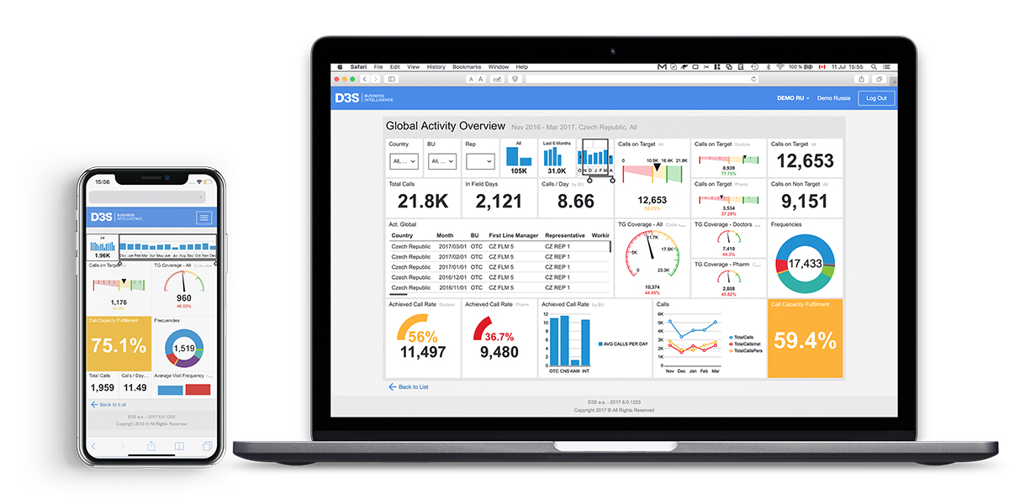


Dashboards
Visual representations of important KPIs, optimized for online viewing

Slide 2
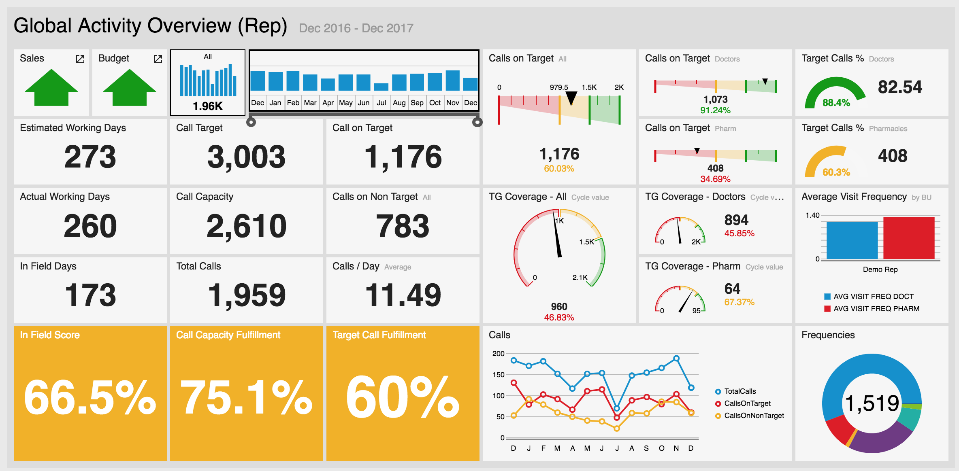
Activity Overviews
This is an example of an activity-based dashboard that measures activities against Target Group assignment (which is used to measure target vs non-target interactions), call rate assignment (which is used to determine call capacity), and definitions for working and in-field days (defined by activities which are classified as working vs. non-working, as well as in-field vs. out-field).

Slide 3
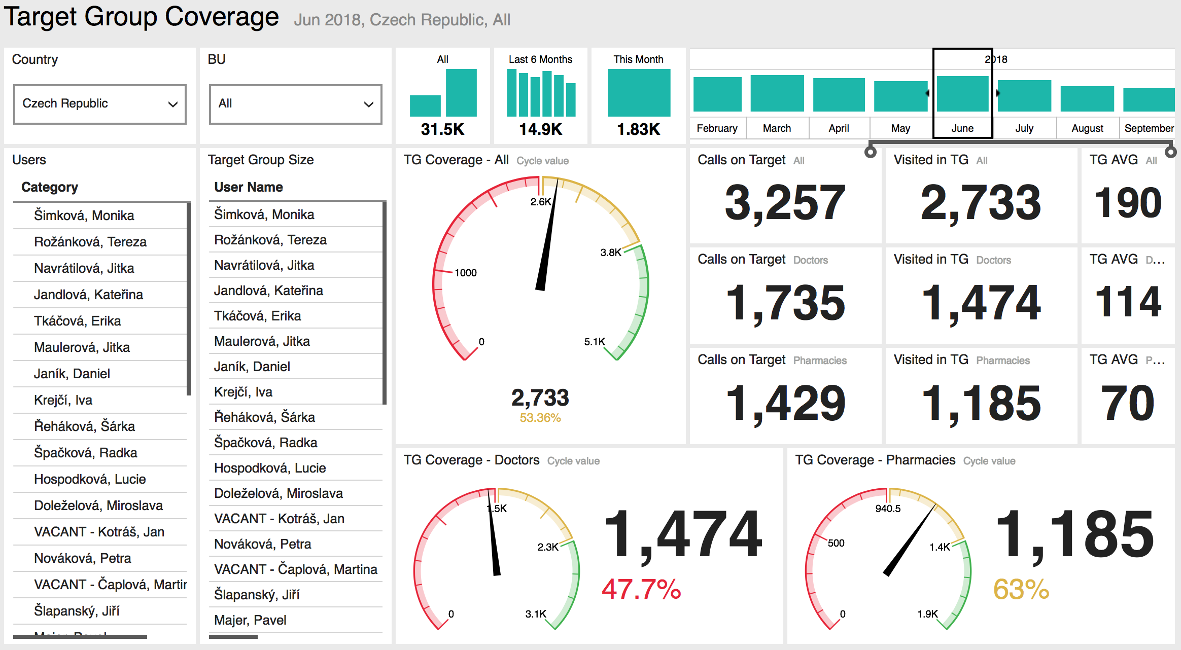
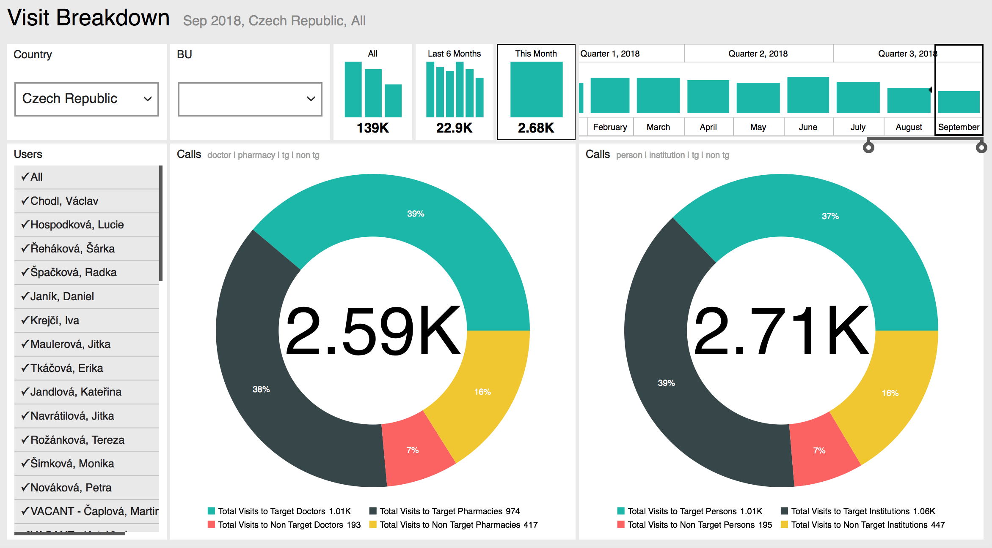
Activity Analysis
These are examples of activity dashboards that are focused on on-target interaction. Typically accessed by drilling through a parent dashboard (like the “Activity Global” dashboard on the previous slide) they both show more detail and allow the manager to select specific reps to see their results – or continue to view results aggregated by BU and across the entire sales organization.
This dashboard provides feedback on target group coverage with breakdowns for doctors and pharmacies. Additional activity KPIs are presented for comparison, e.g. no. target customers visited vs. no. target calls made.
This dashboard displays a breakdown of all calls by type. The chart on the left shows visits by specific subcategories (“doctor” “pharmacy”) while the chart on the right shows a more generic breakdown (by “person” “institution”).

Slide 4
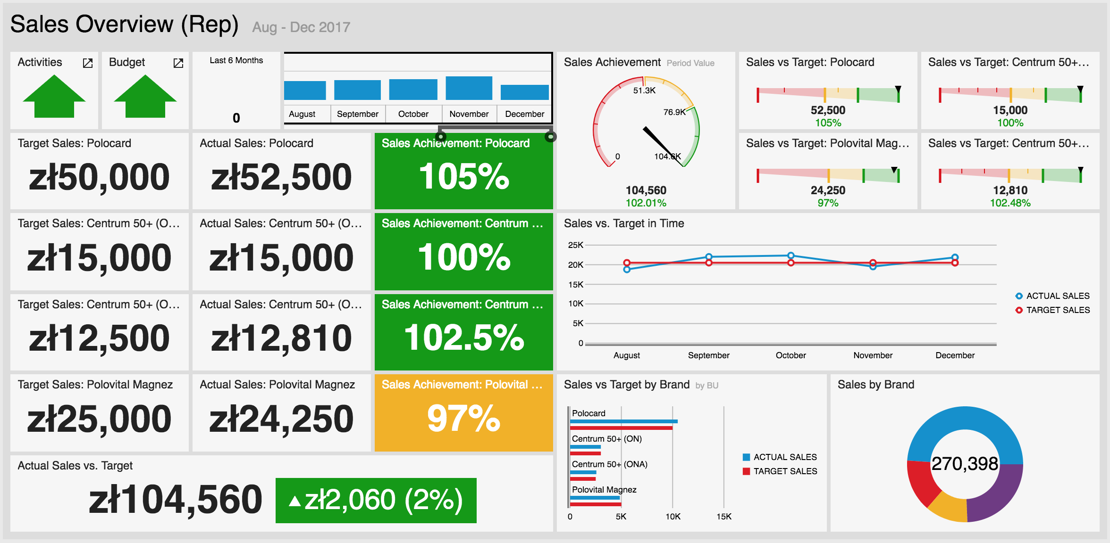
Sales Overviews
This is an example of a sales dashboard that displays sales for promoted brands / product groups against sales targets. In this example, the same data (sales vs. target comparison) are presented a few different ways for illustration – either as direct values (on the left) or via gauges (on the top right). Other charts visualize sales over time, and relative sales contribution by brand.

Slide 5
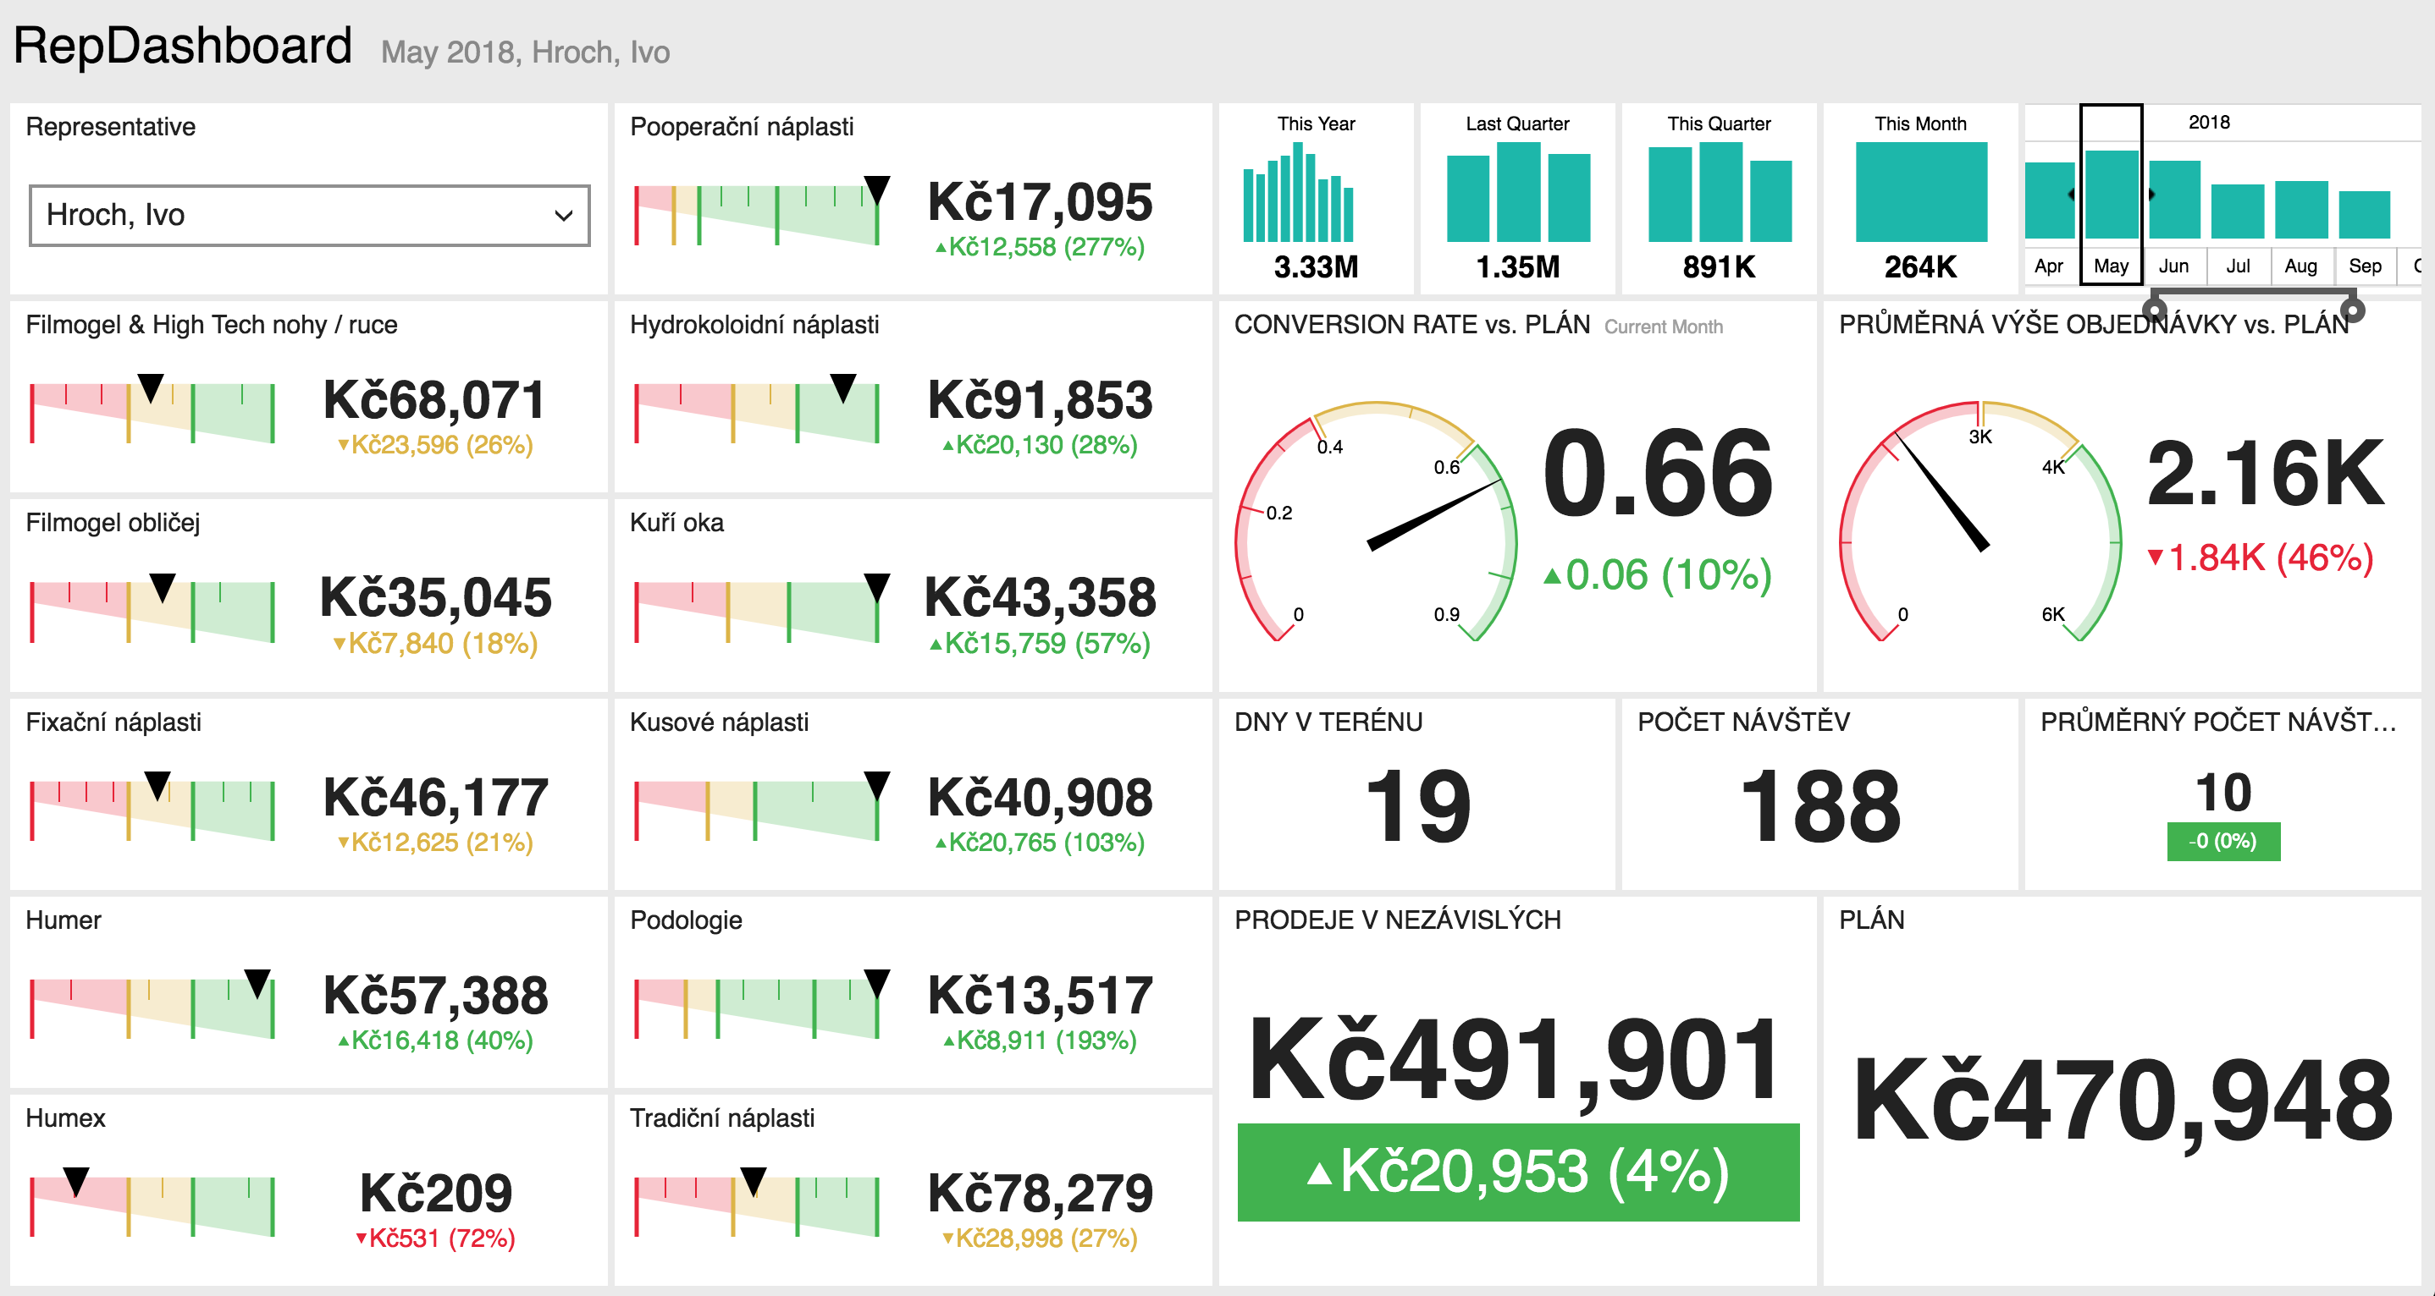
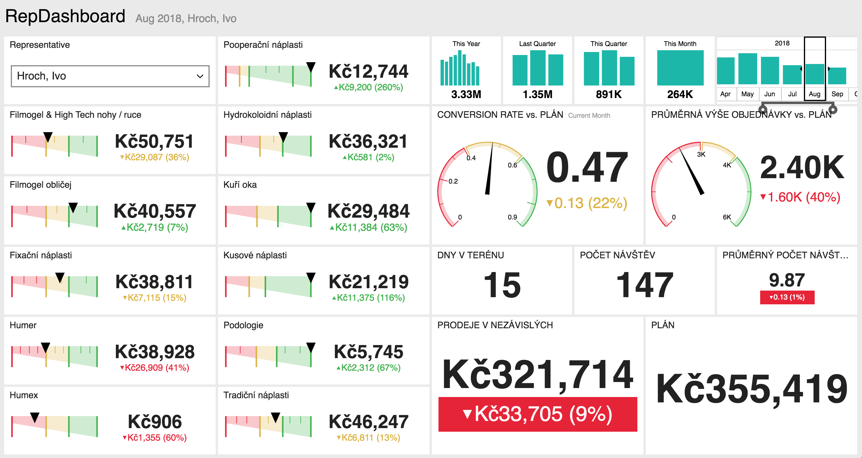
Sales Analysis
This is another example of a sales dashboard that displays sales for promoted brands / product groups against sales targets. In this example, the data (sales vs. target comparison) are presented both as direct values and via gauges where a range has been set to indicate good vs. moderate vs. poor performance.
Additional KPIs are also presented, including conversation rate vs. plan at pharmacies (= no. visits that generated orders); average order value vs. plan (this works when you set a minimum value for a successful order); as well as activity metrics such as days in field, no. visits, and calls per day, which are used to reference the results (as possible reasons for poor or exceptional sales performance).

Slide 6
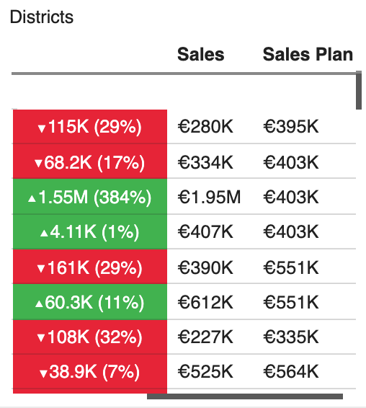
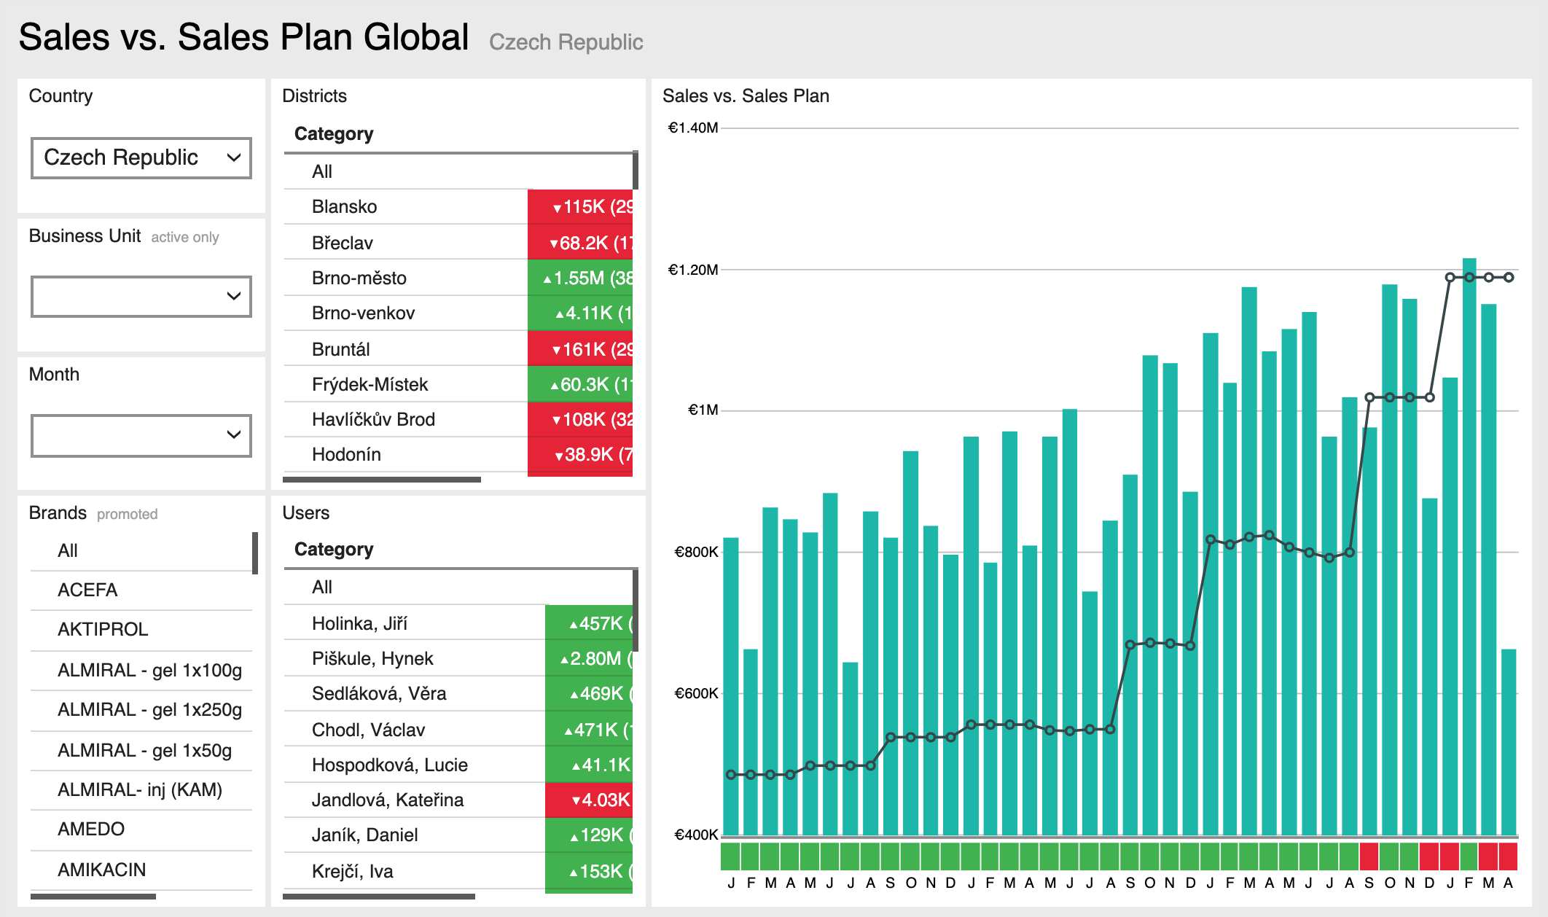
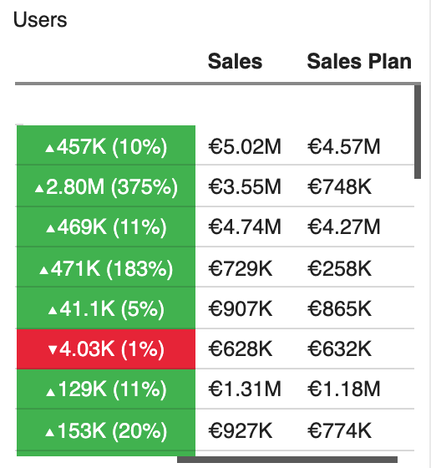
Sales Analysis
This is an example of a sales dashboard that displays sales vs. targets by month with breakdowns by representative (user) and district. Sales can be filtered by location, business unit, period and brand.

Slide 7
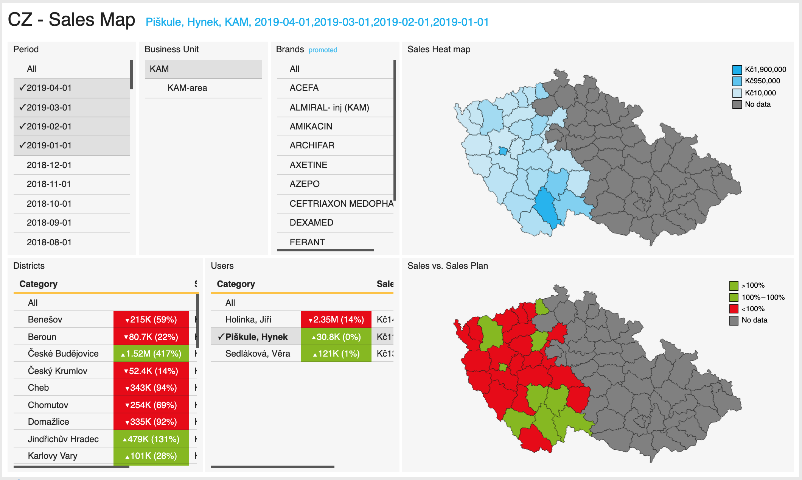
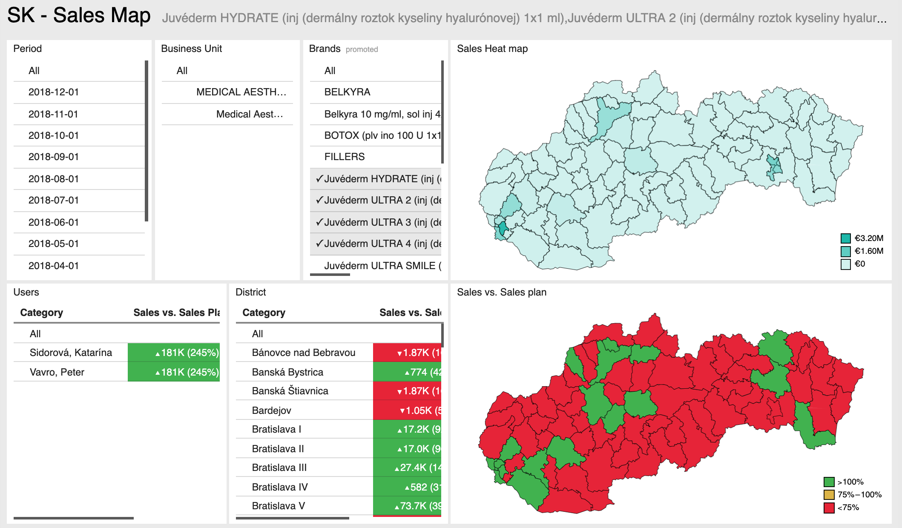
Sales Analysis
This is an example of a sales dashboard that displays sales vs. targets by month with breakdowns by district. Sales can be filtered by location, business unit, period and brand.

Slide 8
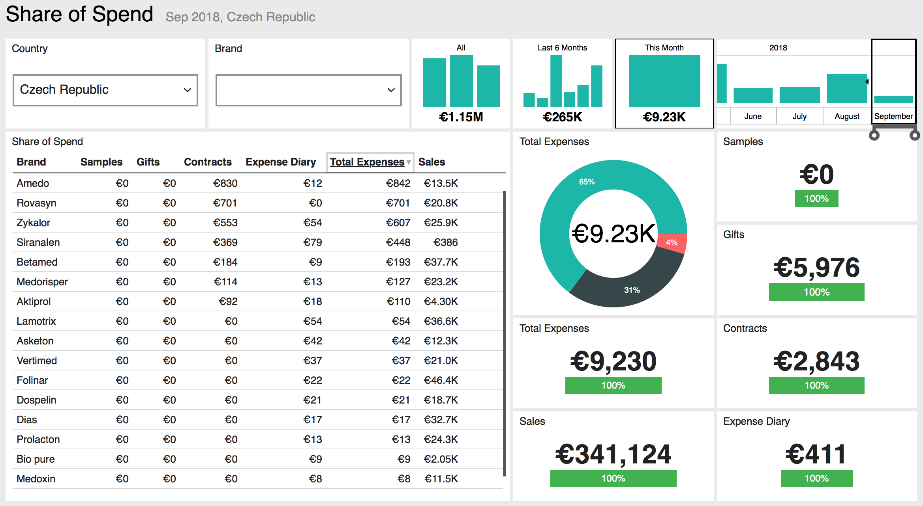
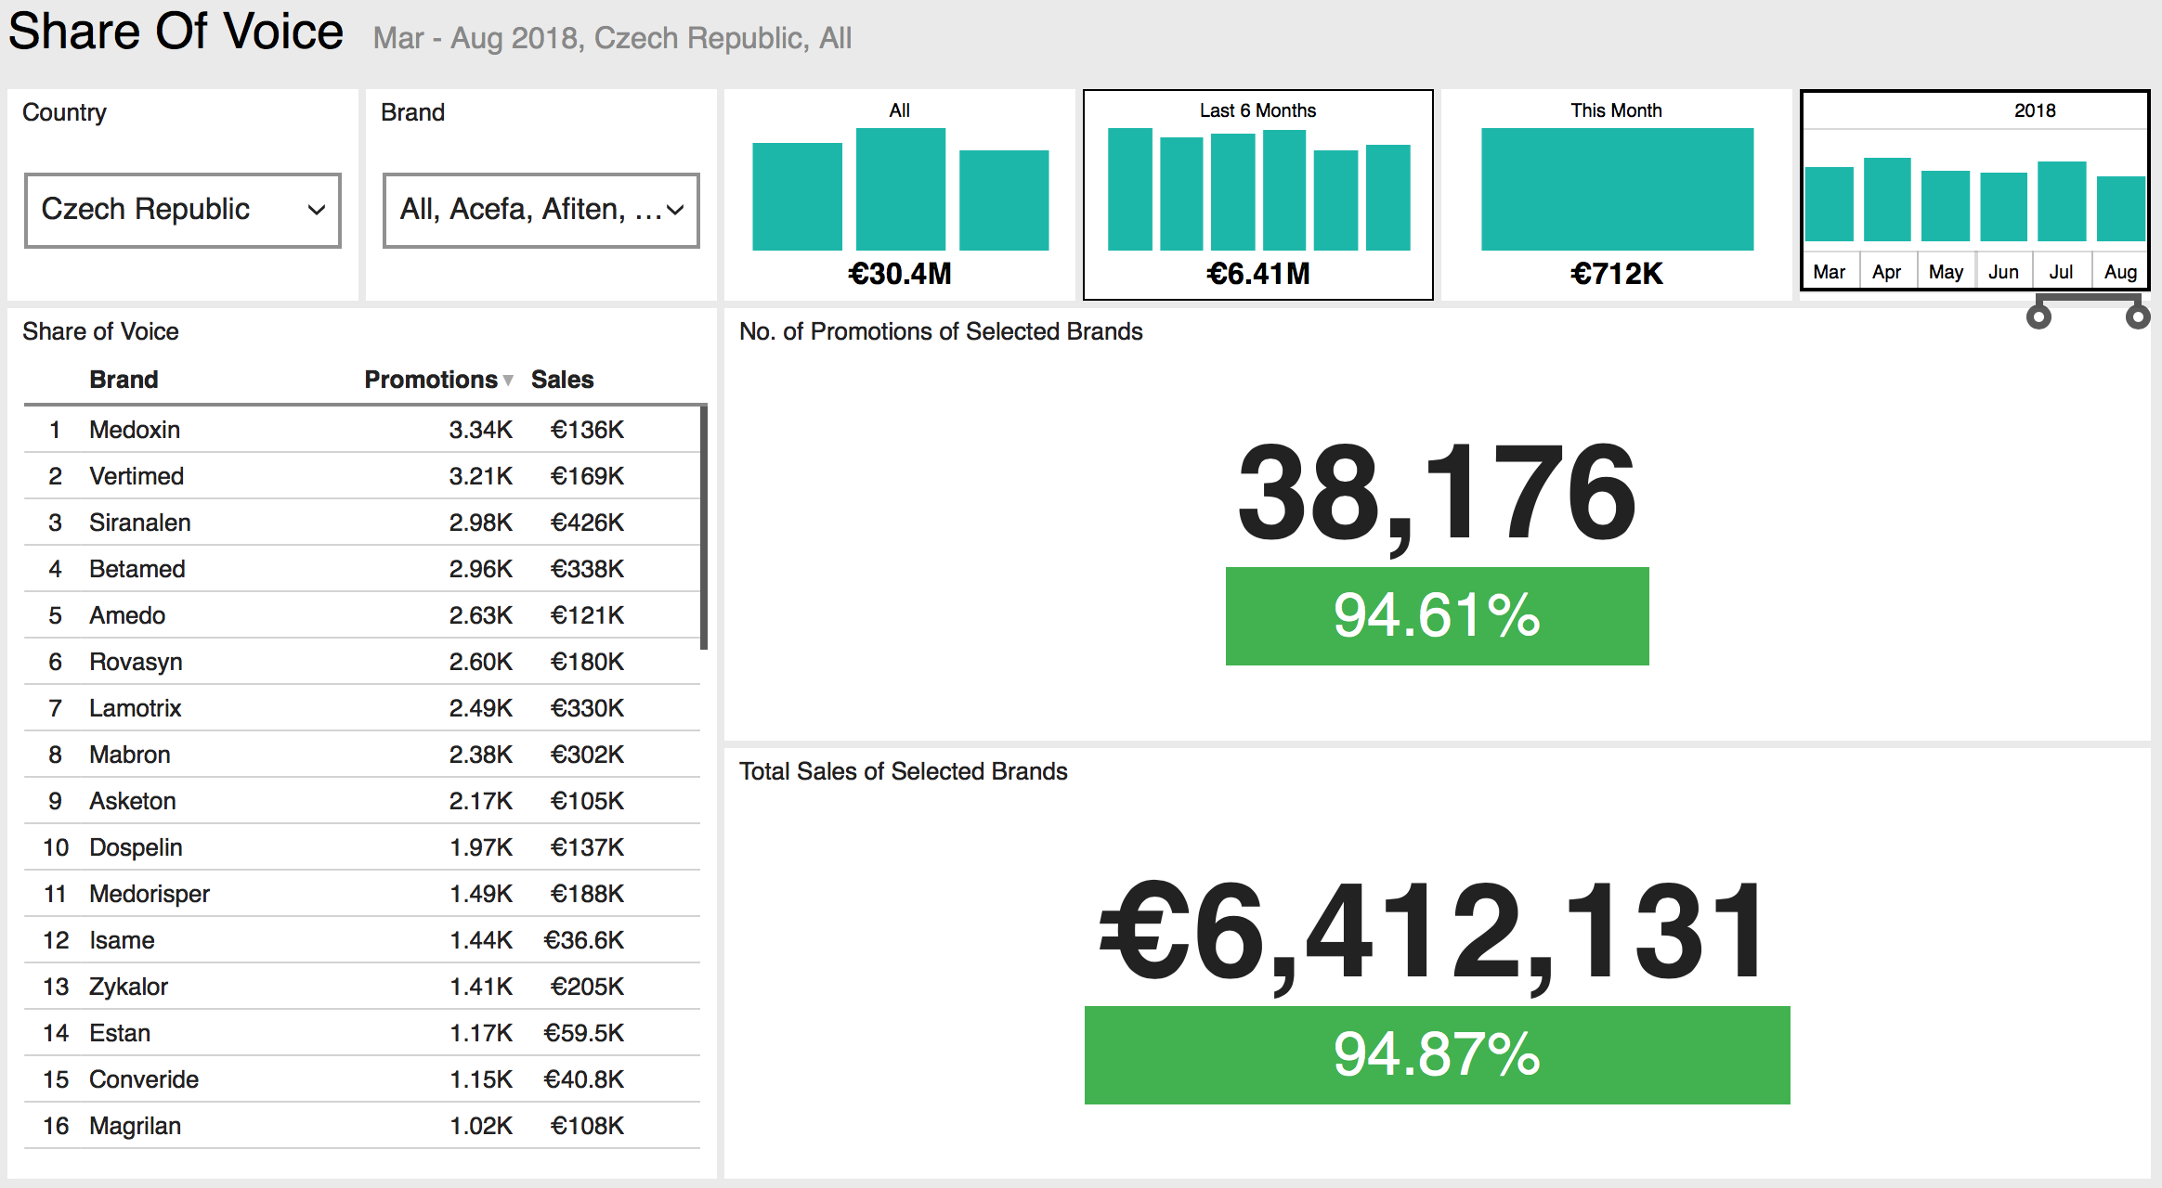
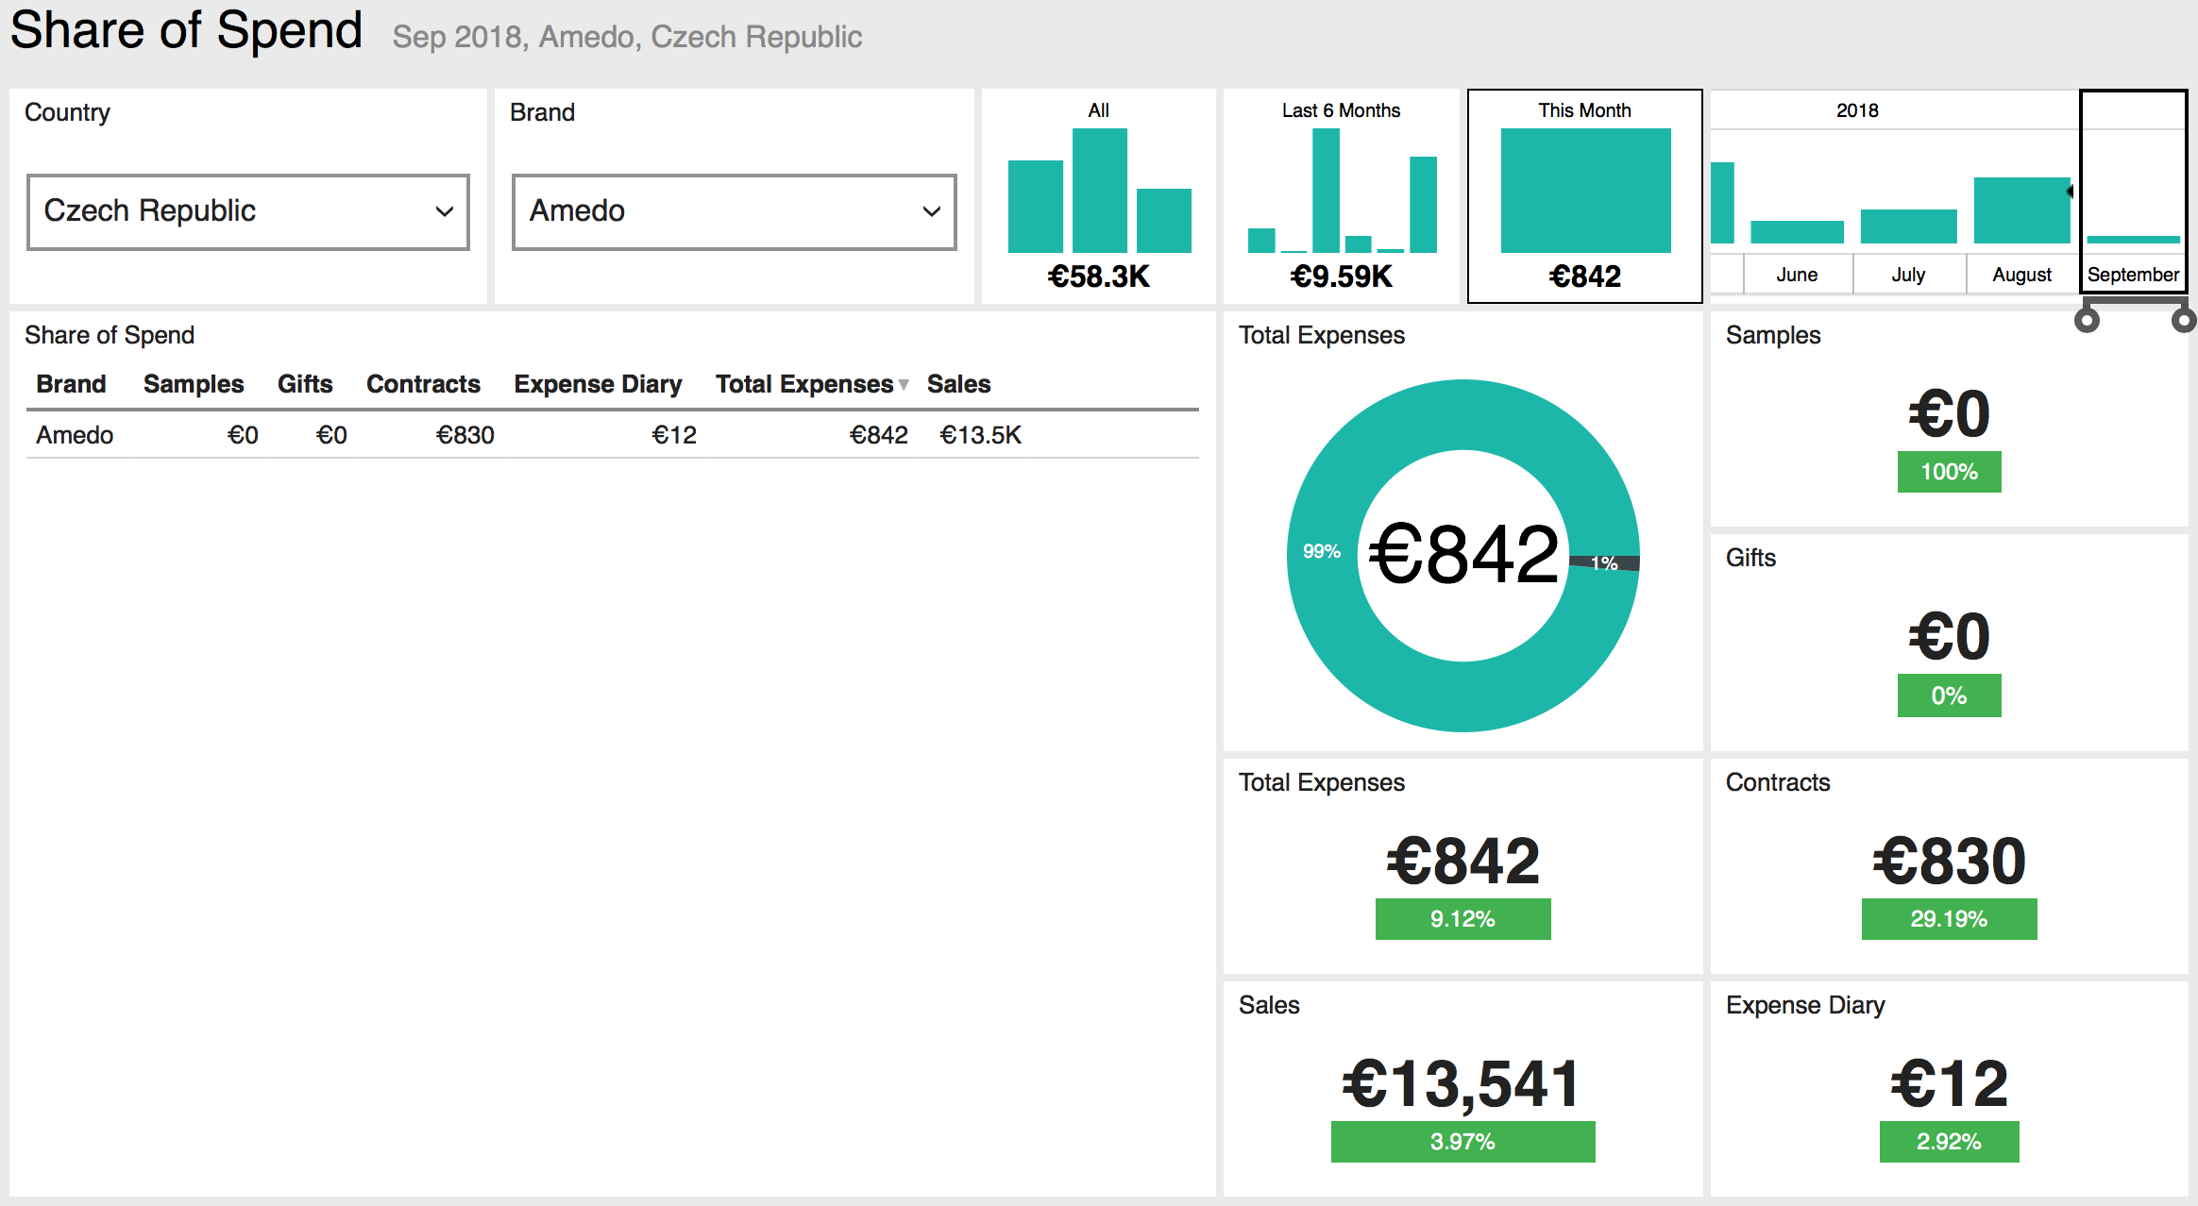
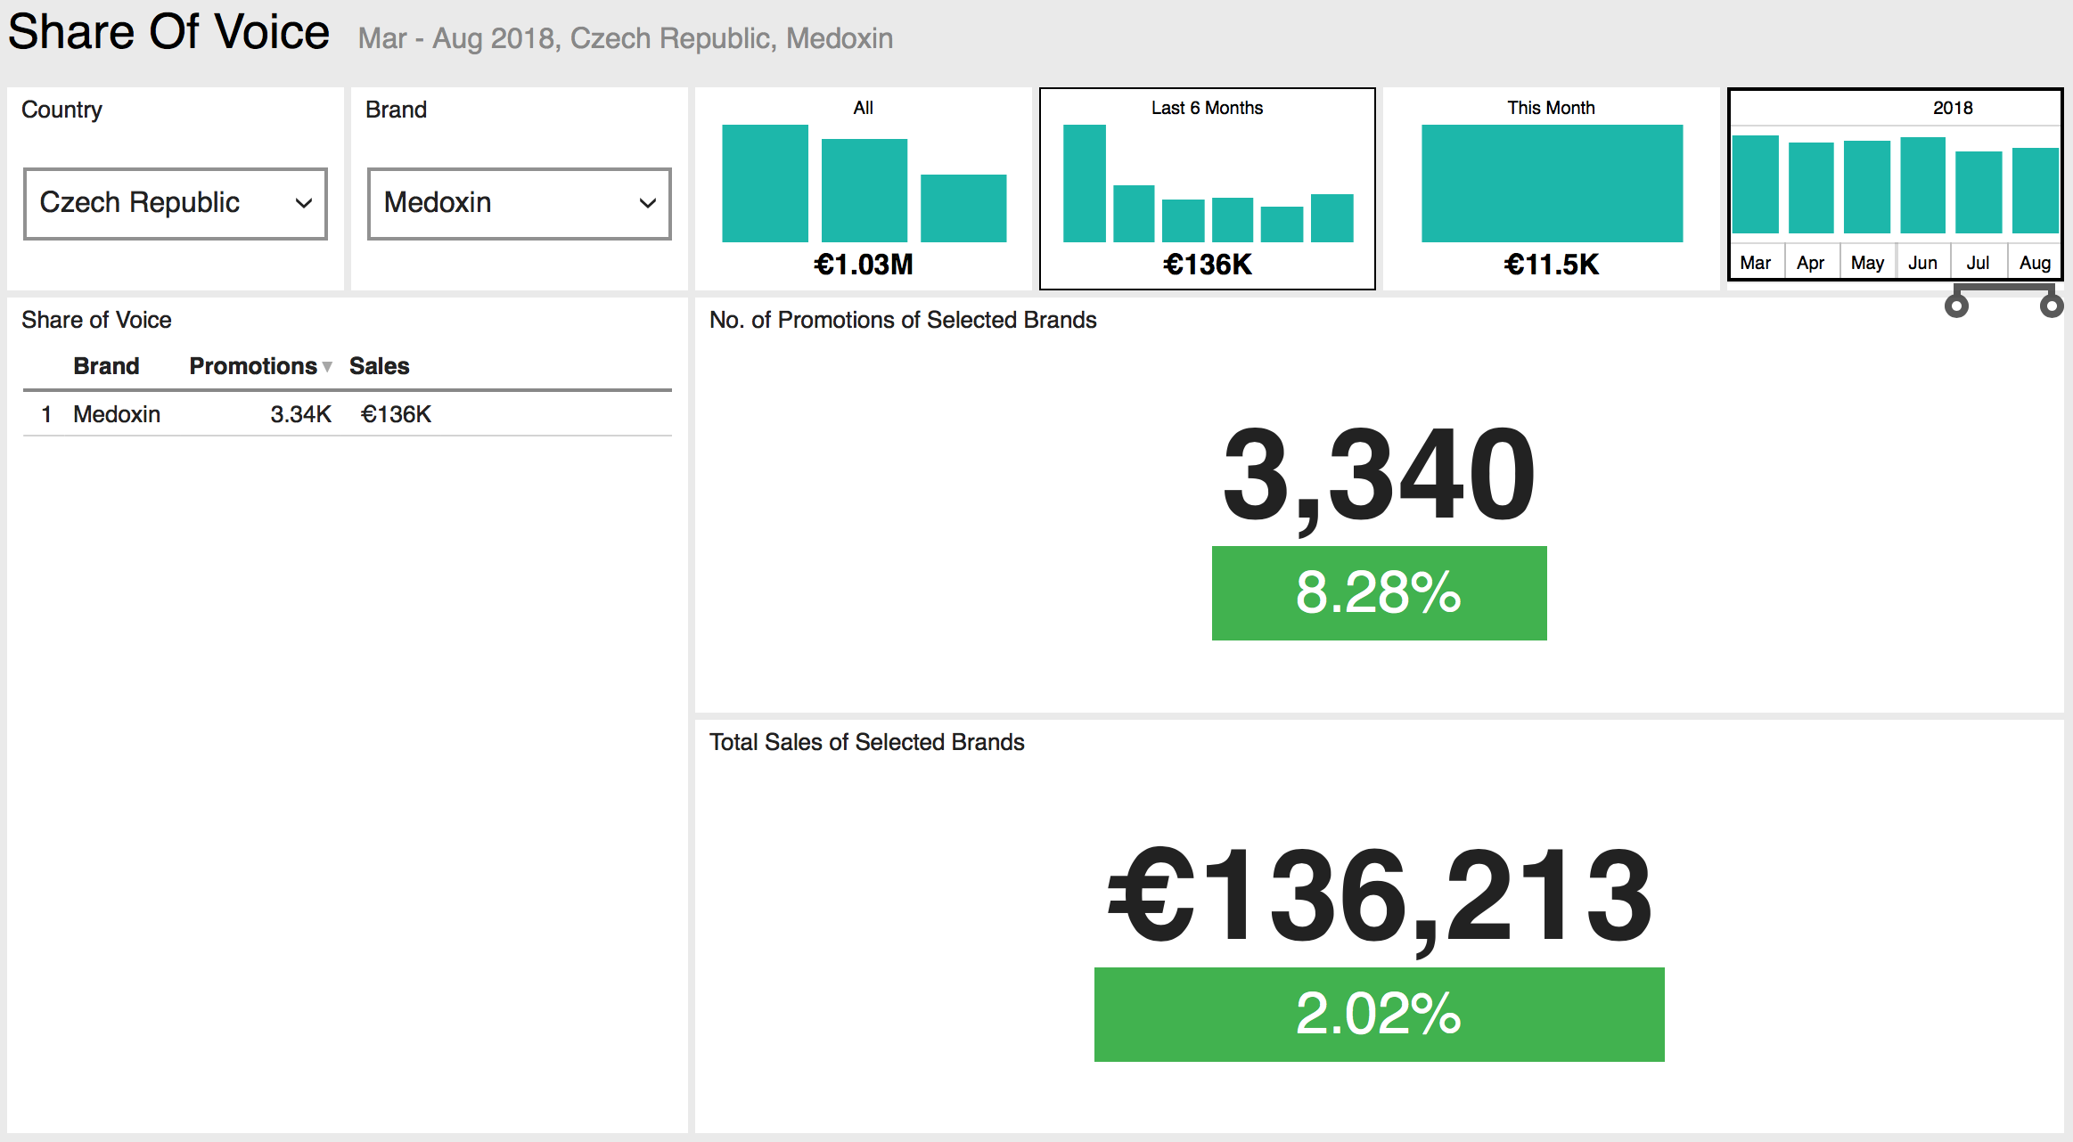
Sales vs Activities & Expenses
These are examples of dashboards that allow the user to explore in more detail the comparison of expenses by type against sales. Share of spend (left) shows the relative amounts of money spent (by expense source) to promote each brand, while share of voice (right) shows the relative promotional effort in terms of product details during customer visits. Both of these are drill-through reports from the KPI Global dashboard and allow the user to sort by expense type and view results for selected brands.

Slide 9
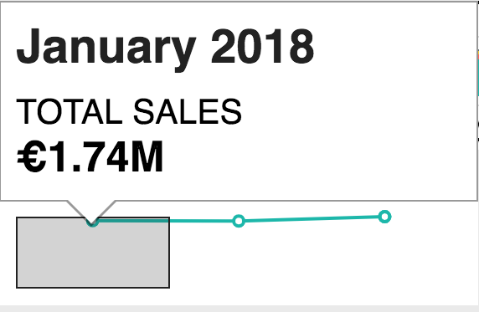
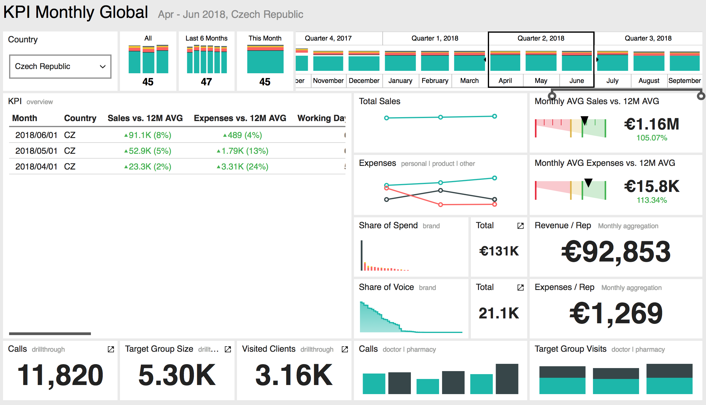
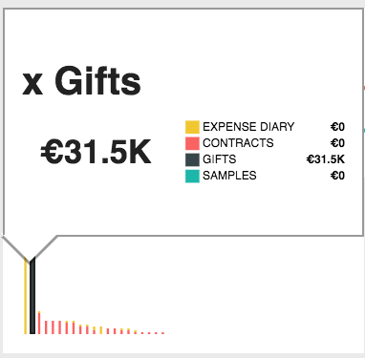
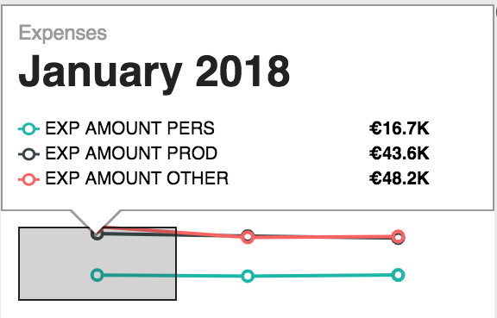
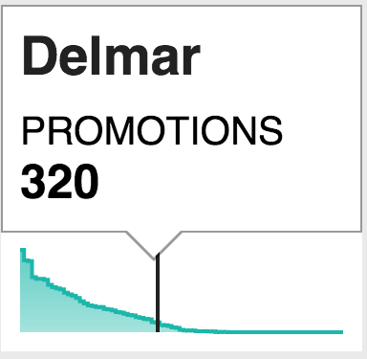
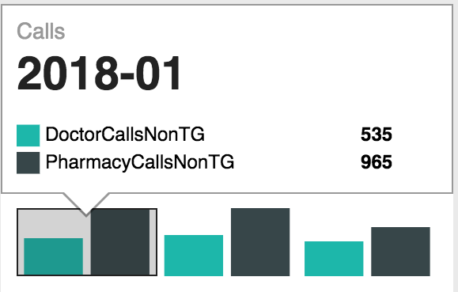
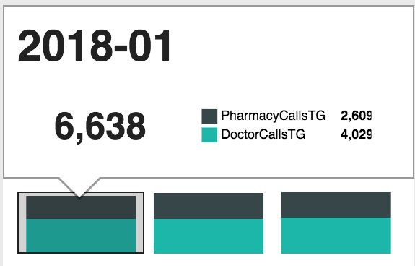
This is an example of a sales vs. expense dashboard that displays overall sales against different kinds of expenses. In this example, the expenses drawn from different sources (i.e. direct expenses, contracts, gifts, samples) are correlated against sales and one another for comparison within a selected period. The dashboard also displays monthly averages for sales and expenses within the selected quarter against the moving 12 month average, along with reference KPIs like calls, target group size, and visited clients. Drilldowns are displayed (as illustrated) by clicking on a given chart or graph.

Slide 10
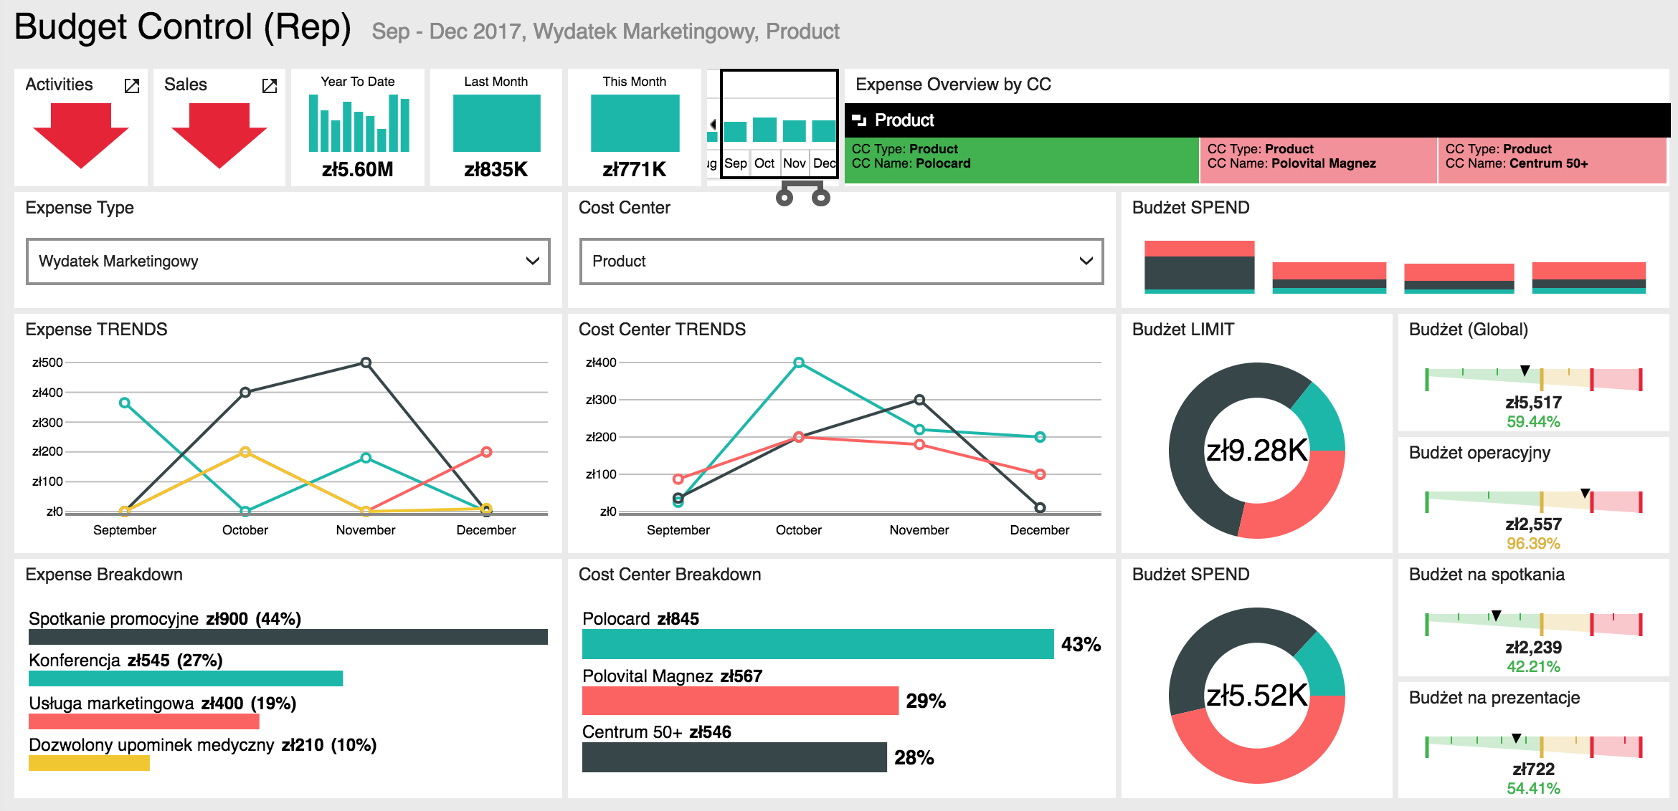
Expense Analysis
This is an example of an expense dashboard used to analyze budget usage within a selected period. This dashboard requires the implementation of the Expense Diary module, which is used both to allocate budgets to end users, and allows them to report their expenses by cost center and by expense type. A cost center is typically named for the brand or product group being promoted (on whose behalf the expense is recorded) while an expense type refers to the categories of expenses a rep can make (e.g. “Lunch with Clients” “Parking” “Marketing” “Conferences” etc.). The charts on the right display budget spend. If a filter is added for user selection, the report user will be able to examine budget usage by individual rep and/or BU as well.

Slide 11
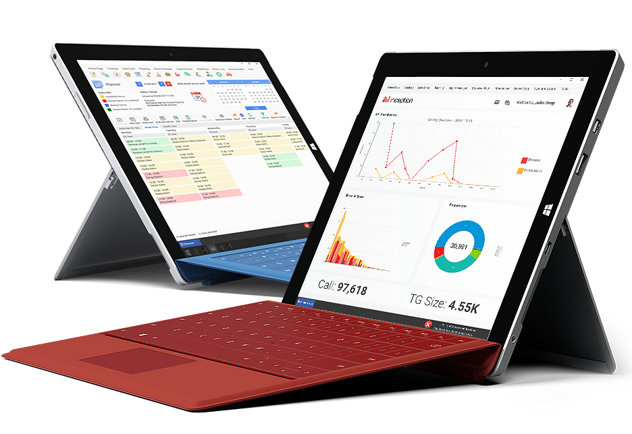
Reports
Tabular representations of important KPIs, created for export to MS Excel

Slide 12
Activity Analysis
This is an example of an export report used for examining a range of activity KPIs rep-by-rep, with summaries for each BU and the overall sales organization. The listed KPIs represent the gamut of standard activity metrics:
Target Group Total, Target Doctors, Target Pharmacies, Target Call Rate: Doctors (Calls Per Day), Target Call Rate: Pharmacies (Calls Per Day), Achieved Call Rate: Doctors (%), Achieved Call Rate: Pharmacies (%), Call Capacity (for Month), Call Capacity Fulfilment %, Working Days (Total), In Field Days (Total), Days With Calls (Total), Number of Reps, Working Days / Rep, In Field Days / Rep, Total Calls, Total Calls Persons, Total Calls Doctors, Total Calls Institutions, Total Calls Pharmacies, Average No. Calls per Day, Calls On Target, Calls On Target (%), Calls On Non Target, Calls On Non Target (%), Calls On Target - Doctors, Calls On Target - Doctors (%), Calls On Target - Pharmacies, Calls On Target - Pharmacies (%), Target Group Coverage, Target Group Coverage (%), Target Group Coverage - Doctors, Target Group Coverage - Doctors (%), Target Group Coverage - Pharmacies, Target Group Coverage - Pharmacies (%), Average Visit Frequency (Doctors), Average Visit Frequency (Pharmacies), …
Click to expand (opens in MS Excel)

Slide 13
Sales and Orders Analysis
This is an example of an export report used to view sales from transfer orders, as well as sales in comparison to transfer orders within both the selected period and comparison periods. Filters used to generate the report include period selection (by type: year, quarter, month; and by specific value), product group(s), and customer ratings (in this case, the customer creates a distinct rating segment for each brand that a given pharmacy might sell – so a pharmacy might be Tier 1 for Brand A, but Tier 2 for Brand B – rather than a single overall rating).
Click to expand (opens in MS Excel)

Slide 14
Activities, Sales and Orders Analysis
This is an example of an export report used to example sales and orders by customer brand segment within the select month and related quarter. It adds data for specific activity KPIs (such as calls per day) in order to better identify the importance of those KPIs as sales impact drivers.
Click to expand (opens in MS Excel)

Slide 15
Y/Y Sales Comparison
This is an example of an export report used for examining sales vs. plan with Y/Y comparisons. The view below is cropped but if you click the image it will expand to show you what the full report looks like in excel.
Click to expand (opens in MS Excel)

Slide 16
Period Sales Tracking
This is an example of an export report used for tracking quarterly sales by representative, with brand- and SKU-level sales vs target represented.
This report can display sales in value or units (the example embedded here is in units) and can show sales by quarter (3 months) or cycle (four months).
Click to expand (opens in MS Excel)

