Slide 1
Inception CRM for pharma A Sales Tool and Database Management System
D3S Group | D3S a.s.

Slide 2
About D3S a.s.
:: Privately Owned, 12 Years of Service
:: Consistent annual growth
:: Stable financial structure
:: Strong record of successful implementations
:: Rapid expansion to new segments in 2016-17

Slide 3
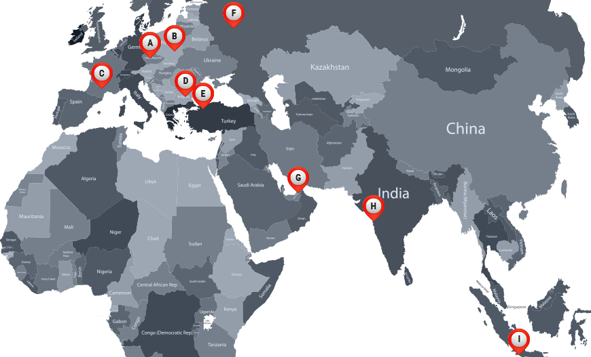
Global Service Capability
(A) Prague | (B) Warsaw | (C) Toulouse | (D) Bucharest | (E) Istanbul | (F) Moscow | (G) Dubai | (H) Mumbai | (I) Jakarta
© 2017 D3S a.s.

Slide 4
Successful Projects In More Than Three Dozen Countries
Albania
Austria
Belgium
Bosnia
Bulgaria
Czech Rep.
Cyprus
Denmark
Finland
Hungary
Iceland
Iran
Iraq
Italy
Jordan
Kosovo
Lebanon
Luxembourg
Macedonia
Morocco
Netherlands
Palestine
Poland
Romania
Serbia
Slovakia
Slovenia
Spain
Sudan
Sweden
Switzerland
Syria
Tunisia
Turkey
Ukraine
United Kingdom
USA
Most of our software projects reflect a broad set of functional requirements. In each case, global/corporate and country-specific requirements are met with a flexible and adaptable approach and implemented in an efficient and cost-effective manner in keeping with local budgets and expectations.
© 2017 D3S a.s.

Slide 5




















Successful Projects In More Than Three Dozen Countries
Our clients have included some of the world’s largest and most prestigious companies, representing a diverse a range of industries, from pharmaceuticals to telecommunications, manufacturing, online media and advertising.
© 2017 D3S a.s.

Slide 6
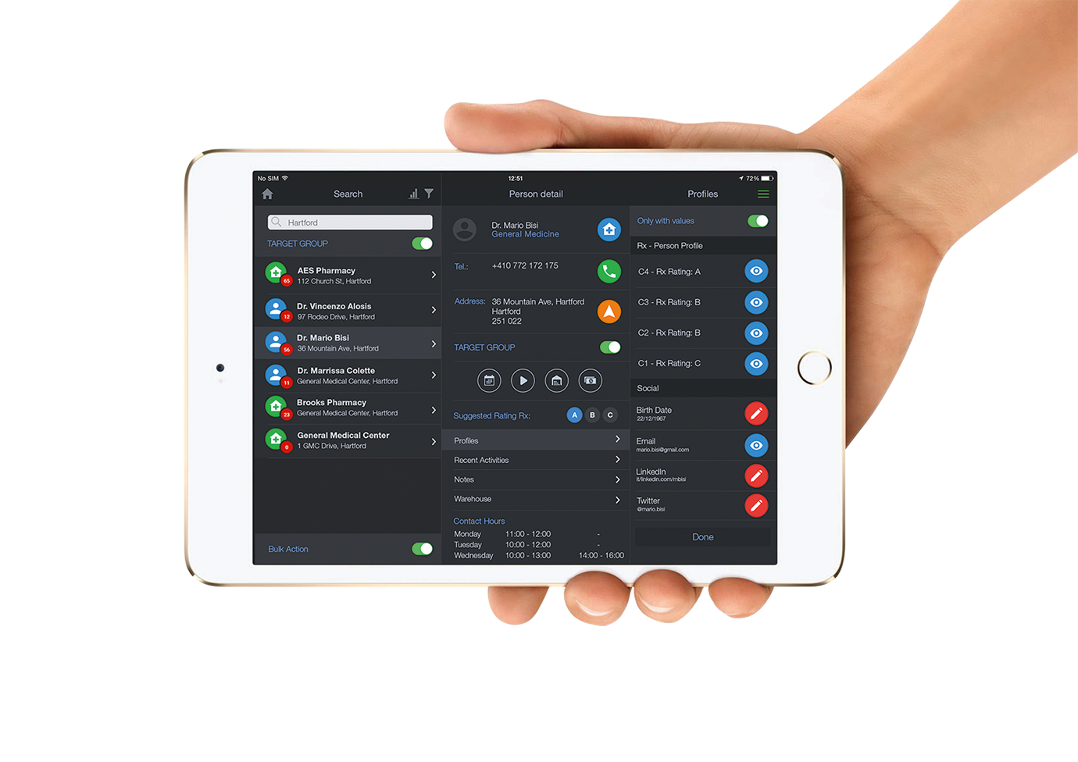

for iPads & Android Tablets
Inception CRM is a robust & user-friendly CRM app for sales teams that harnesses the power and flexibility of iPads, Android tablets, and Windows PCs to deliver superb performance on the go.
Our fully native CRM apps guide users through even the most complex workflows with ease and efficiency. With a few clicks, sales reps can research customers, optimize plans, report activities, present media, create orders, manage promotional expenses, and track their most important KPIs.
© 2017 D3S a.s.

Slide 7
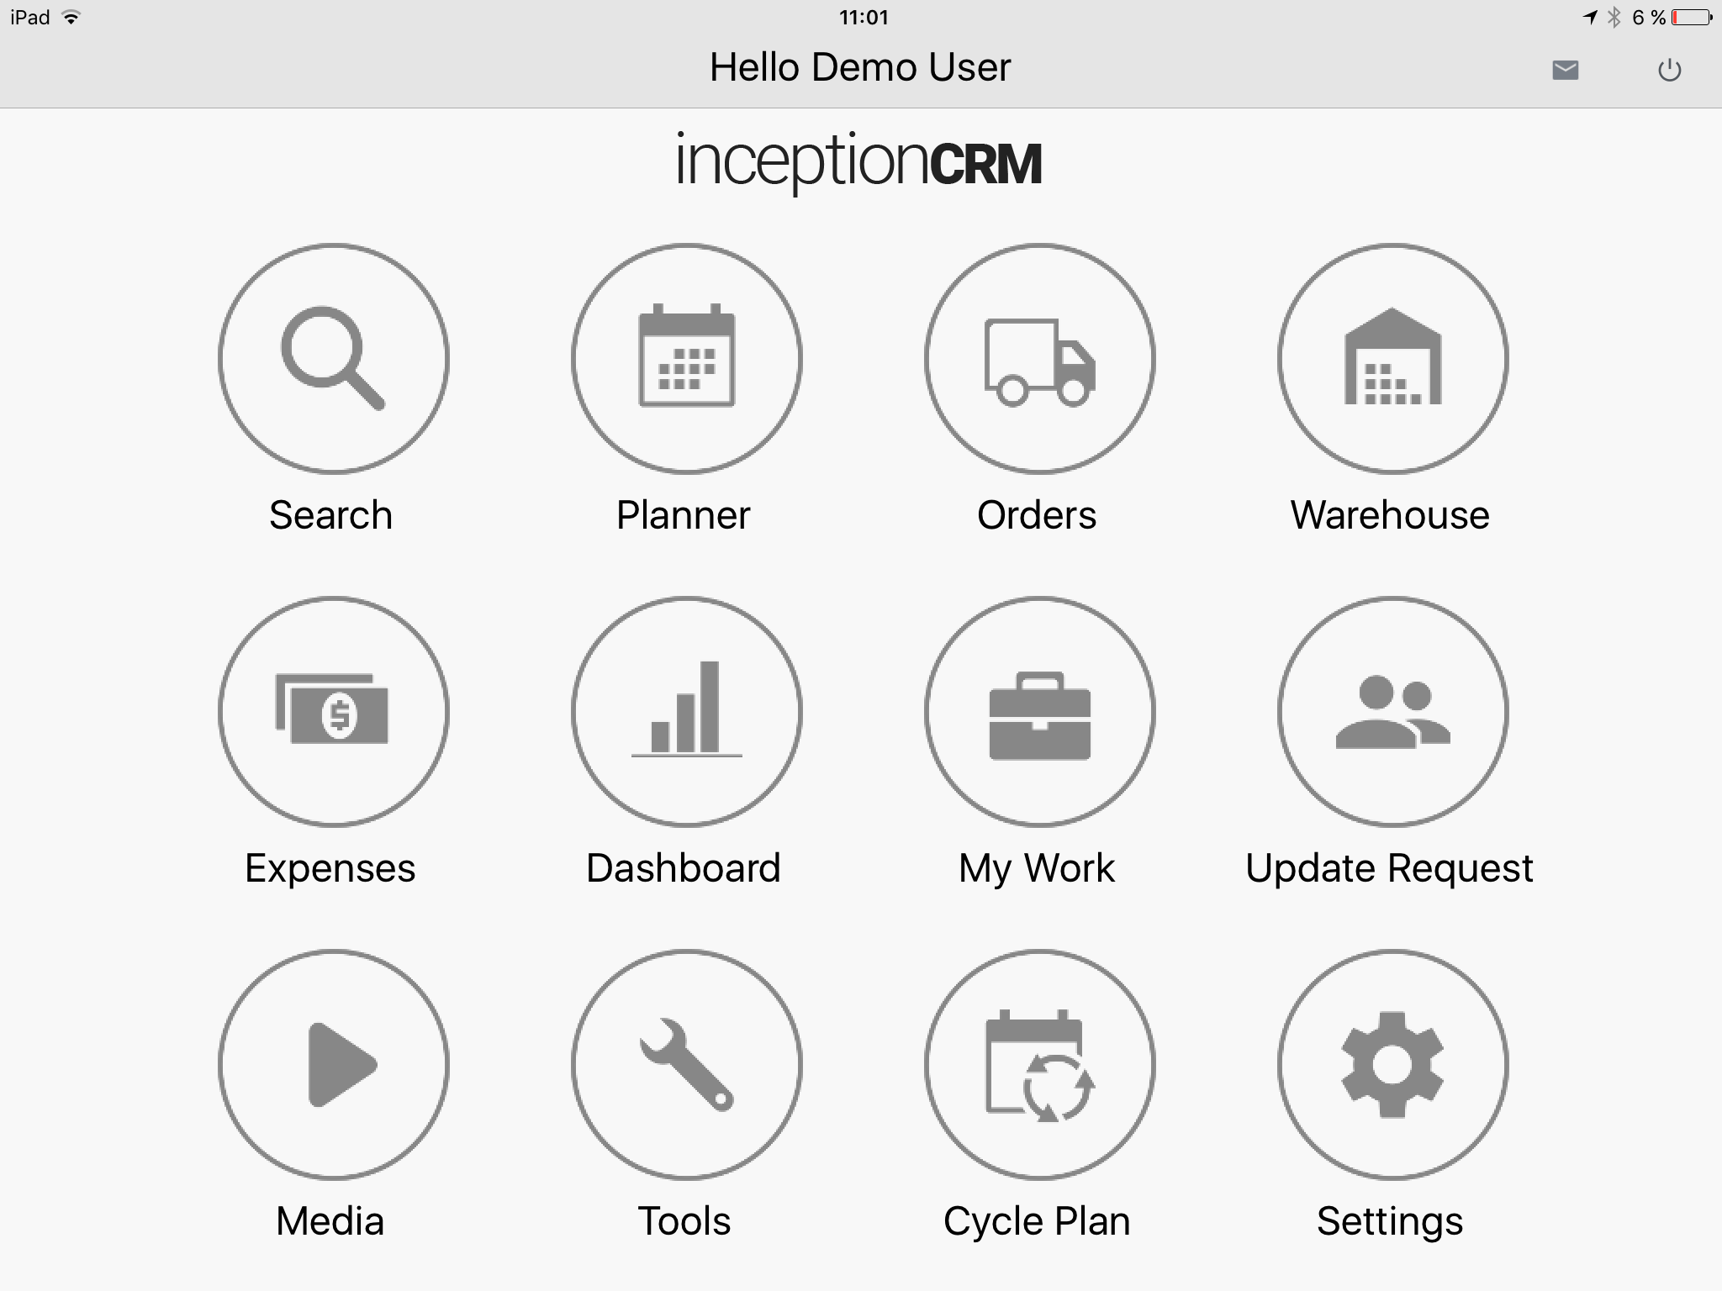
Inception CRM Modules
The HOME PAGE provides immediate access to all modules, which can also be accessed via the sidebar menu from any module within the application.

Slide 8
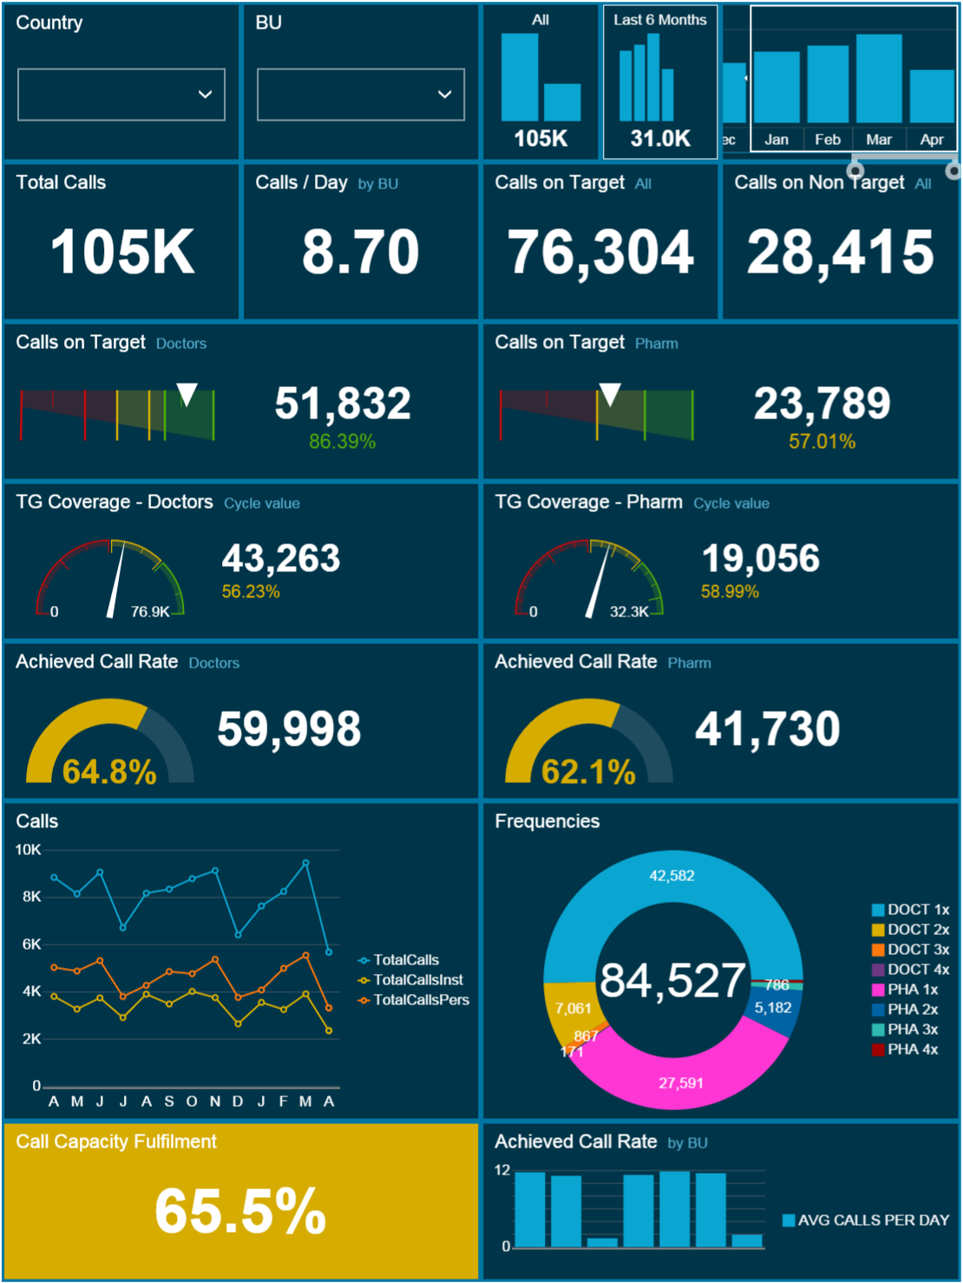
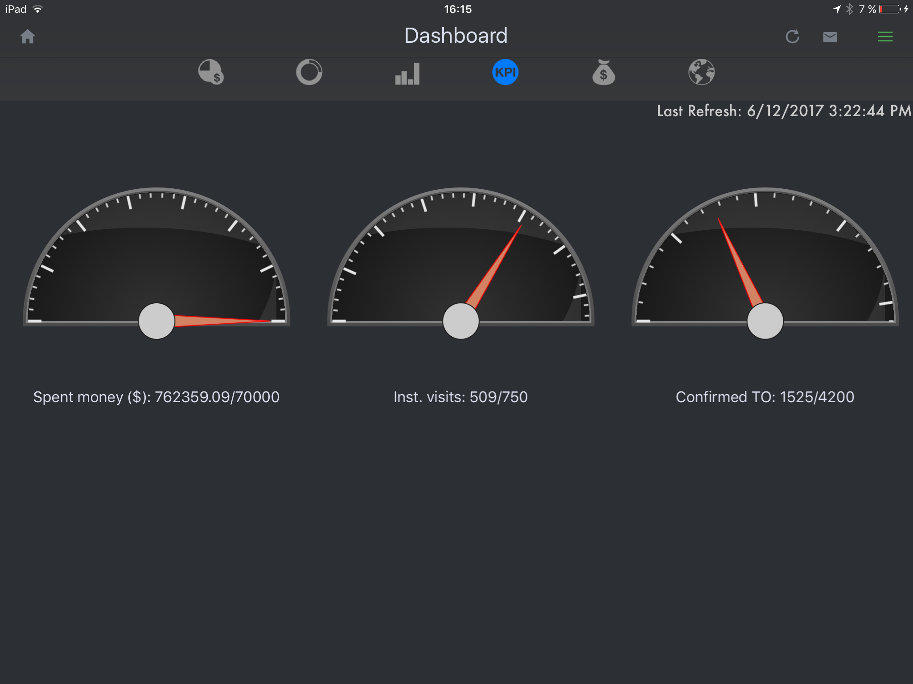
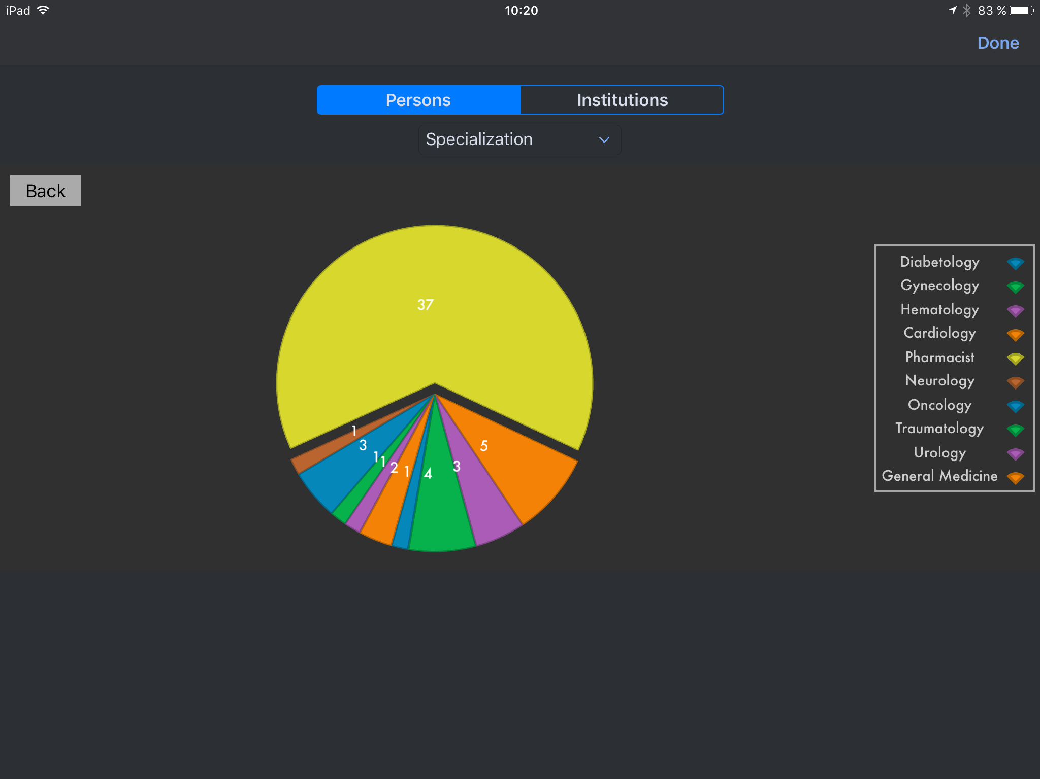
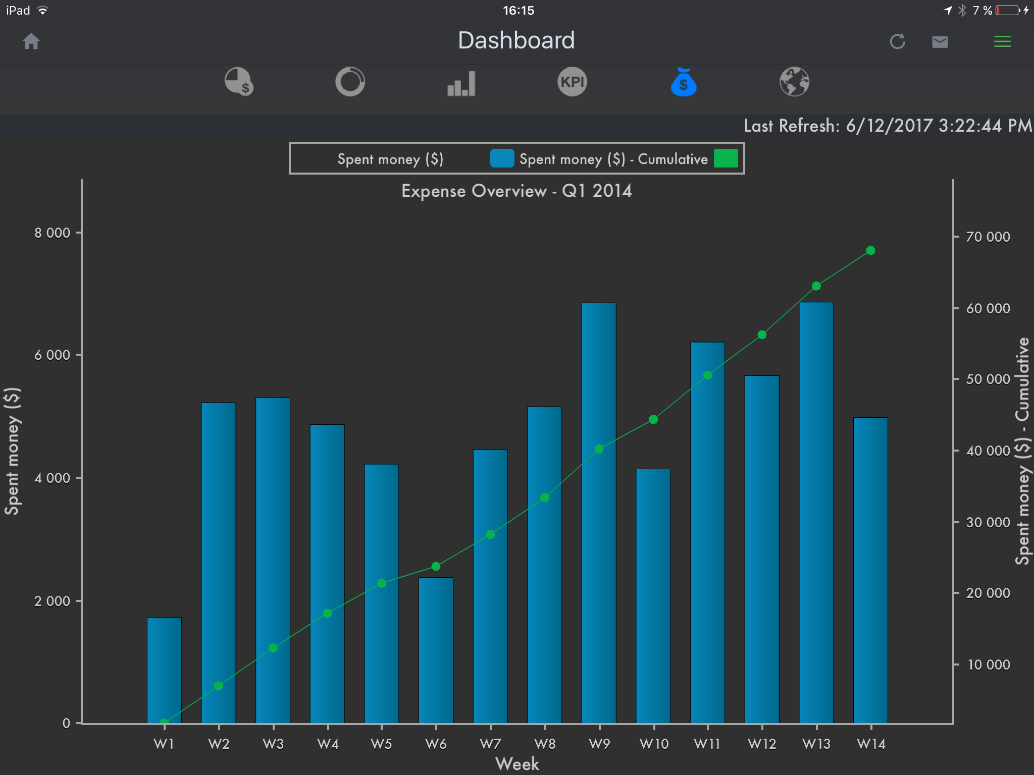
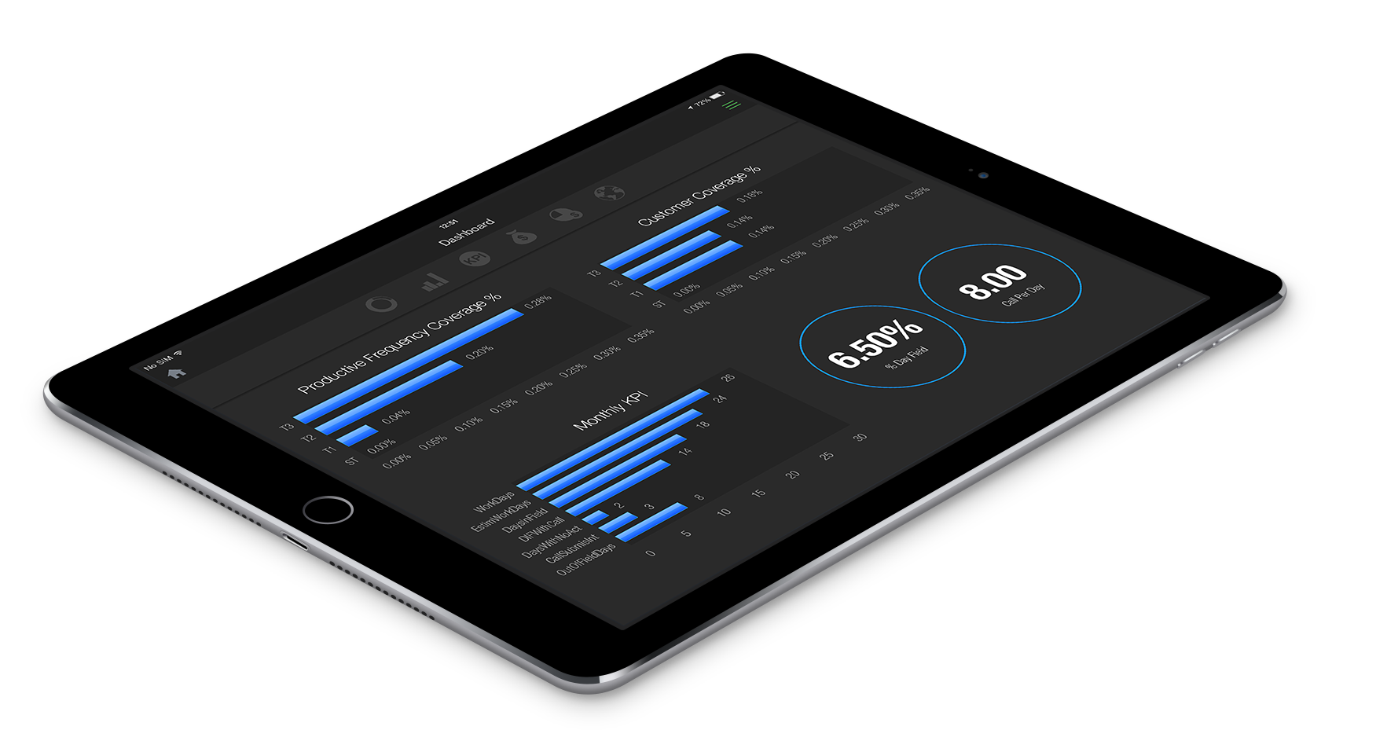
Inception CRM Rep Dashboards
TRACK key performance indicators & results with interactive dashboards that can correlate data from multiple sources.
© 2017 D3S a.s.

Slide 9
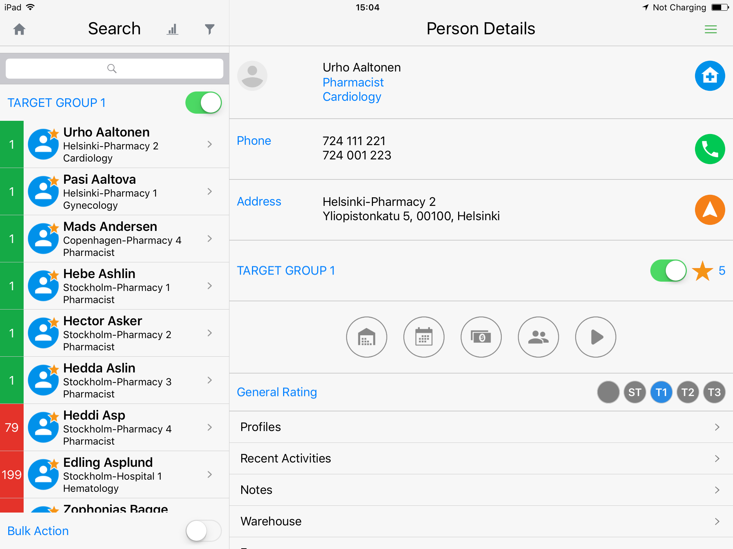
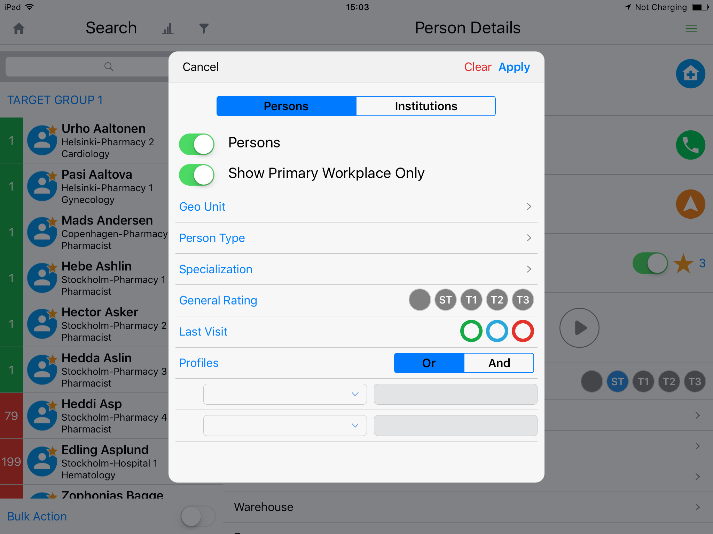
Inception CRM Searching Customers
Includes customer cards and rich features such as profiles, interaction histories, promo drops, orders, notes, and expenses
Supports an unlimited number of profiles and multiple profile types (e.g. static vs. dynamic, editable vs. locked)
Customer cards provide direct access to relevant modules such as Planner, Warehouse, Orders, Expenses, Media, and Updates
The features of the Search List include bulk actions, free text search, and advanced search filters.
© 2017 D3S a.s.

Slide 10
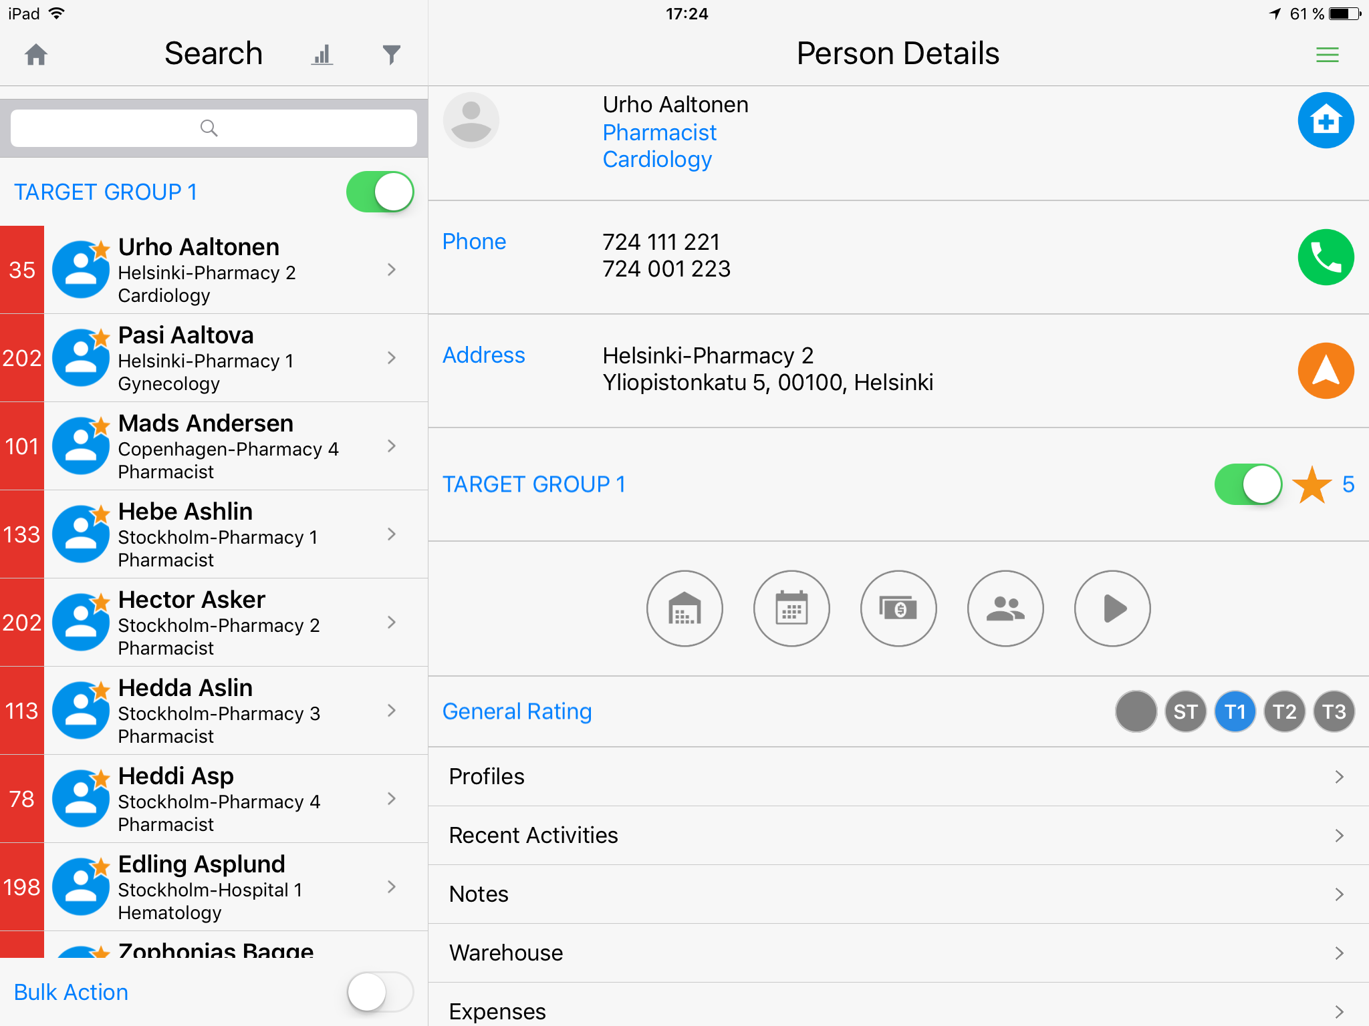
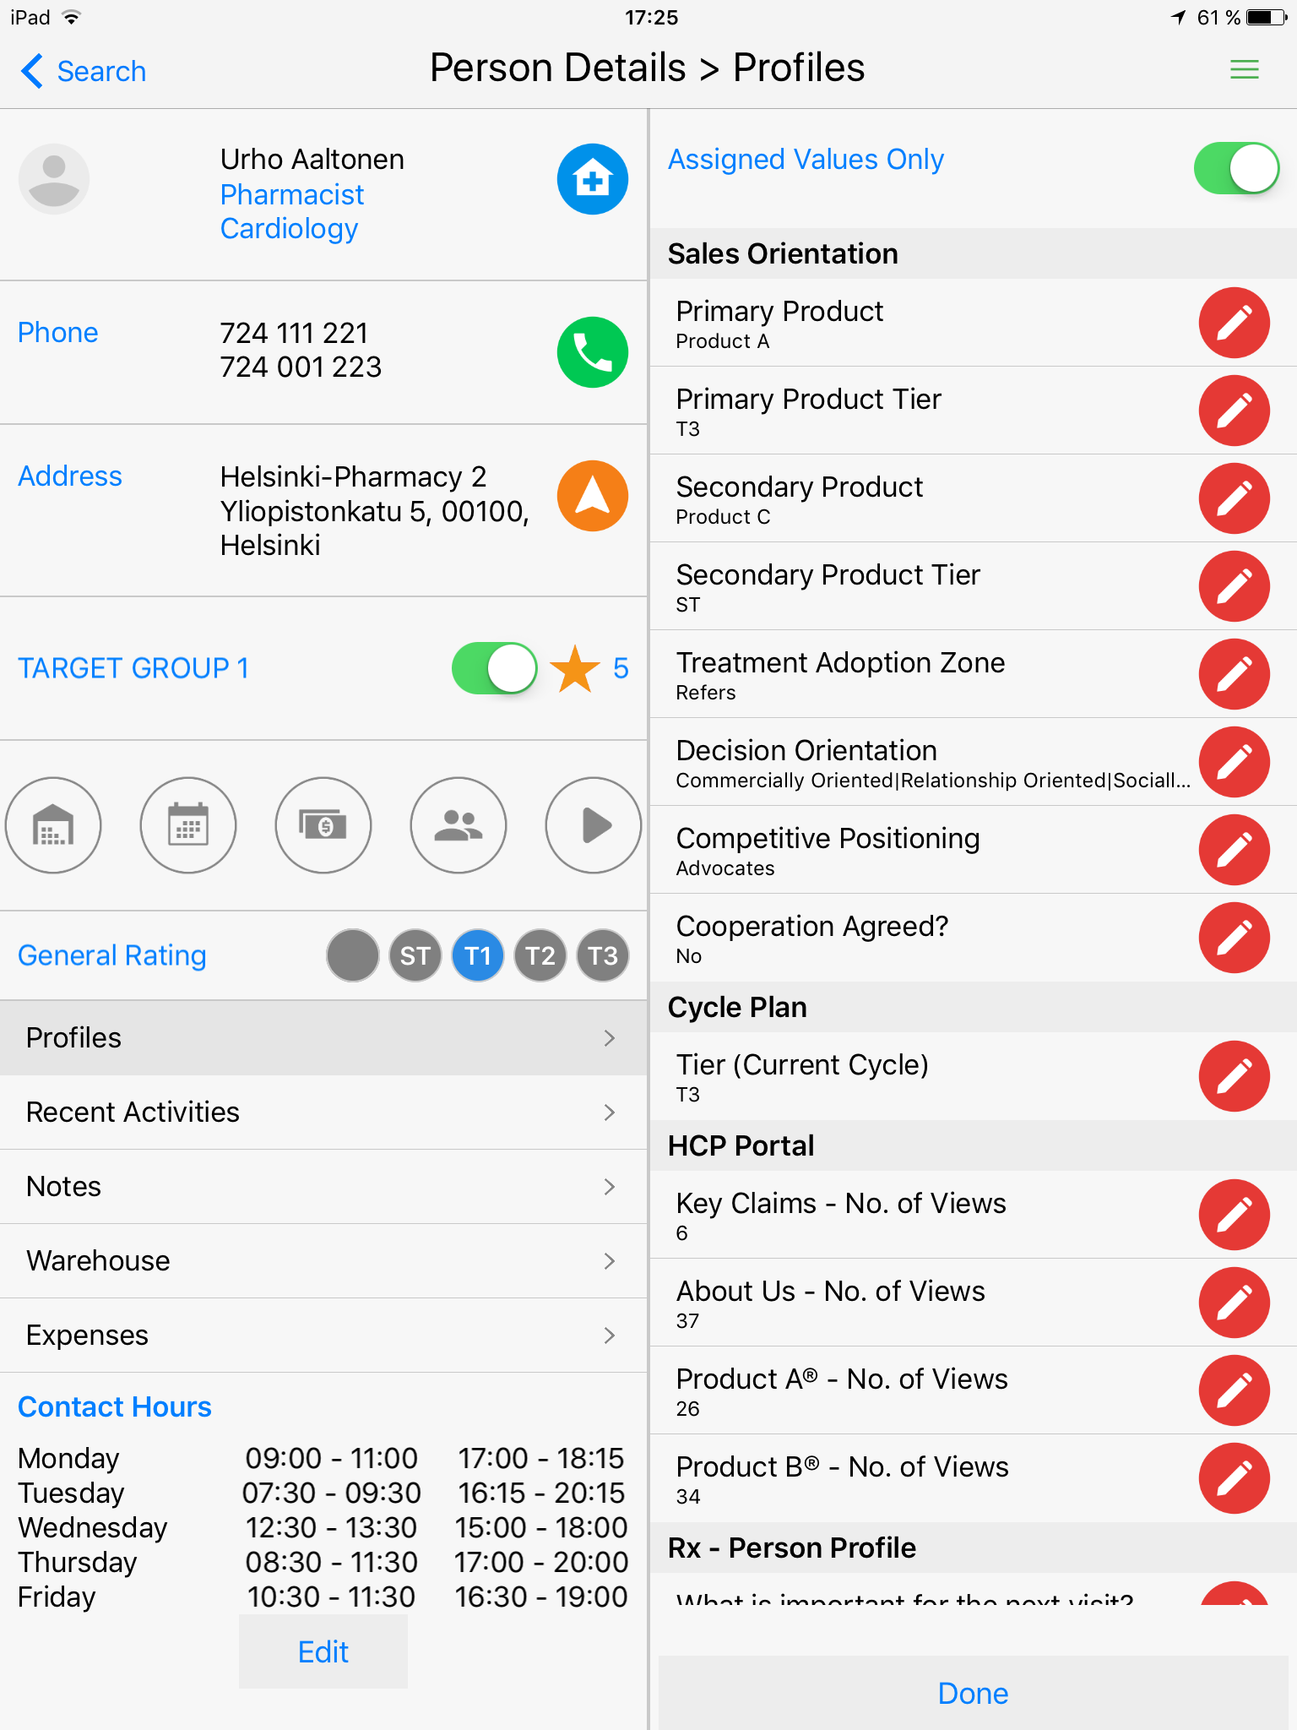
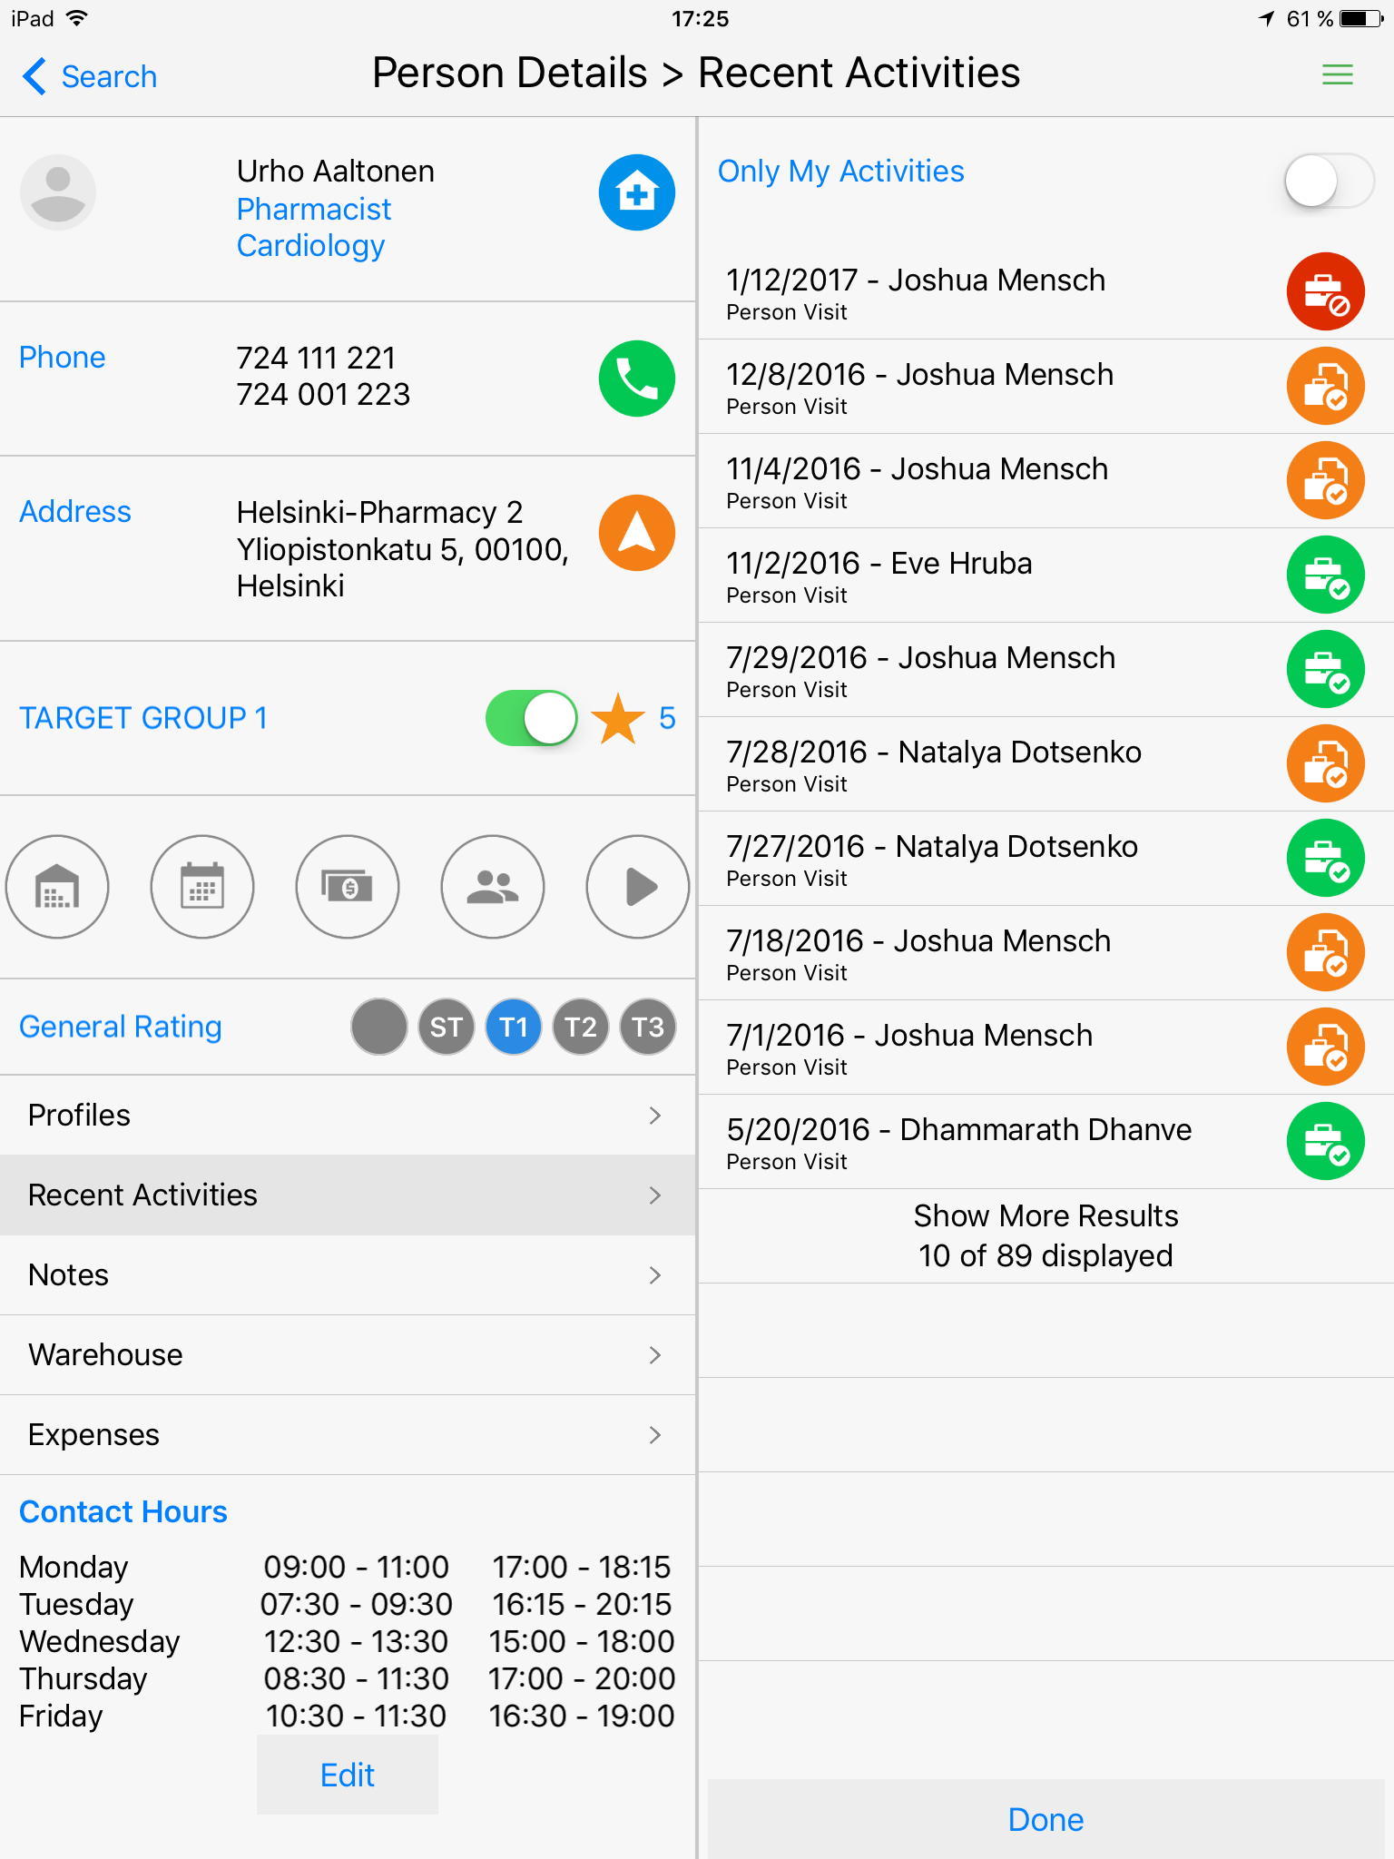
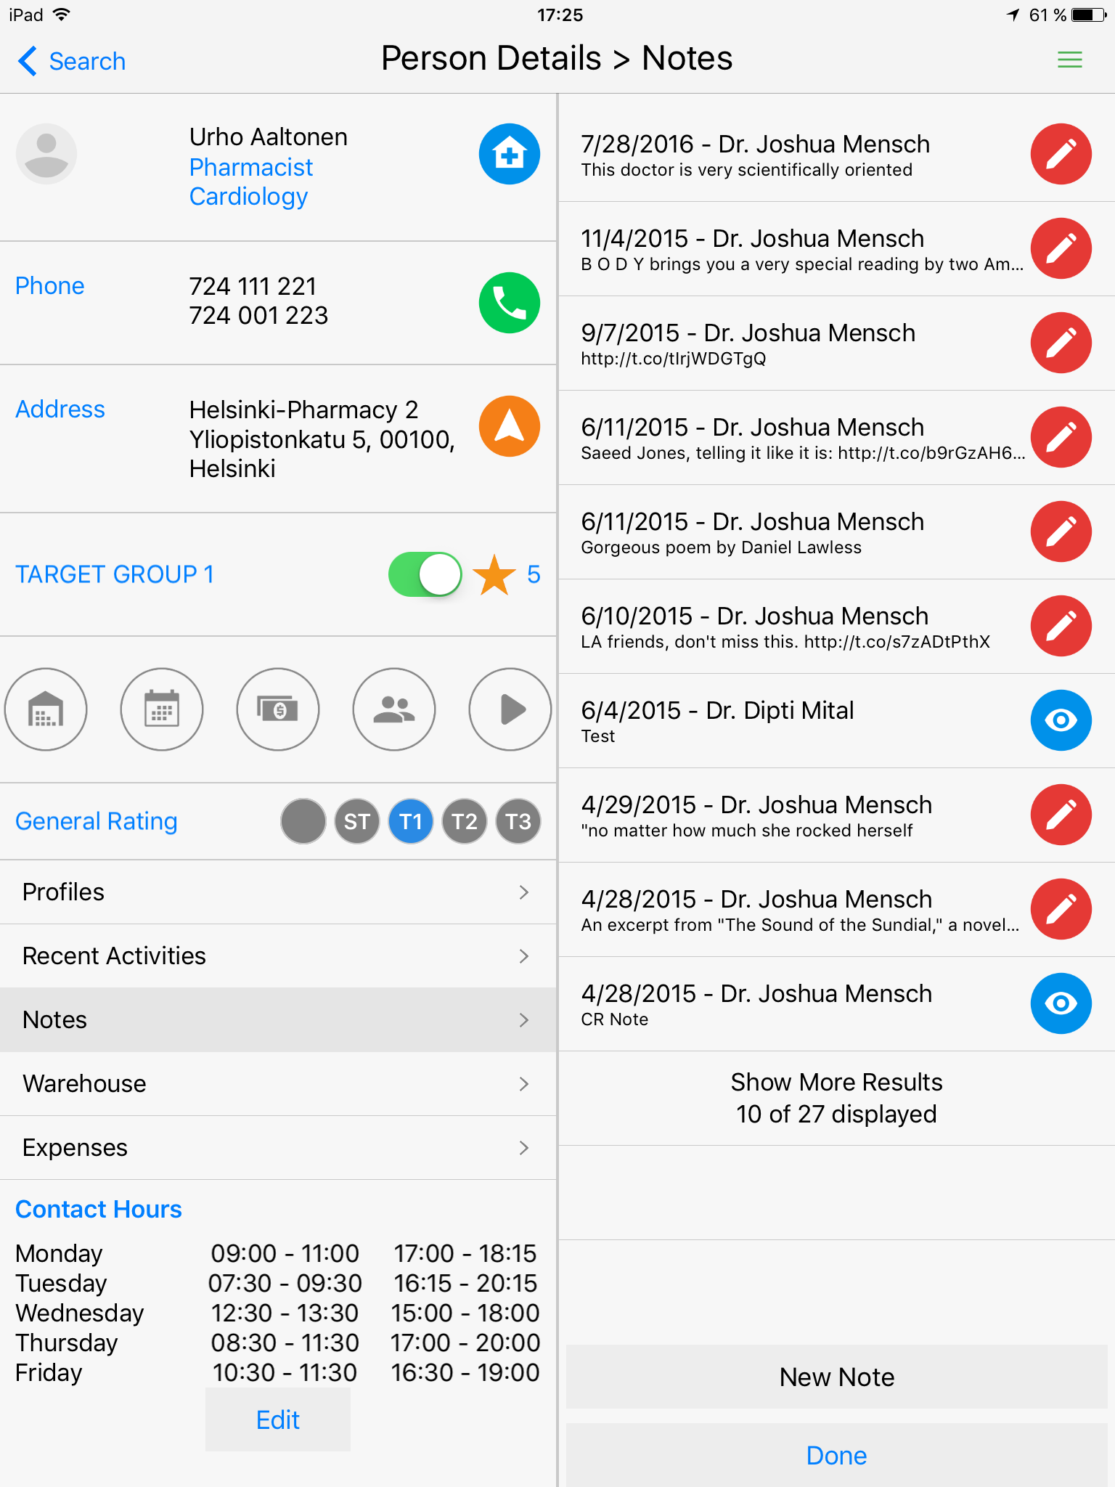
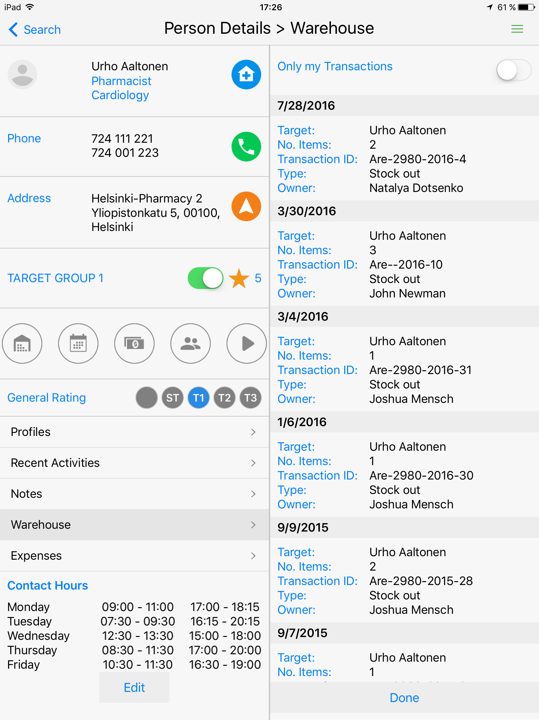
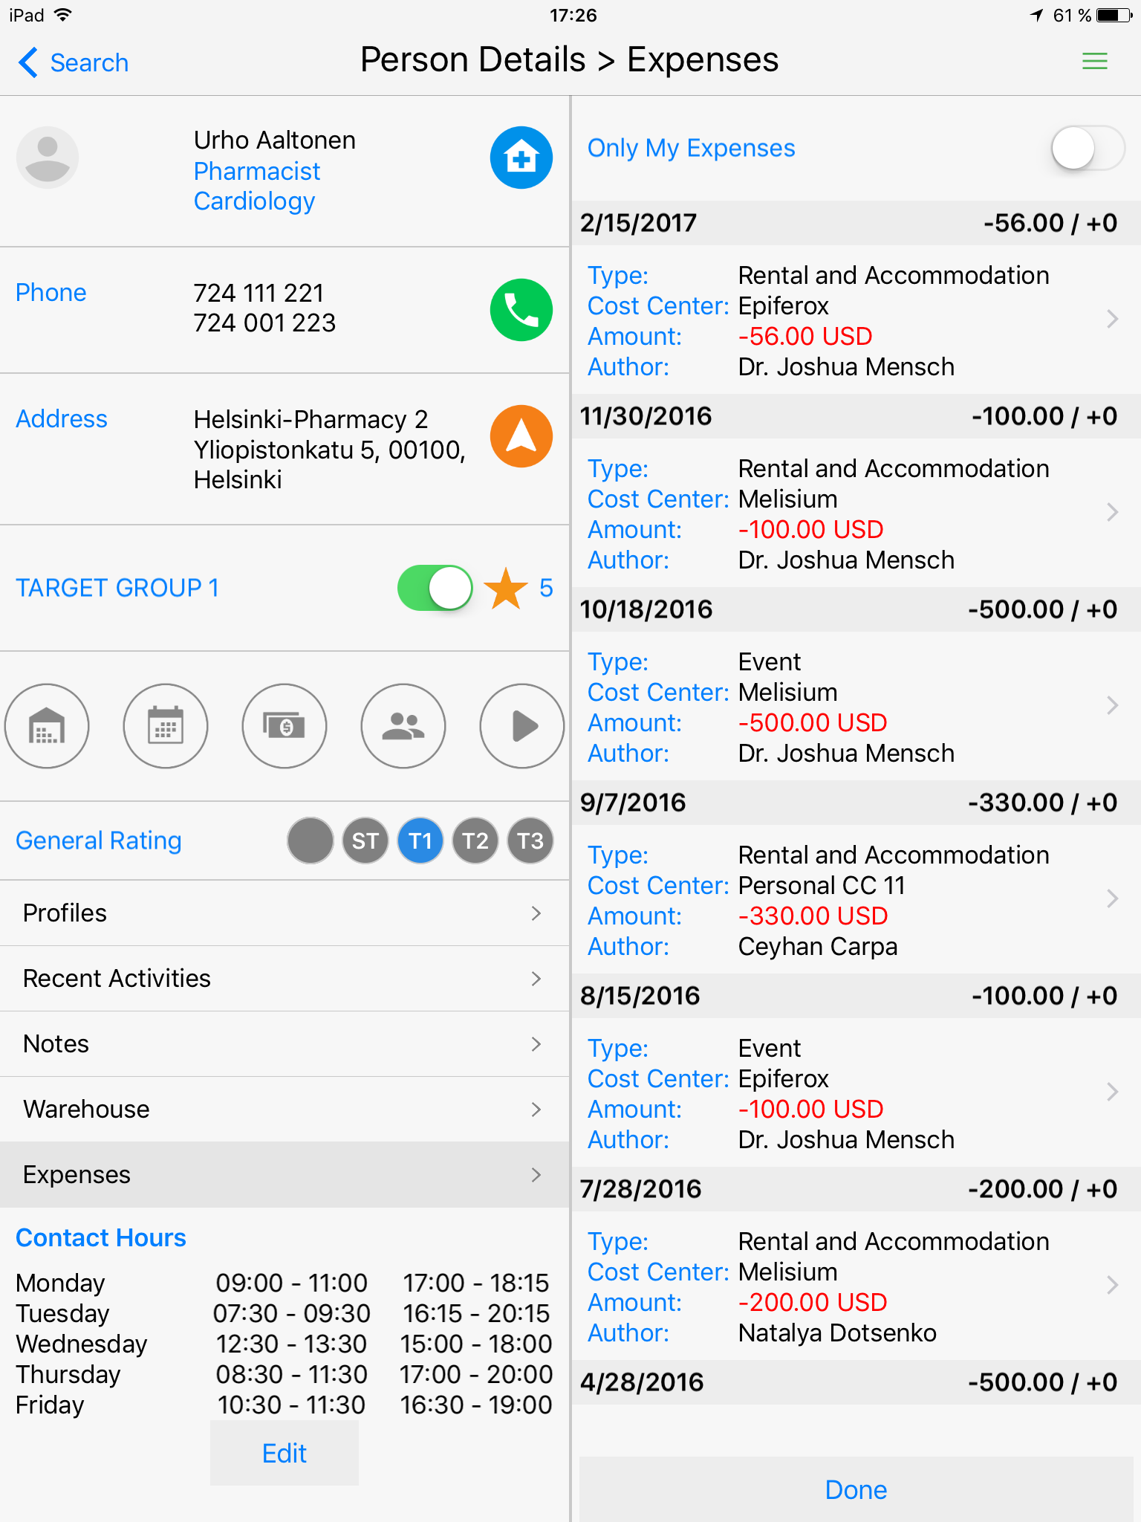
Inception CRM Reviewing Customer Information
SEARCH allows reps to find client contacts quickly and review detailed info about customers, including profiles, interaction histories, financial investments, orders, and much more.
© 2017 D3S a.s.

Slide 11
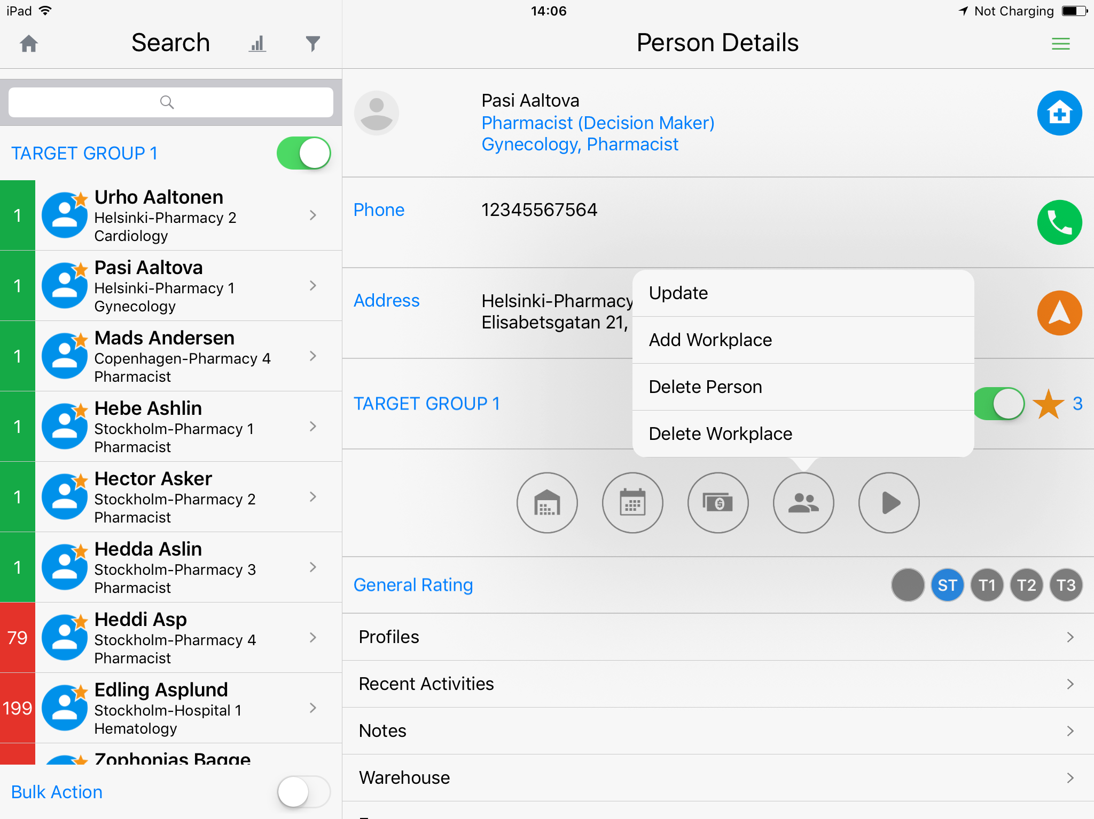
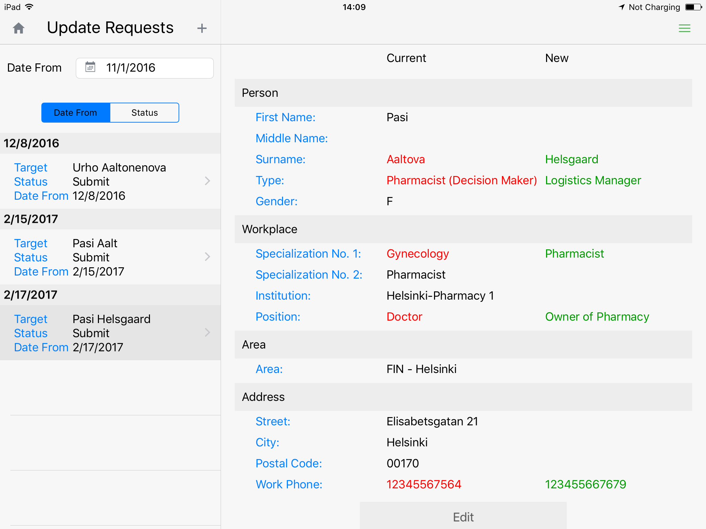
Inception CRM Updating Customer Information
UPDATES maintain the validity of customer information. Users can update customer data on the fly, with changes processed immediately or after validation, according to company policy.
© 2017 D3S a.s.

Slide 12
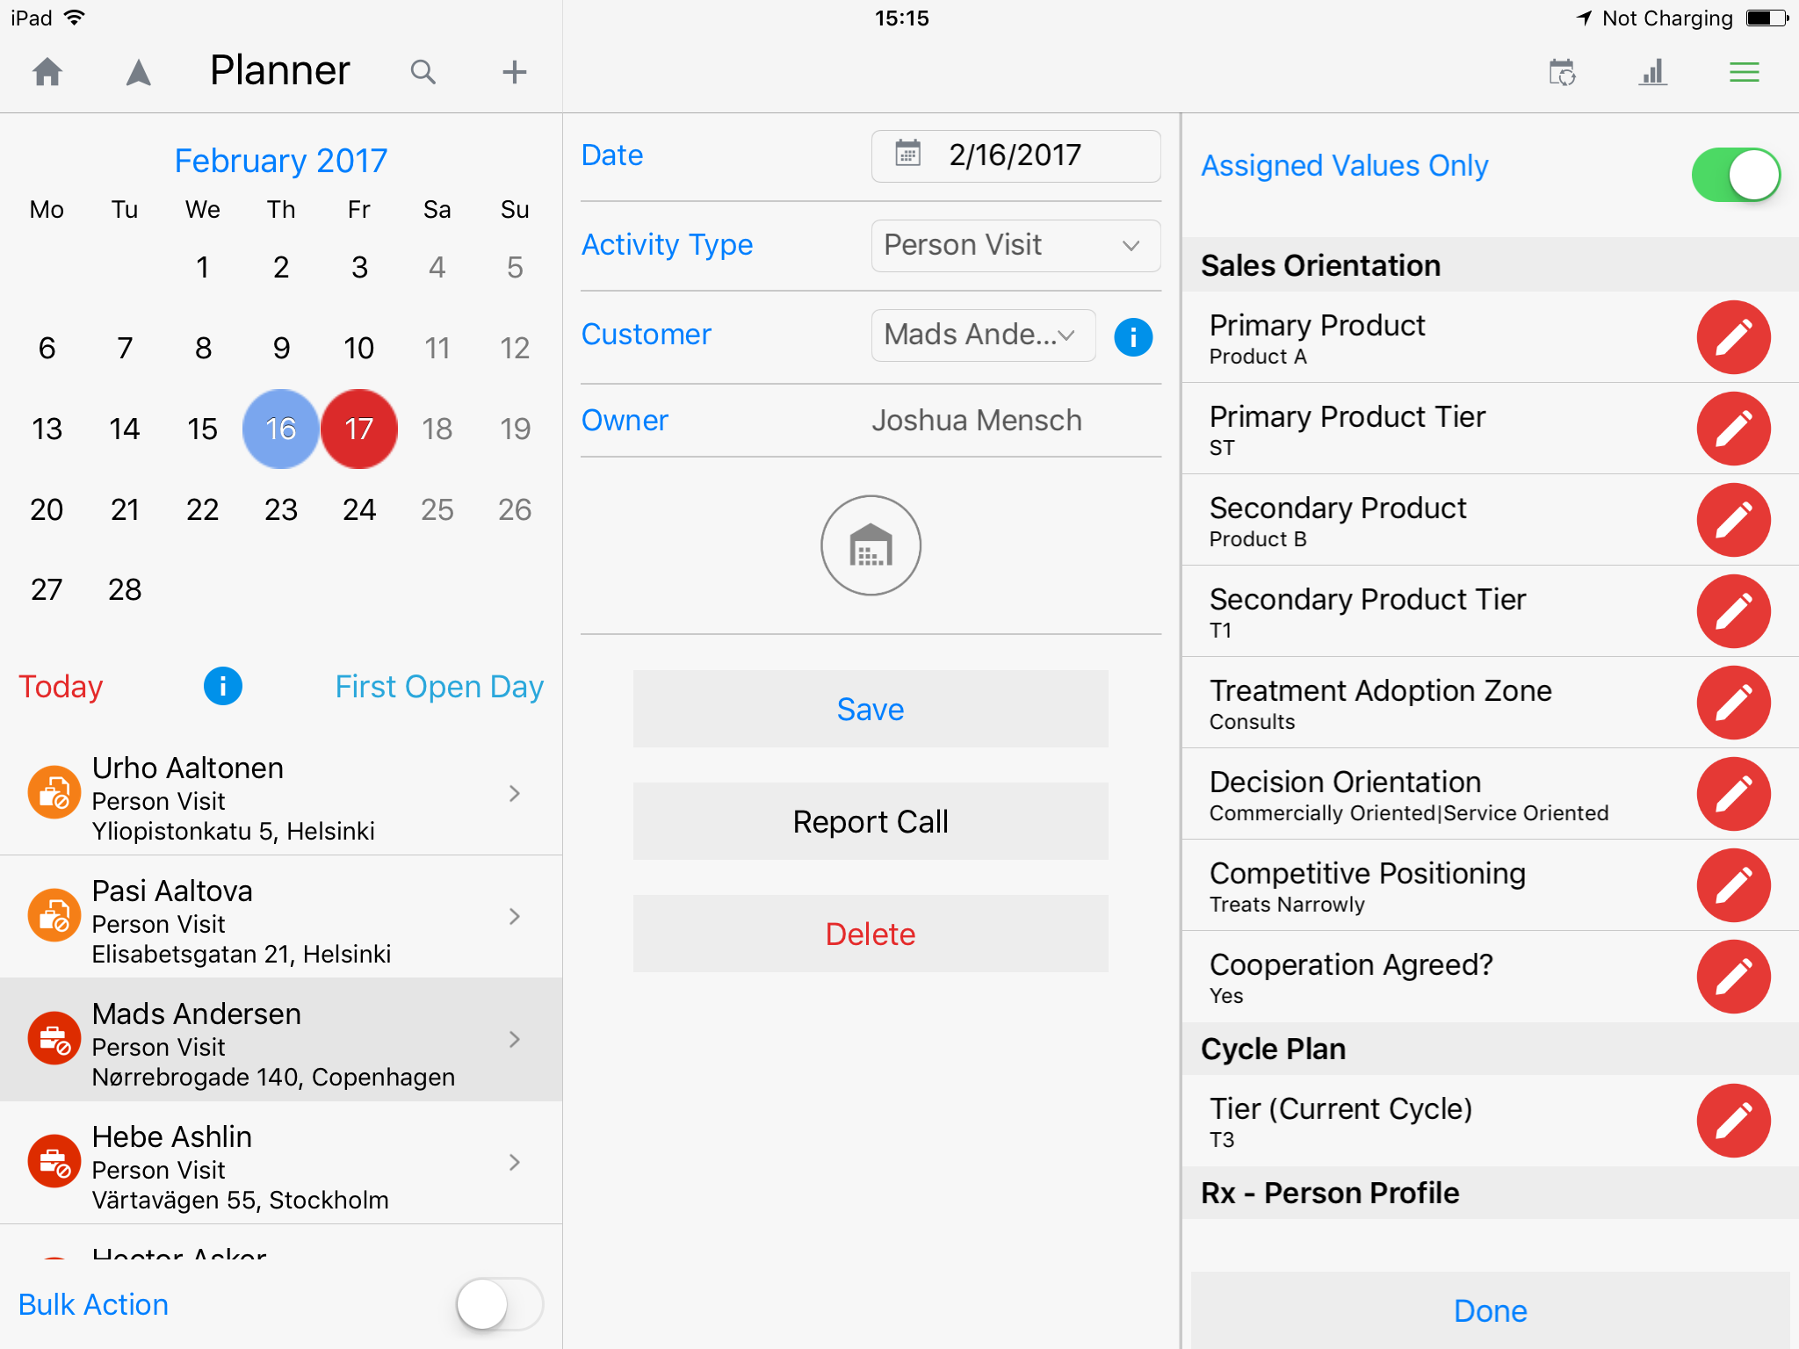
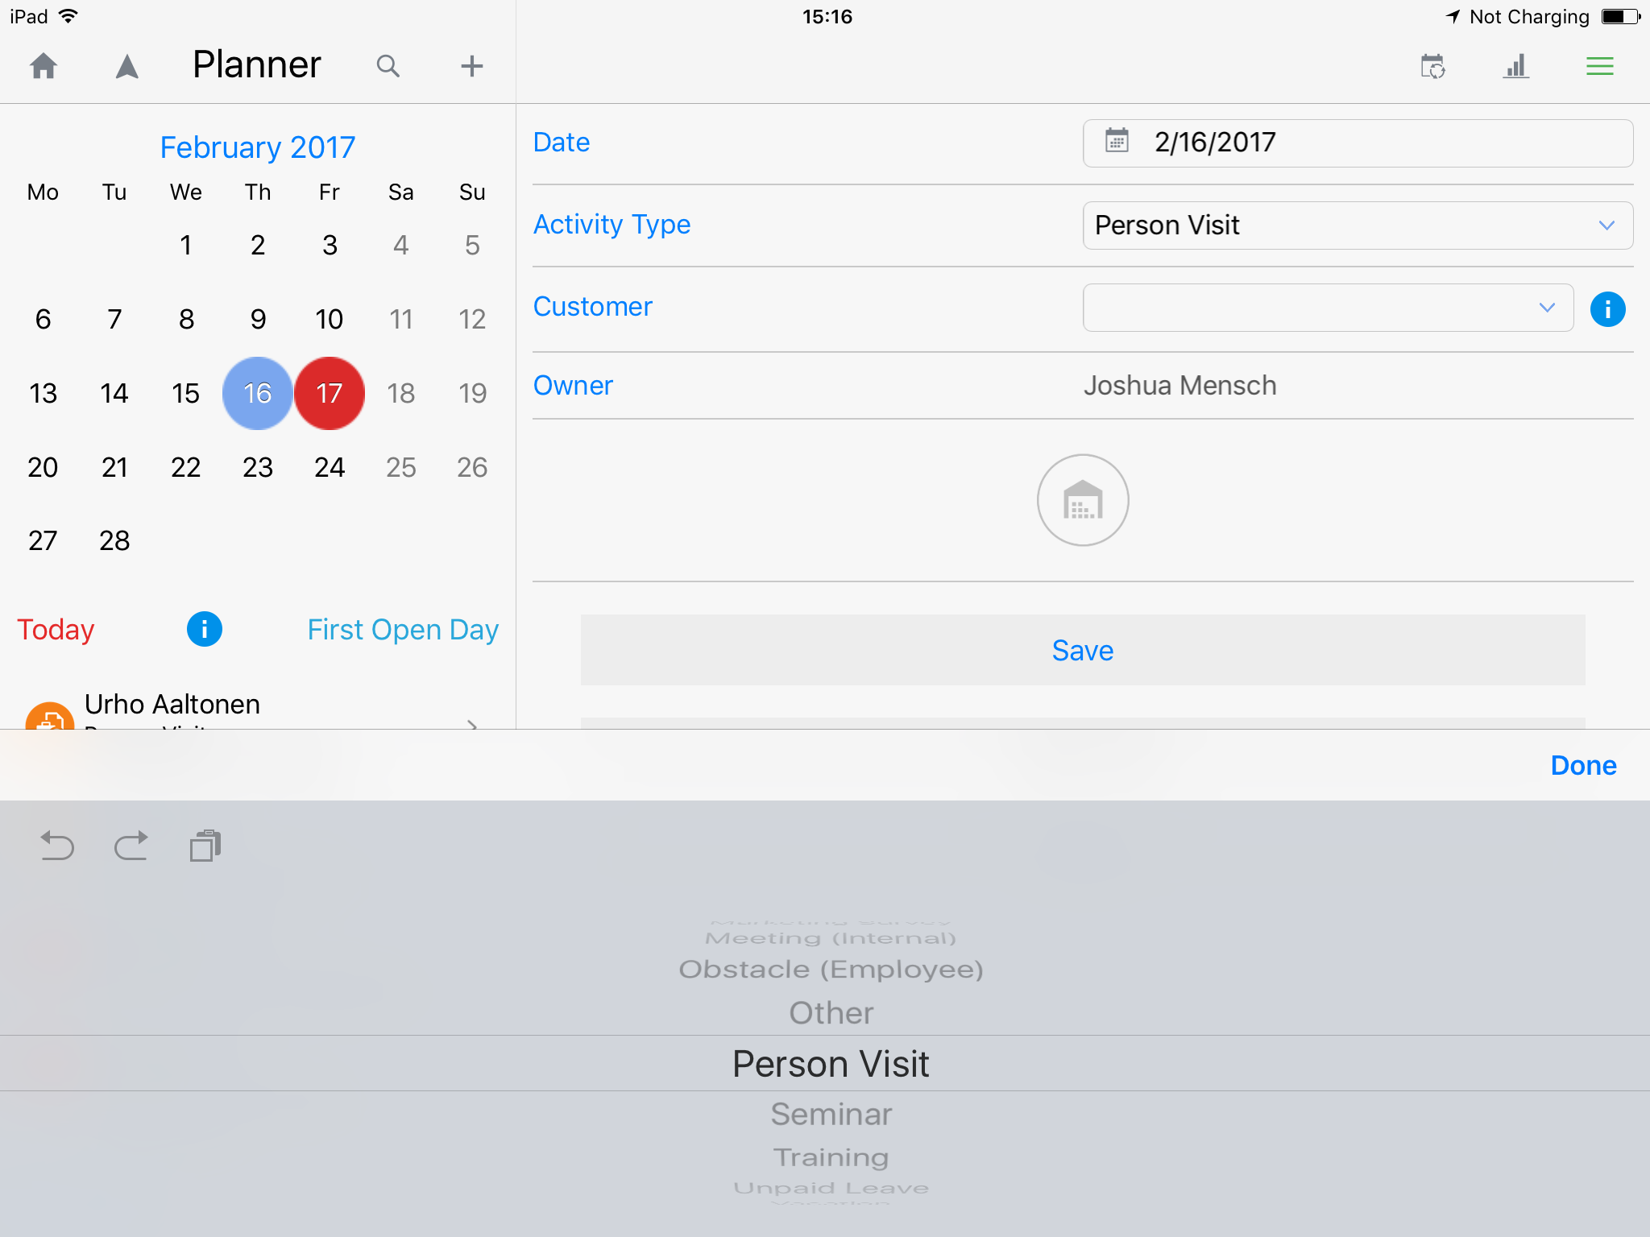
Inception CRM Call & Activity Planning
Supports a virtually unlimited range of activity types each with their own unique workflows and reporting processes
Includes a monthly calendar, daily activity list, cycle plan view, route maps, direct access to customer information (full customer card view), built-in analytics (activity overviews and statistics), all within a dynamic interface that adjusts according to selected conditions.
© 2017 D3S a.s.

Slide 13
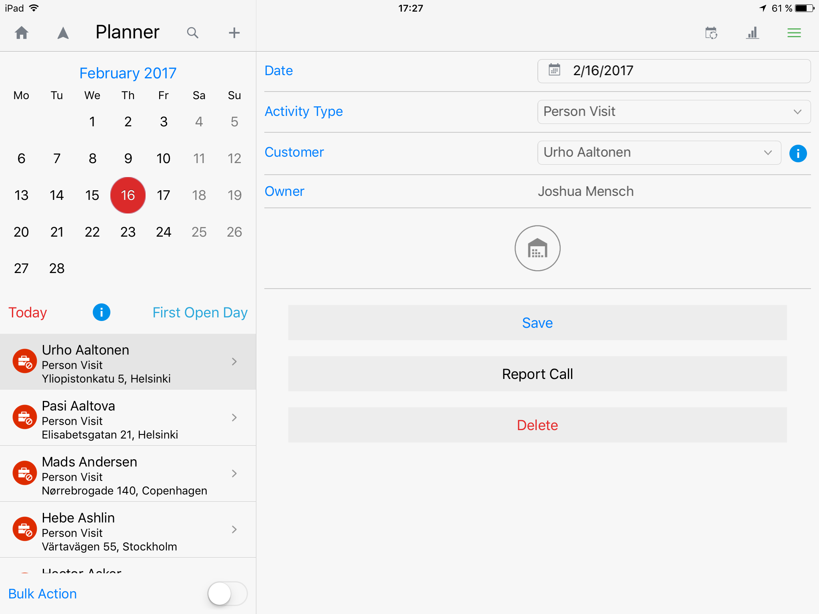
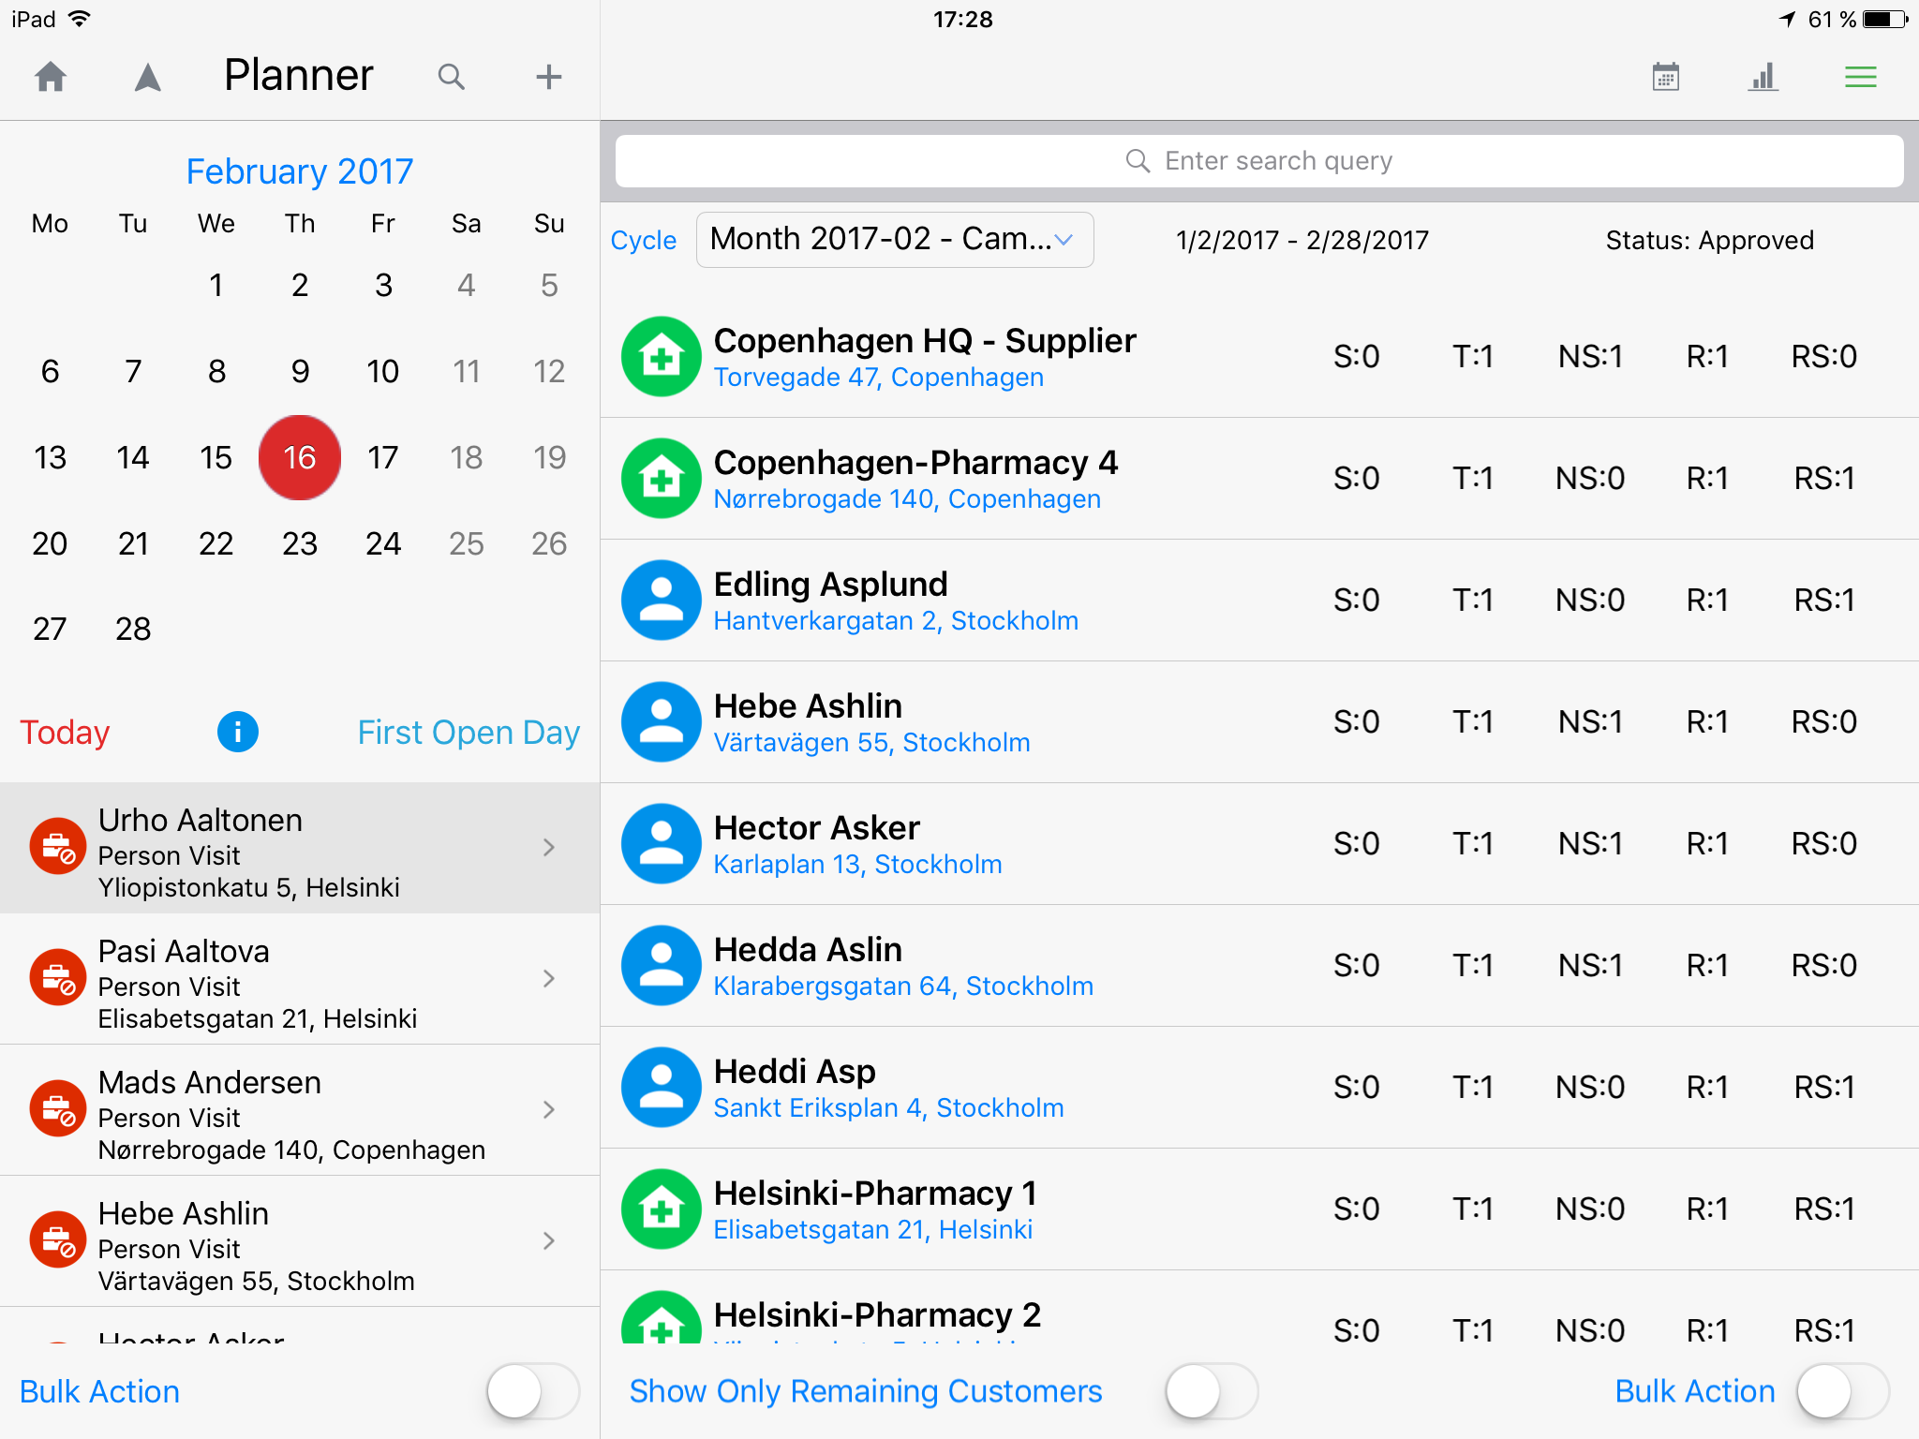
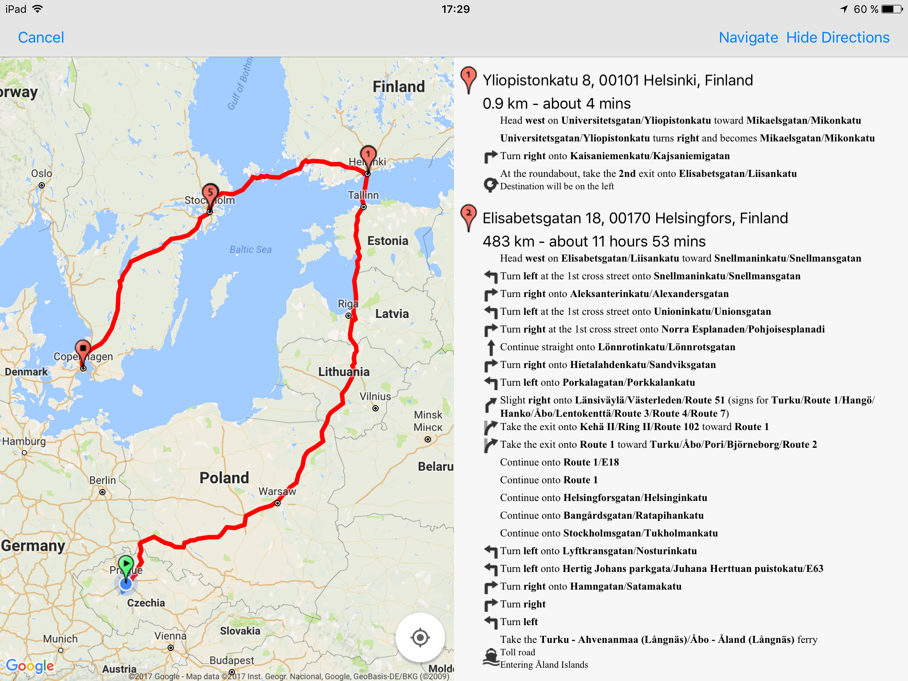
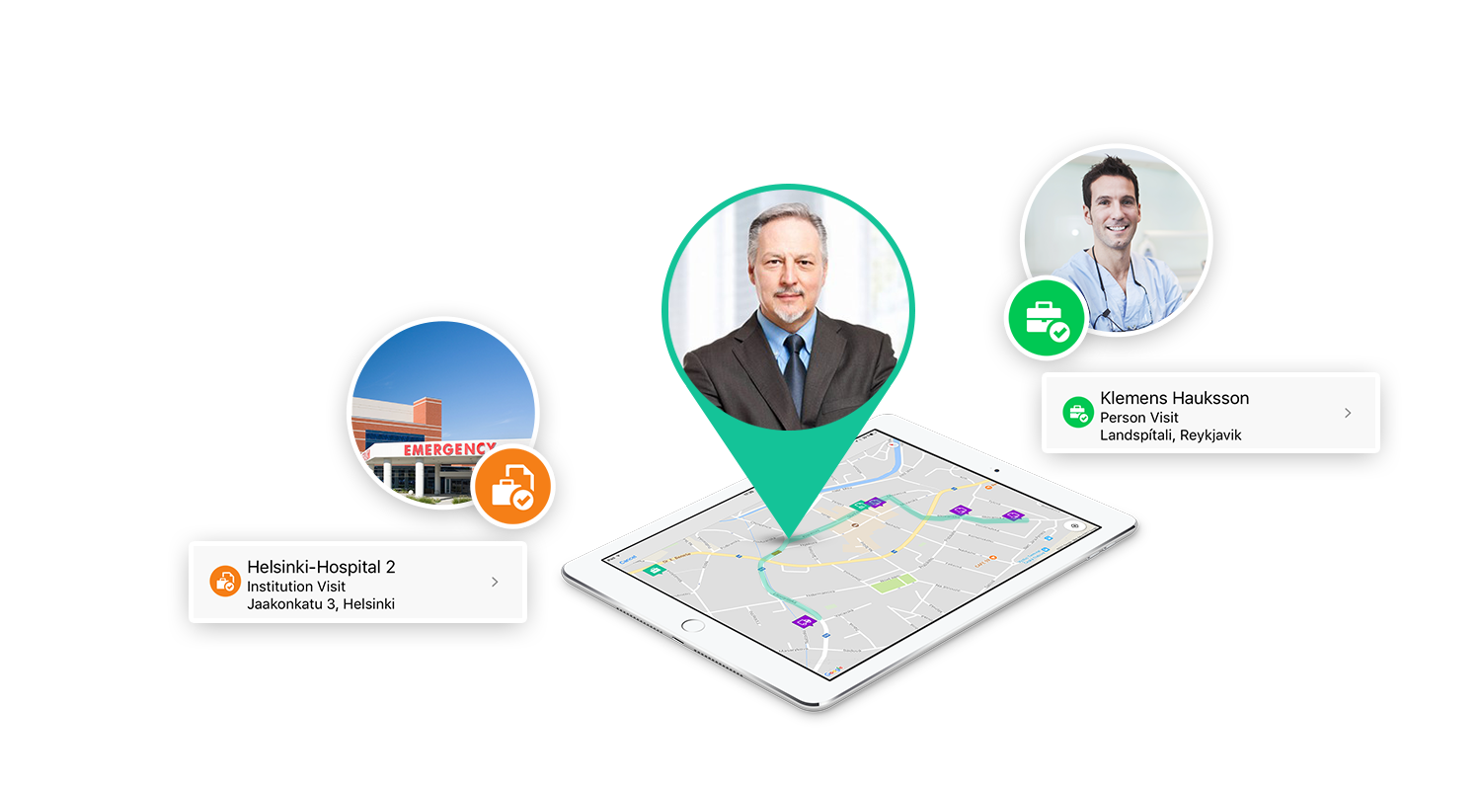
Inception CRM Call & Route Planning
PLAN and report a virtually unlimited range of activities, each with its own workflows and reporting requirements, according to your company’s demands, then optimize your routes using integrated Google Maps.
© 2017 D3S a.s.

Slide 14
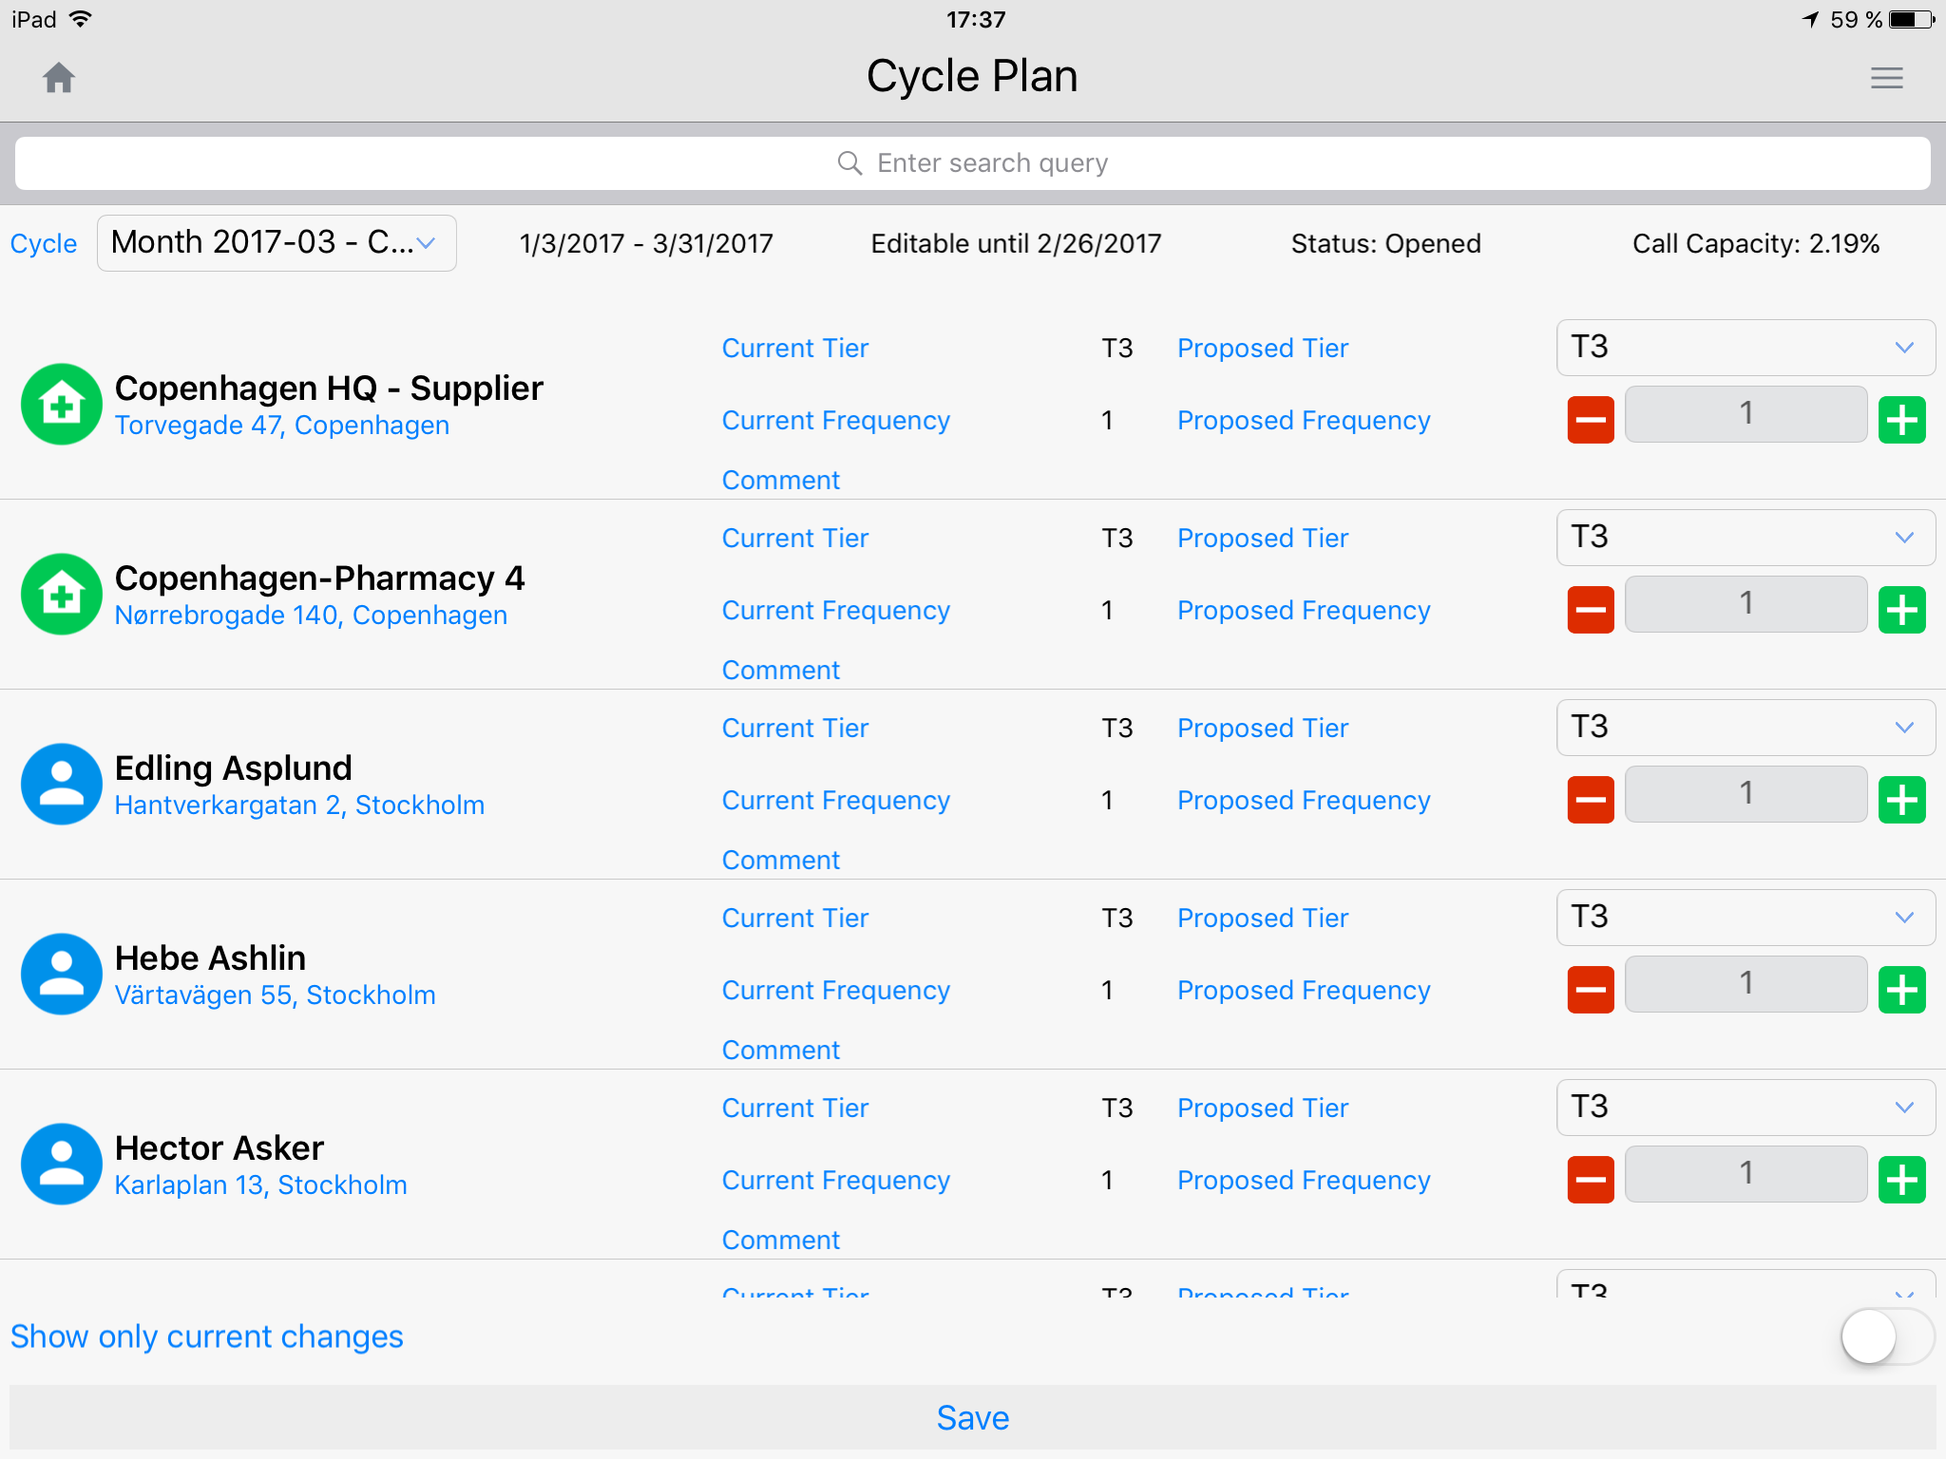
Inception CRM Cycle Planning & Target Management
PLAN period-specific campaigns with structured plans for sales and in-field marketing.
Cycle Plan transforms target lists into firm commitments based on customer frequency goals.
© 2017 D3S a.s.

Slide 15
Inception CRM Cycle Planning & Target Management
The Cycle Plan represents the plan of a specific Rep for his/her customer Target Group within a Cycle
A Target Group is defined as a sub-set of customers in a Rep’s database that (typically) represents the individuals with the highest potential for generating sales
The size of the Target Group reflects the call capacity of a Rep within a given Cycle (nTG x Total Frequency = Call Capacity)
A Cycle is a configurable business period – it can be a calendar month, business quarter, or other
Changes made to a Cycle Plan for one period (e.g. C1), once approved, are automatically inherited by the Cycle Plan for all subsequent periods (e.g. C2, C3, etc.) until changed again
Changes made to the Frequency and Tier of a specific customer, once approved, become permanent regardless of their disagreement with the official Tier-Frequency correlation
© 2017 D3S a.s.

Slide 16
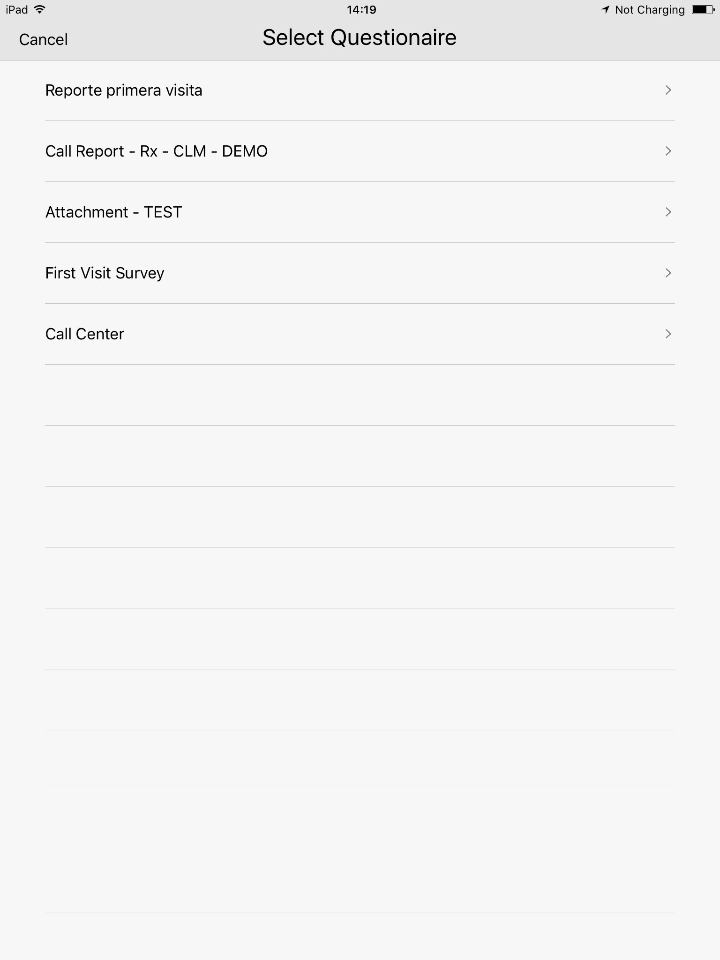
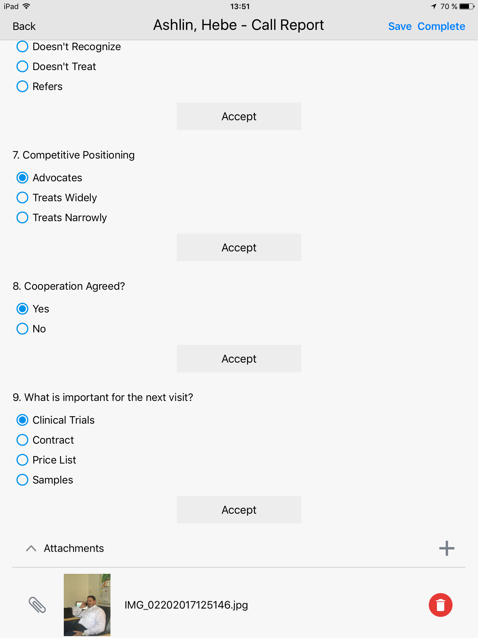
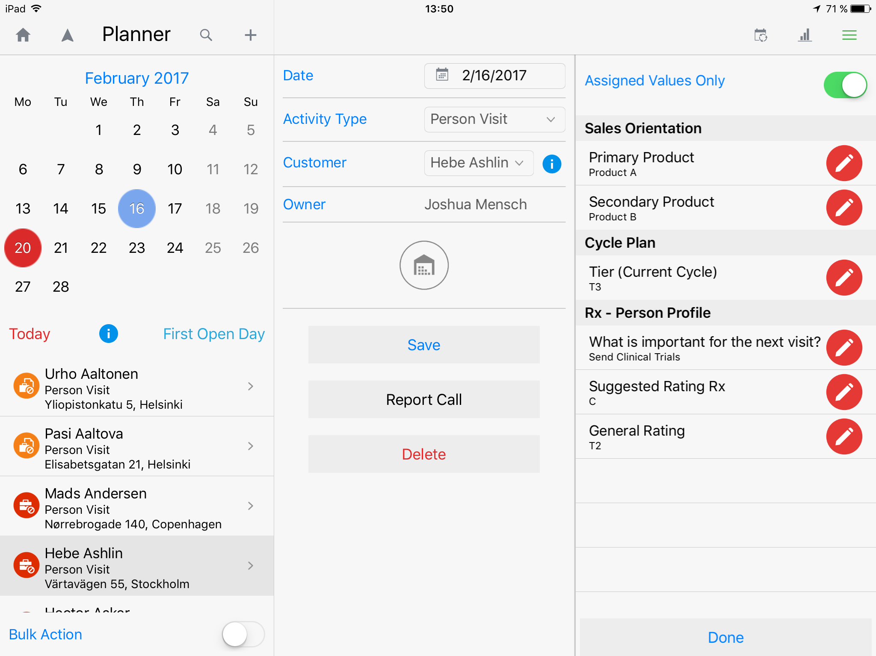
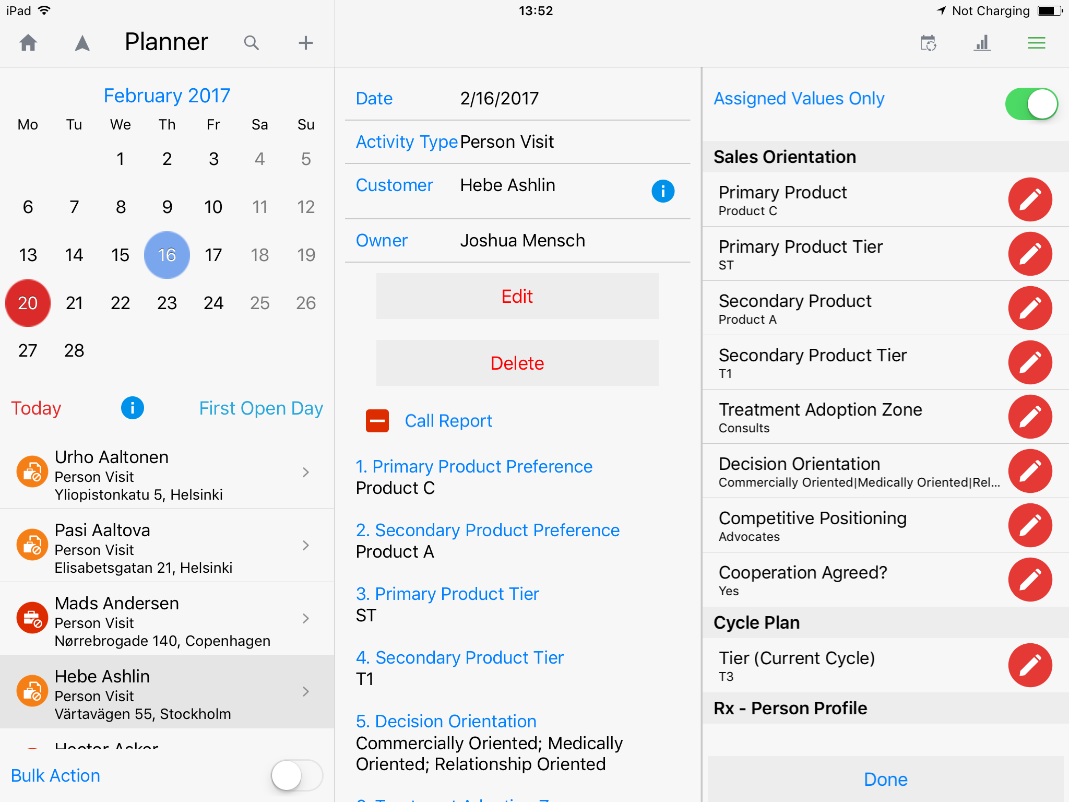
Inception CRM Call Reporting
Highly flexible approach allows for easy creation of multiple call report questionnaires that can be published simultaneously
Supporting multiple question types, call reports can function as guided questionnaires, quickly satisfying complex reporting goals
The system can automatically offer the most appropriate questionnaire according to customer status or relationship progress
Questionnaires can capture data used across the system, such as profiles, which are automatically recorded based on answers
PROFILES are automatically captured and recorded during call reporting and stored in the Profiles section of the customer’s card. PHOTOS can also be captured as evidence of visits.
© 2017 D3S a.s.

Slide 17
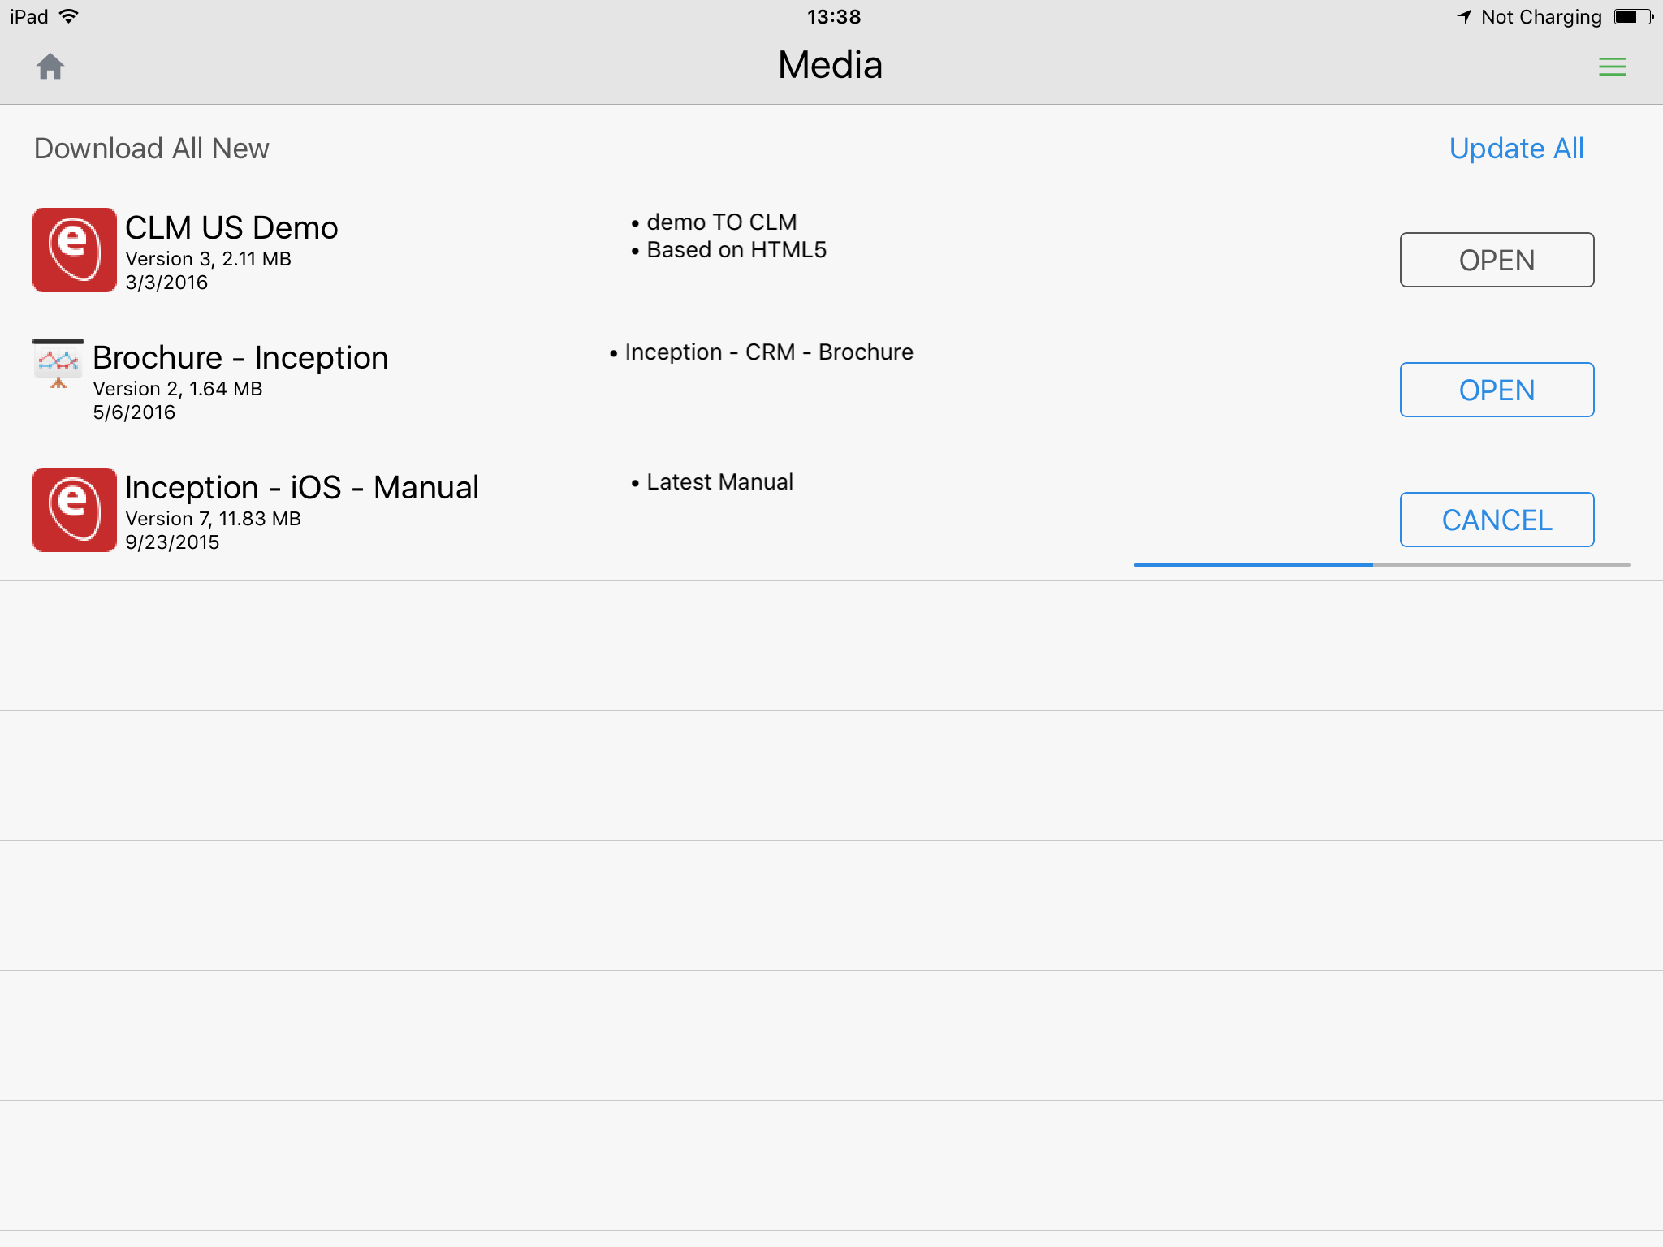
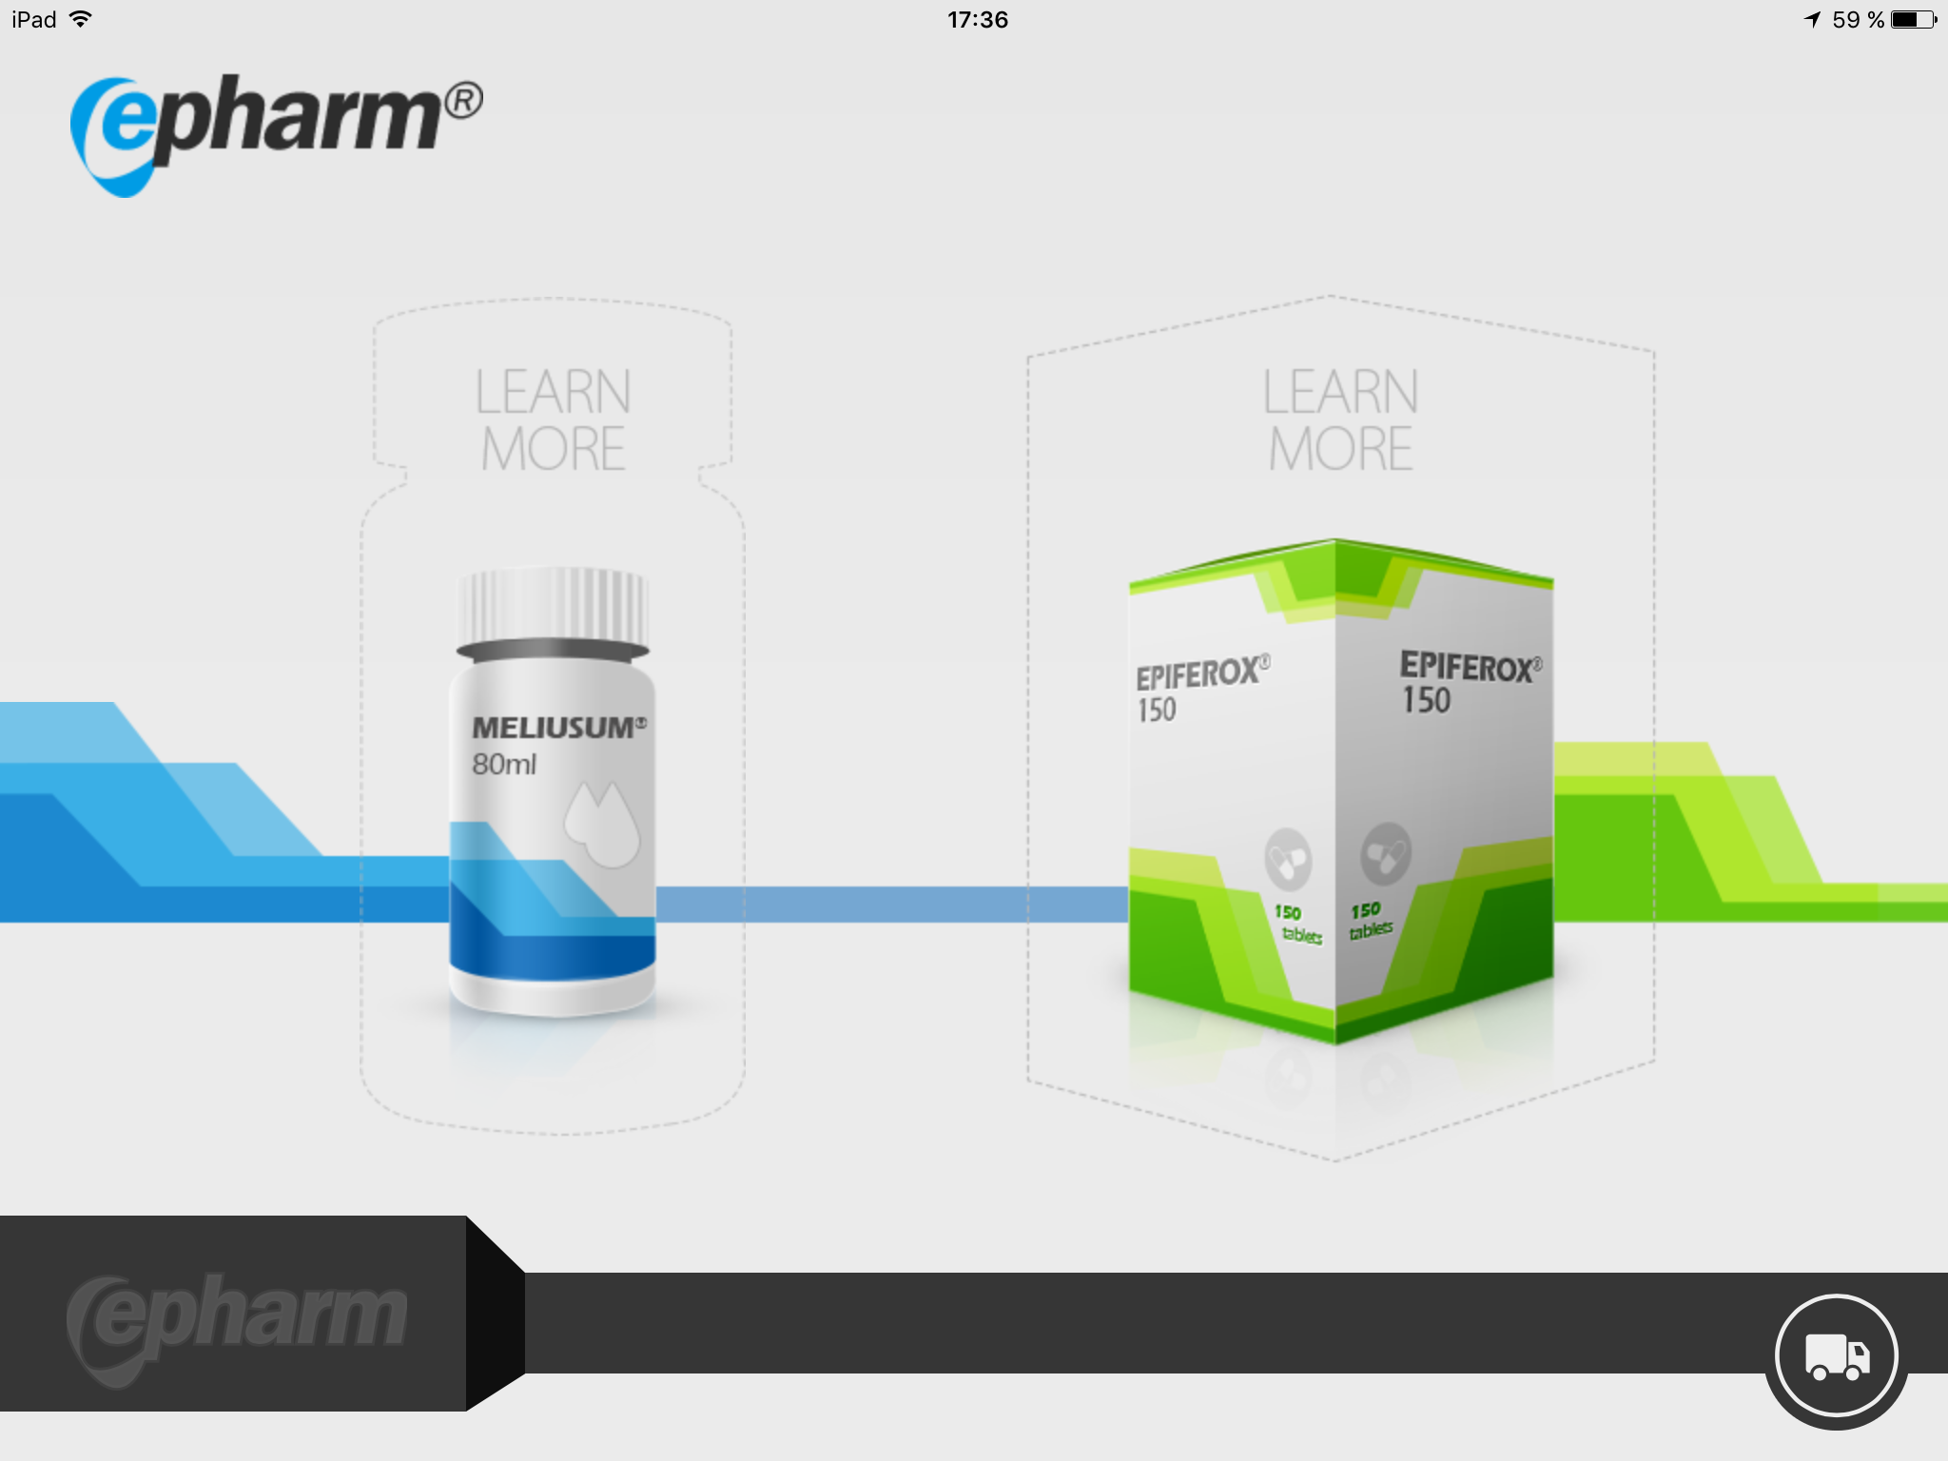
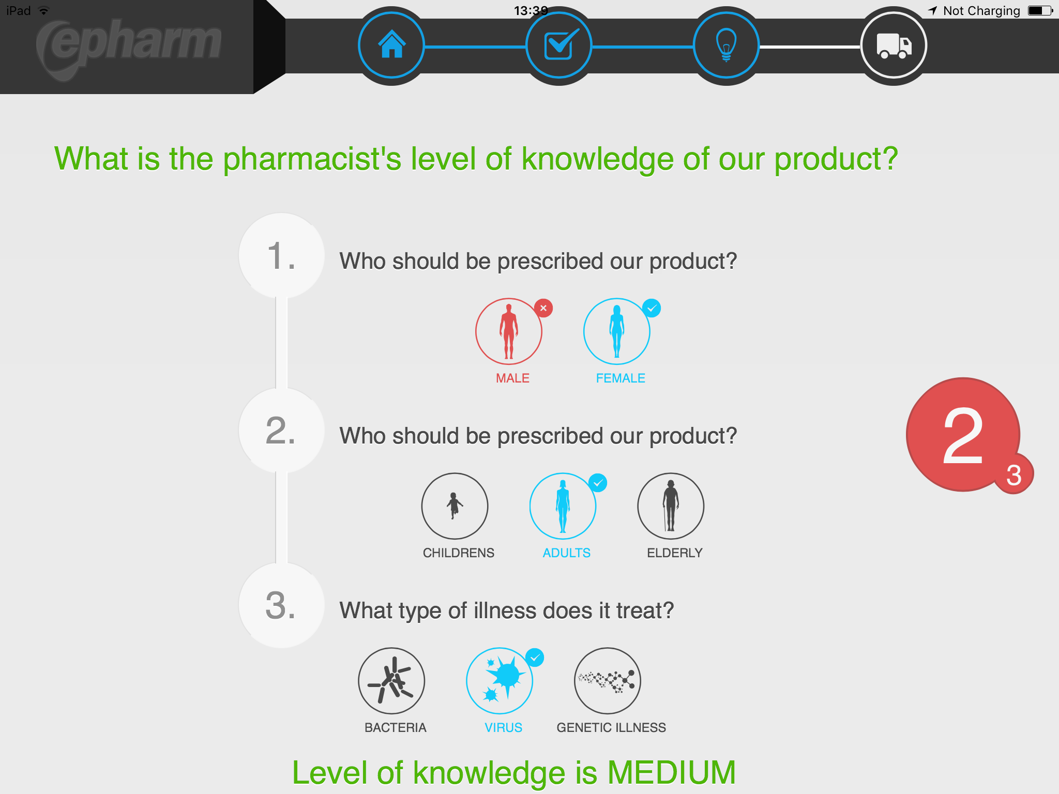
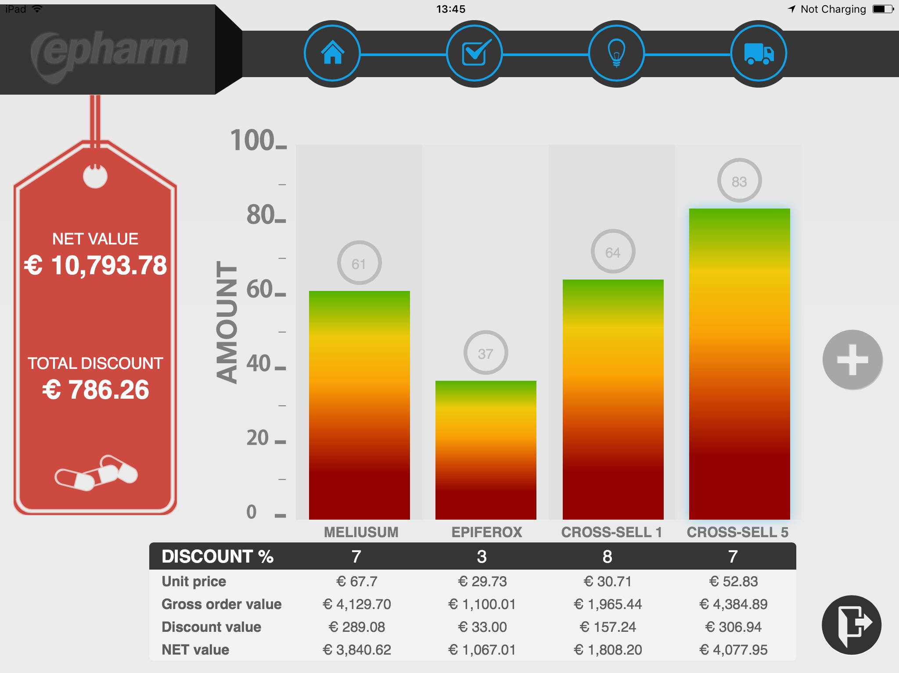
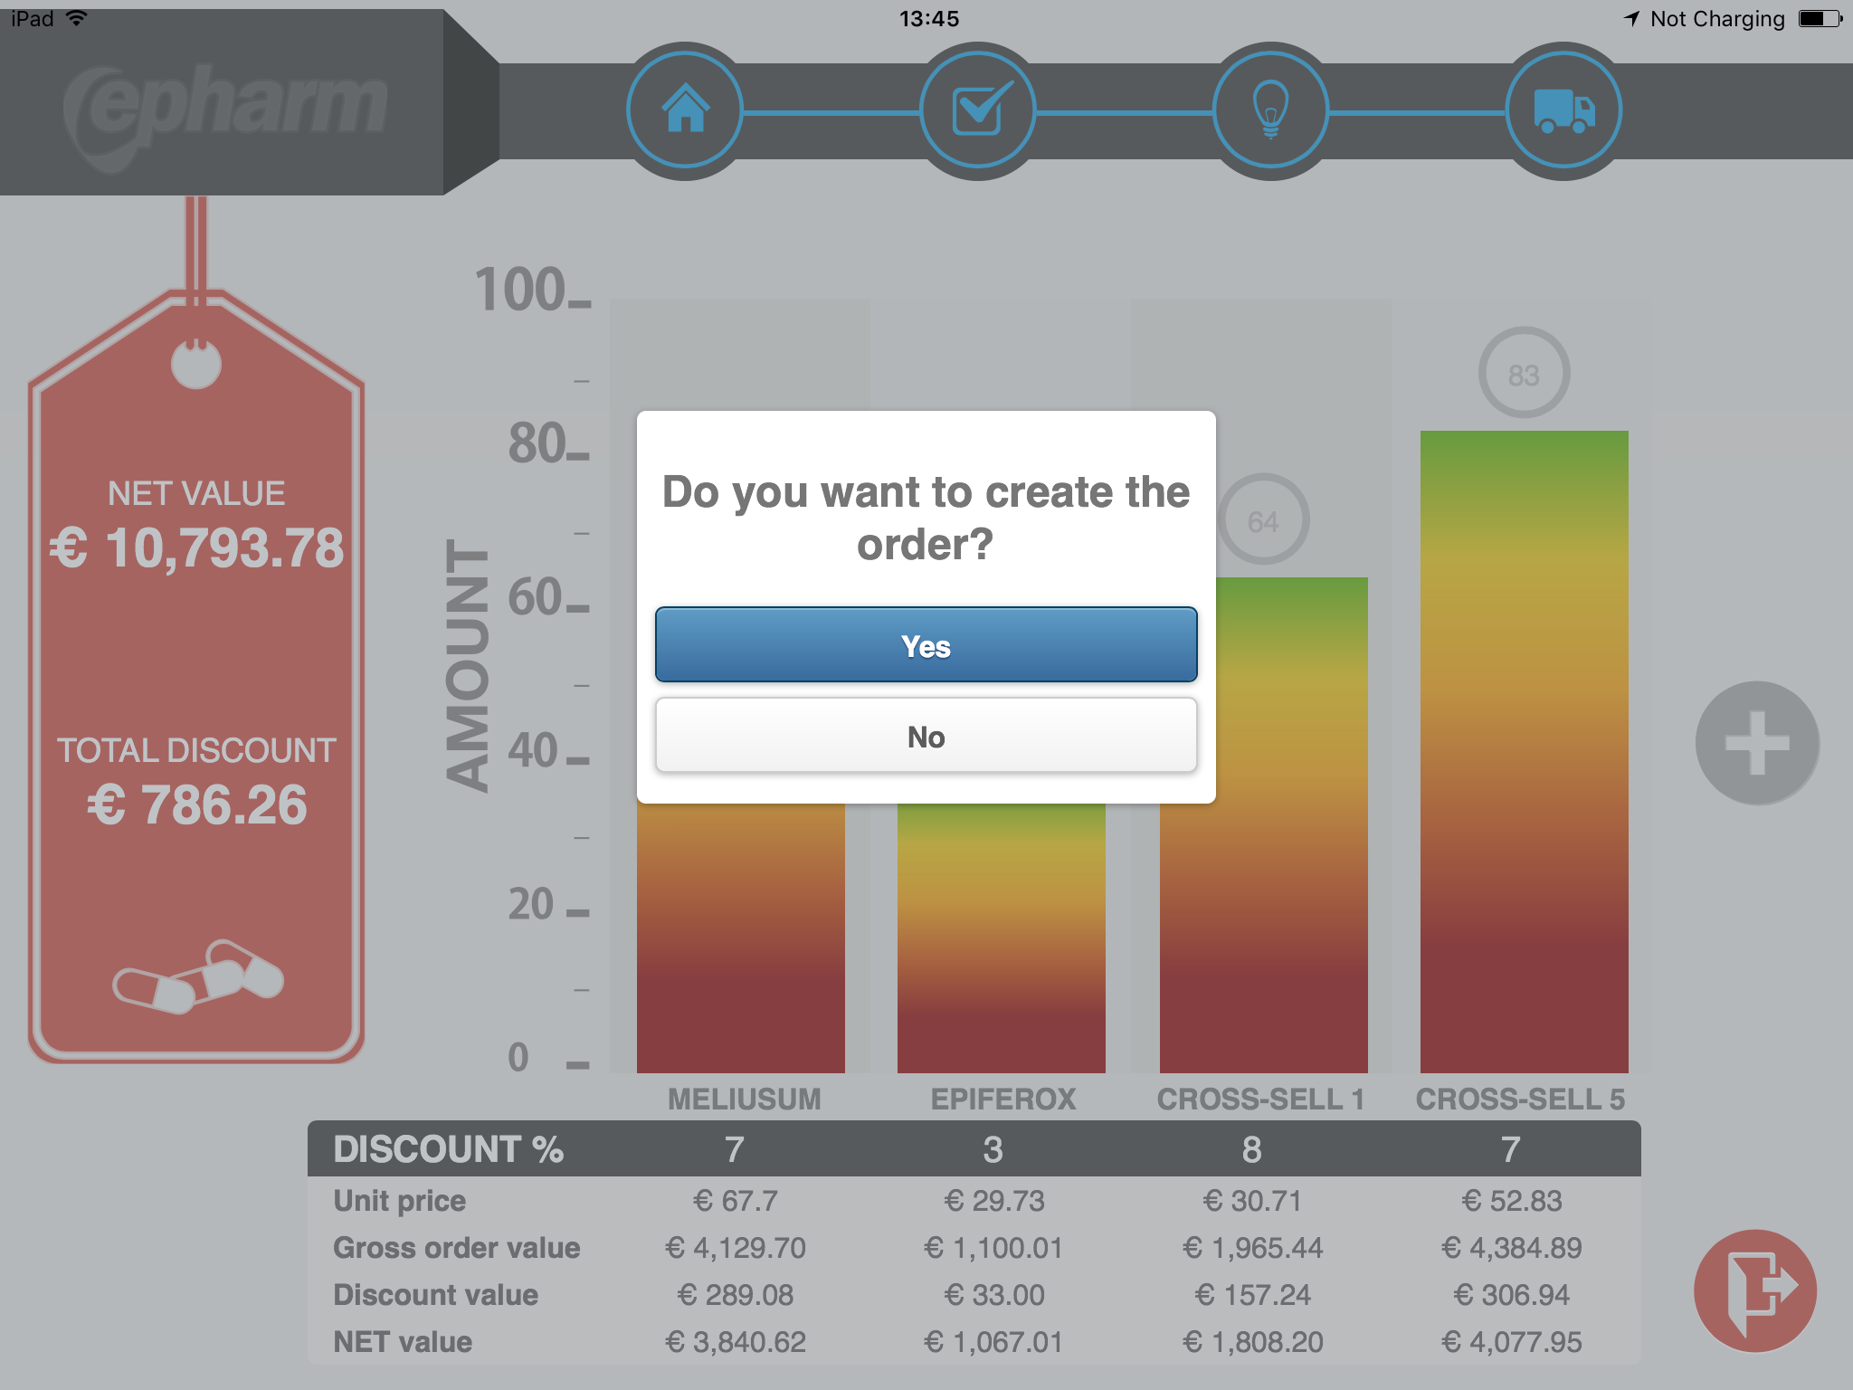
Inception CRM Media & Closed Loop Marketing
MEDIA is a built-in “app store” and publishing engine that supports a wide range of multimedia content, from approved docs and training materials to promo videos and interactive HTML5 CLM presentations. Reps access only the latest approved content. When used to streamline workflows and reporting, CLM presentations can be used to complete call reports, record sample/promo drops, and create orders. BI Analytics integration supports robust data capture for management dashboards and drilldown reports.
© 2017 D3S a.s.

Slide 18
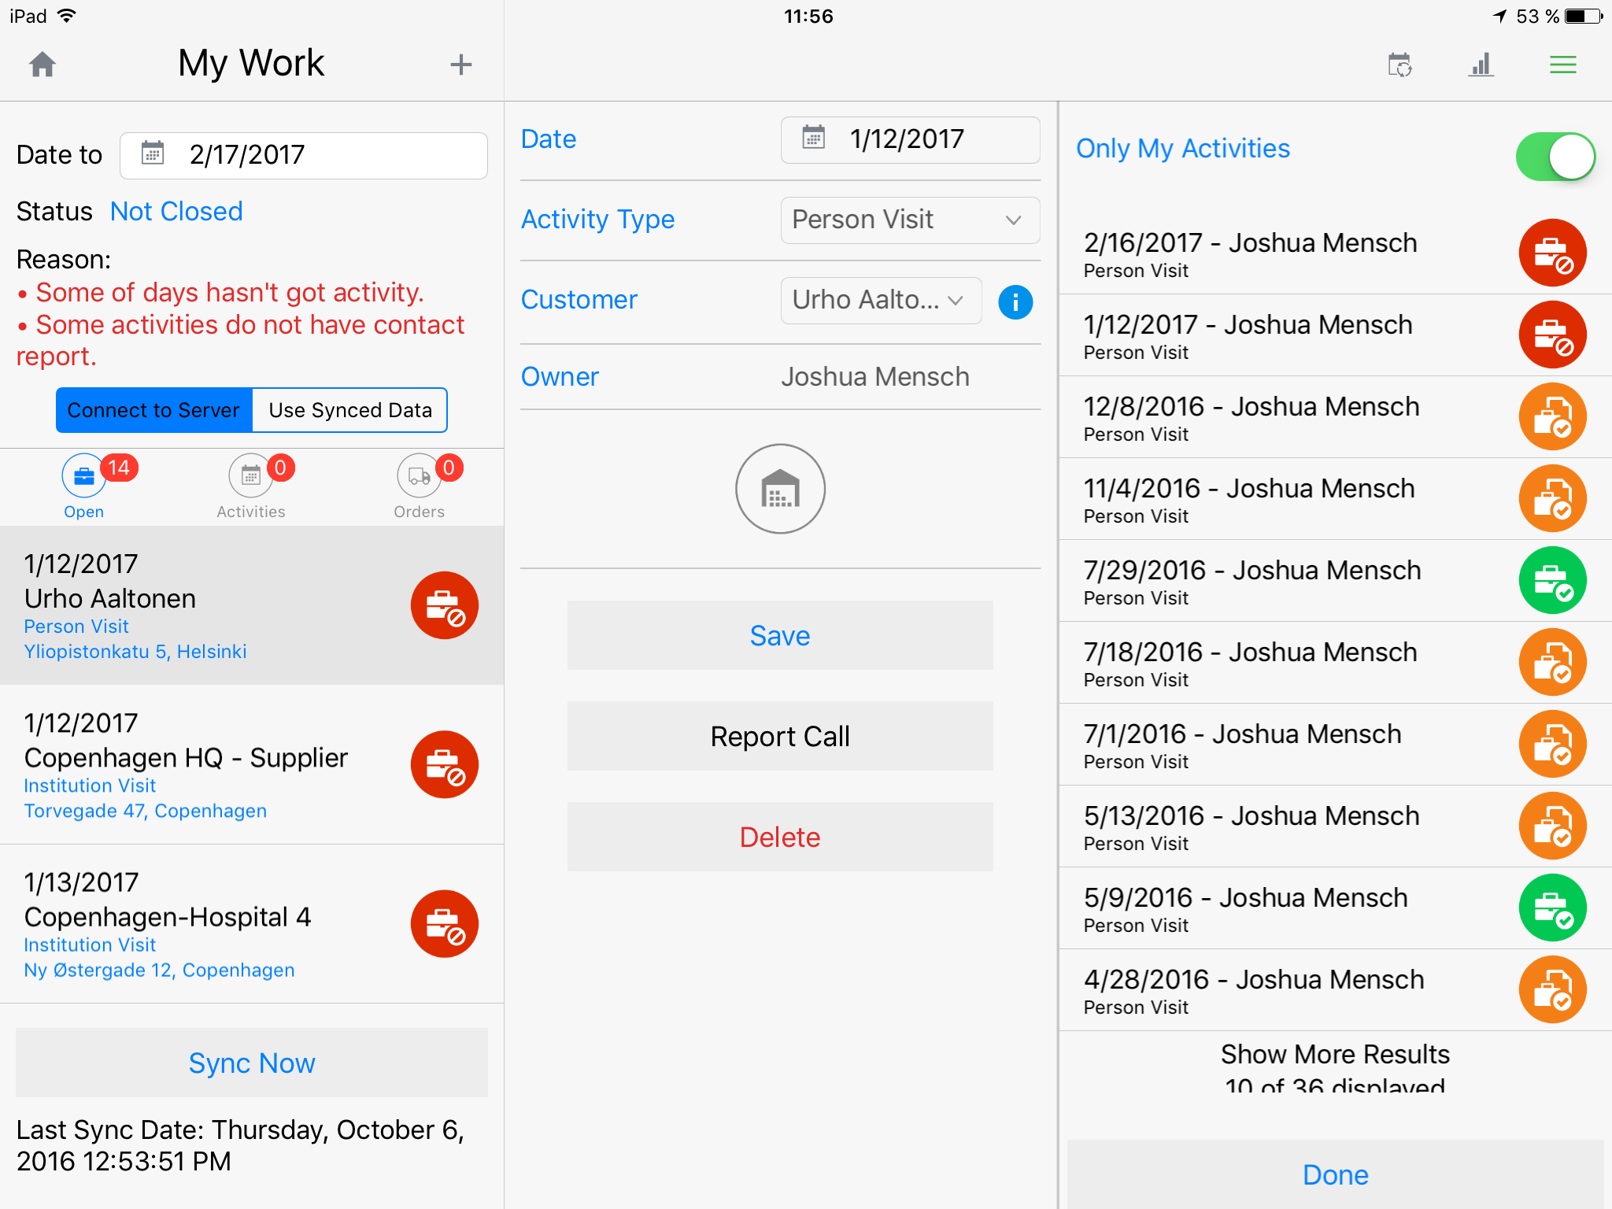
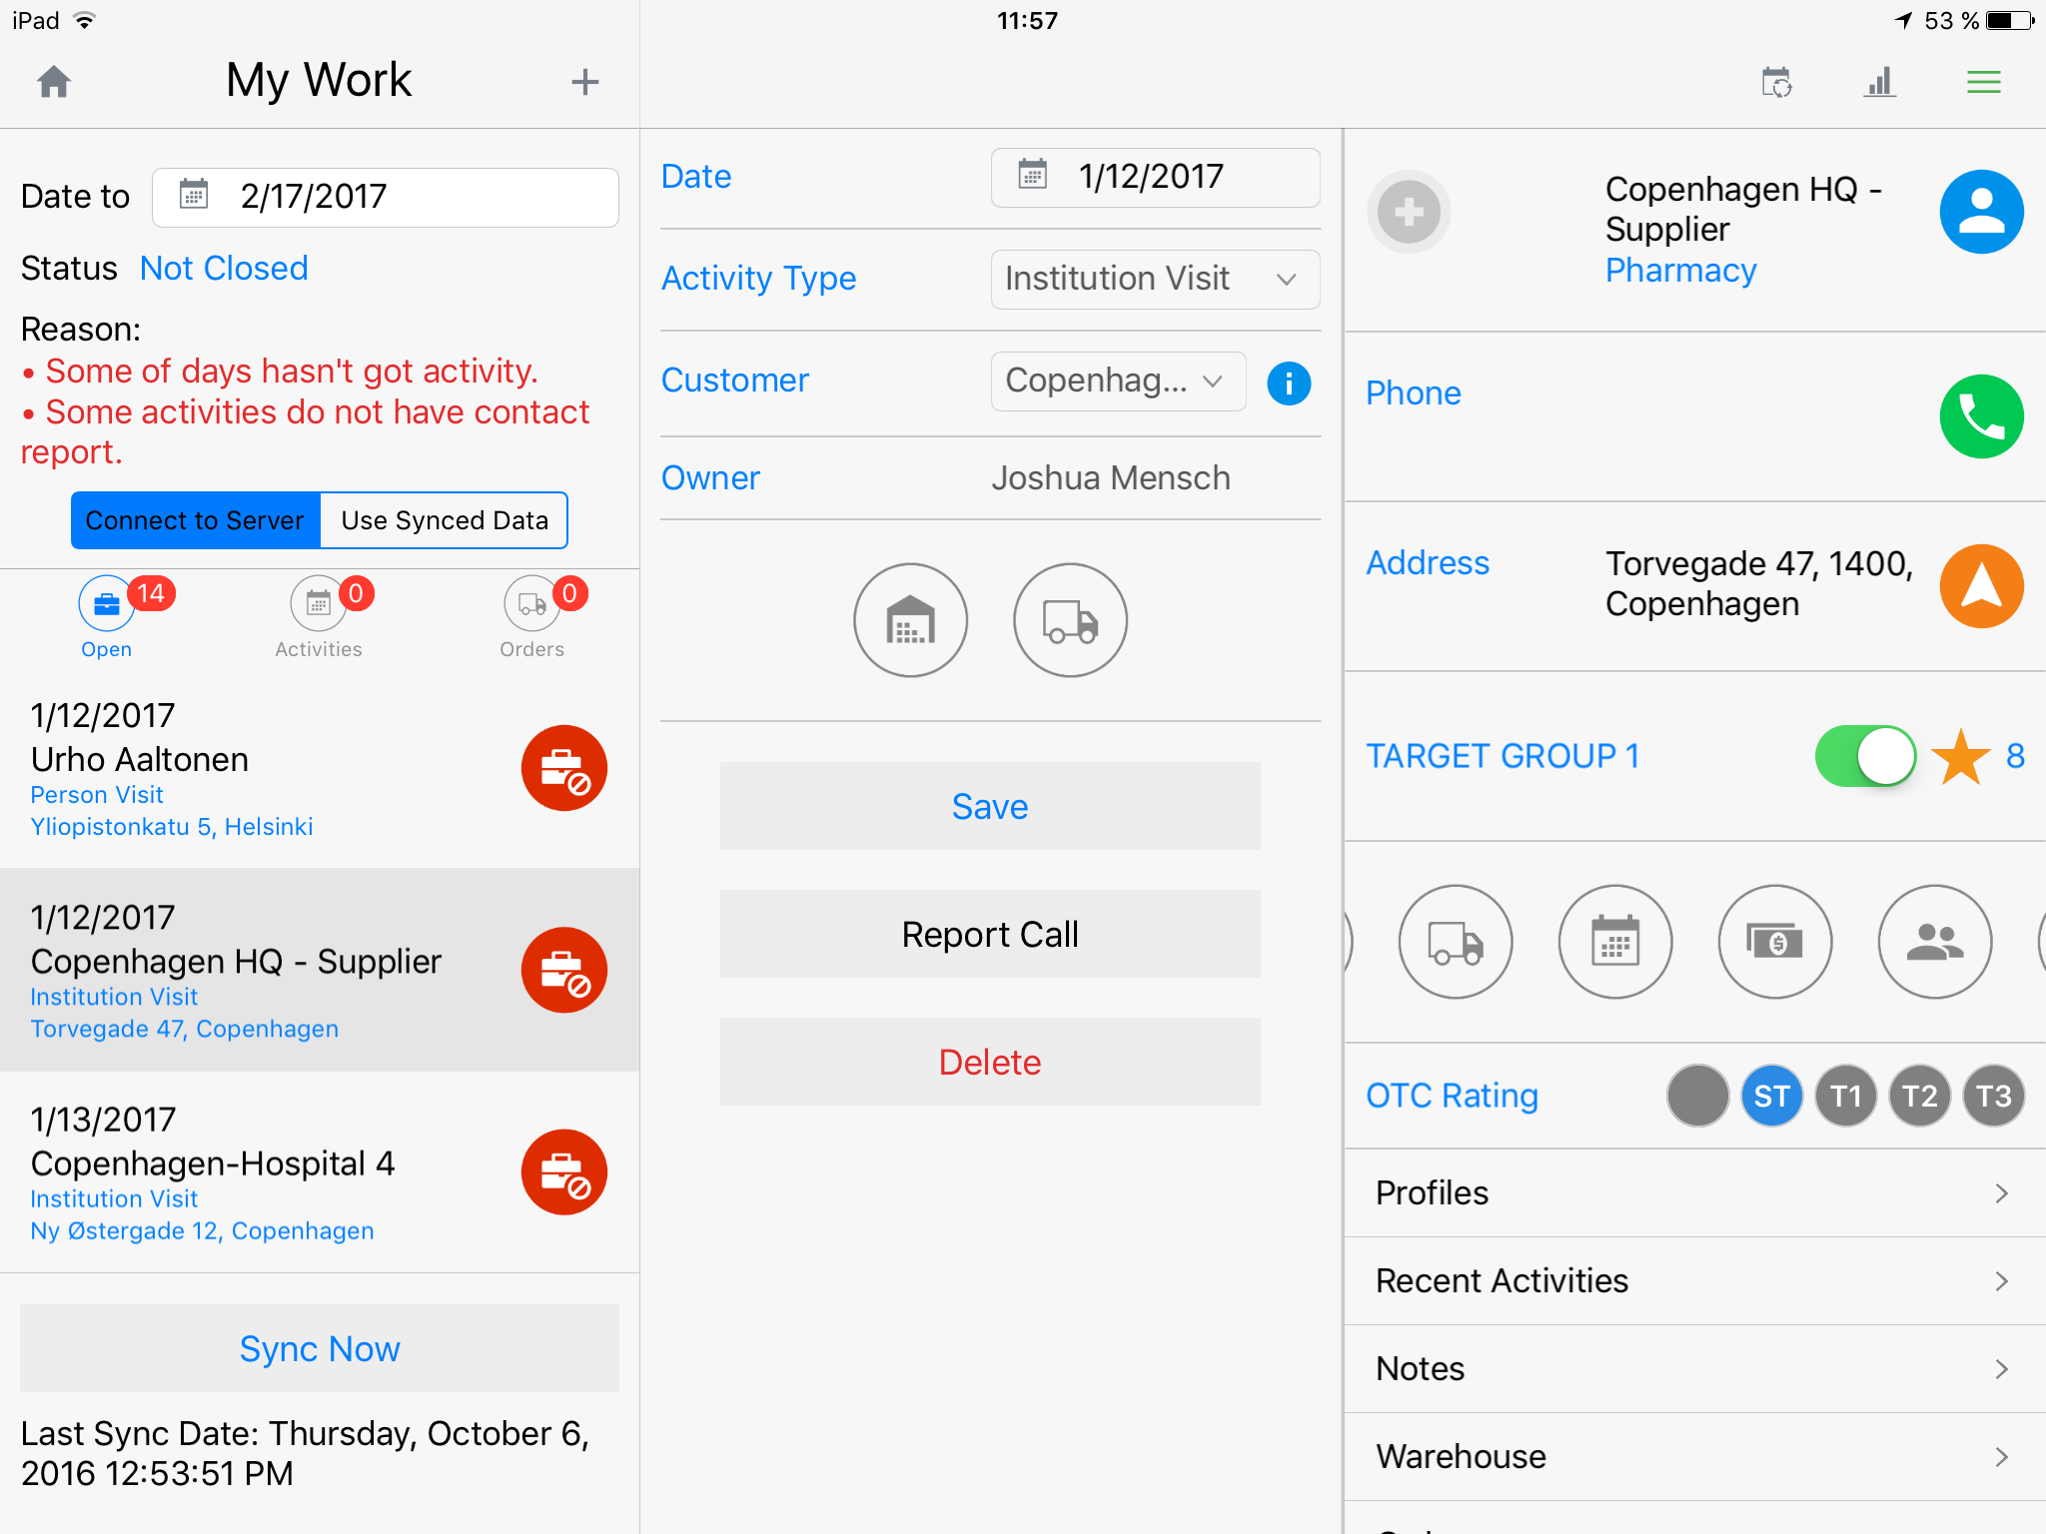
Inception CRM My Work (Tasks)
MY WORK puts all unfinished and pending tasks in one place, giving users the ability to quickly catch up on responsibilities – even when the device is offline – and complete their objectives for the day.
© 2017 D3S a.s.

Slide 19
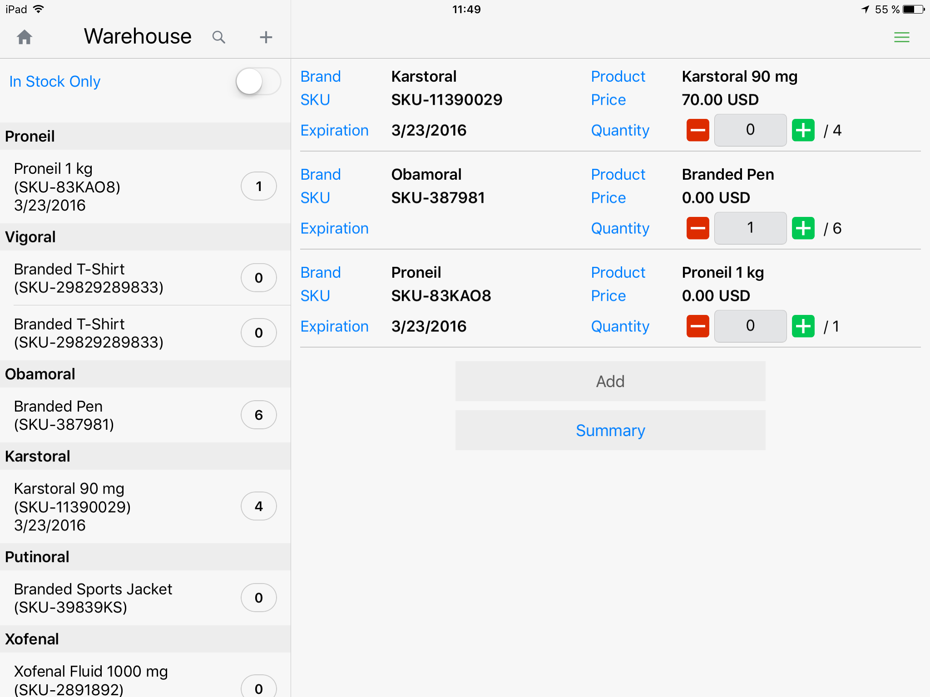
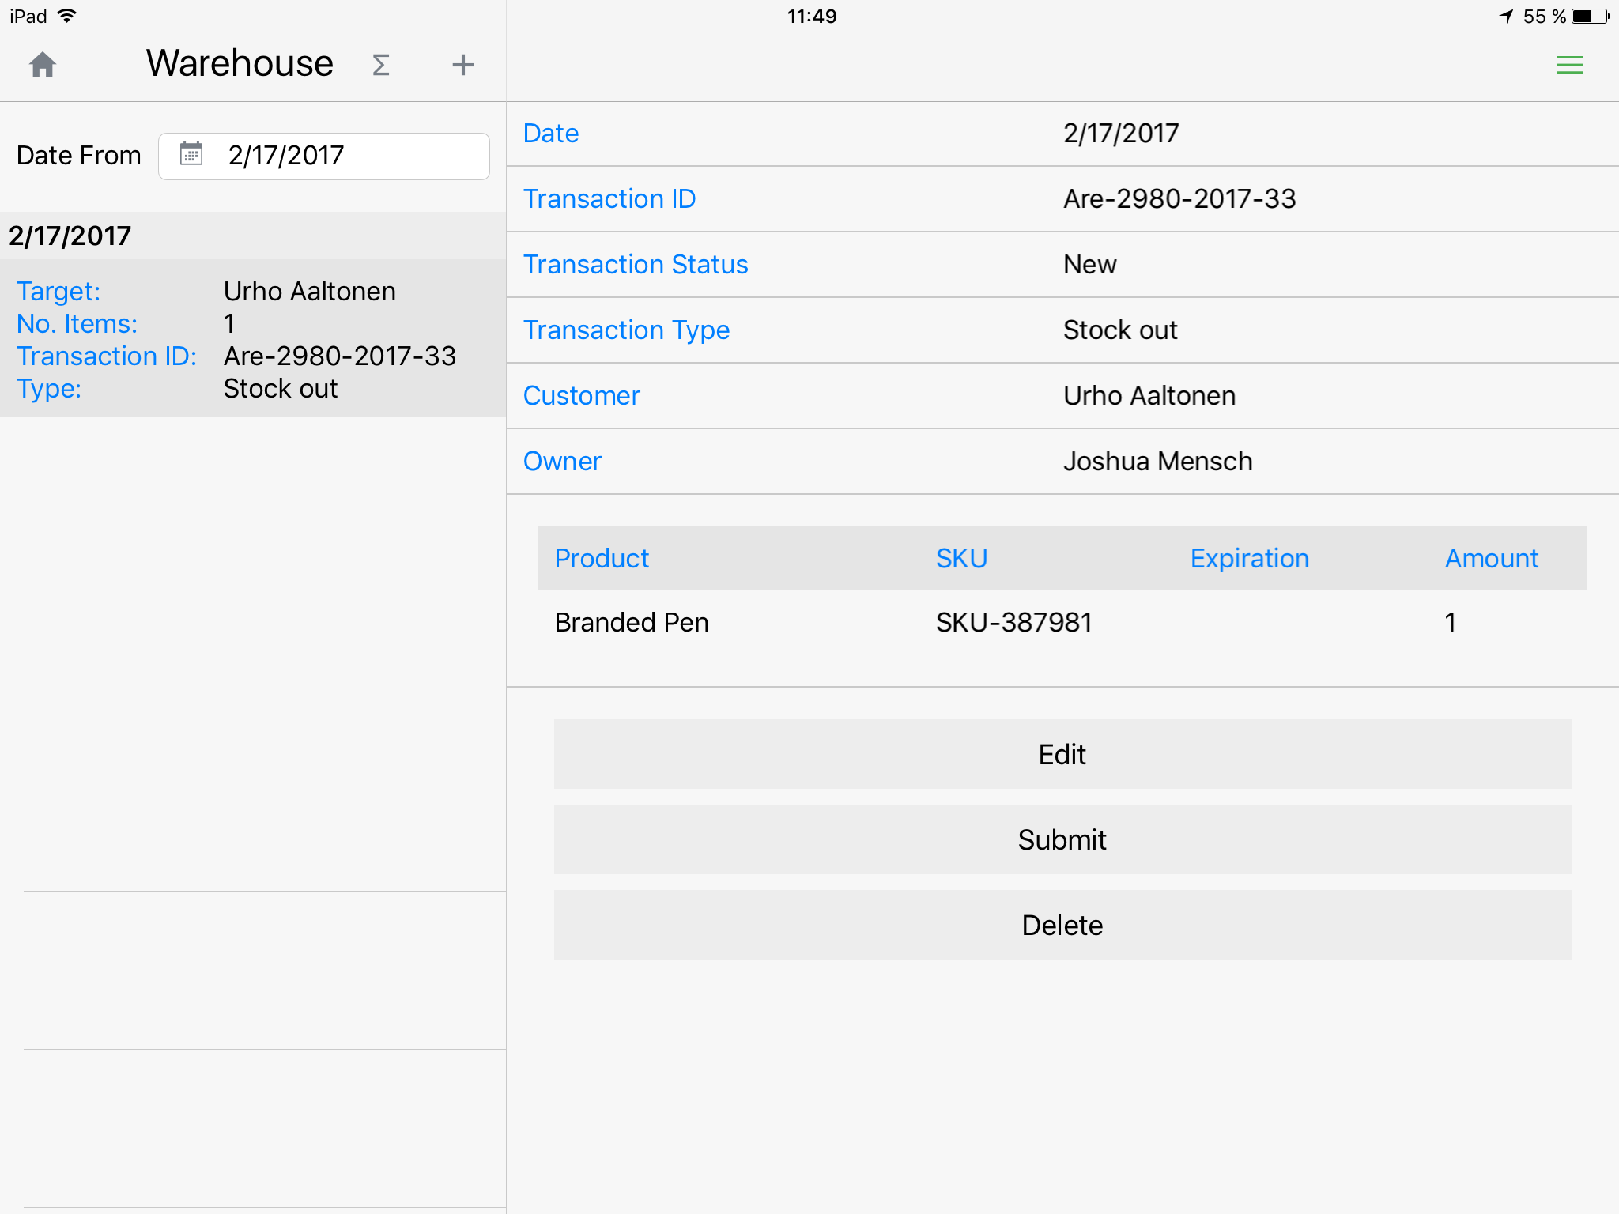
Inception CRM Sample & Promo Drop Management
STOCK management for ensuring compliant distribution and use of samples and promotional goods, as well as keeping track of your promotional spend.
© 2017 D3S a.s.

Slide 20
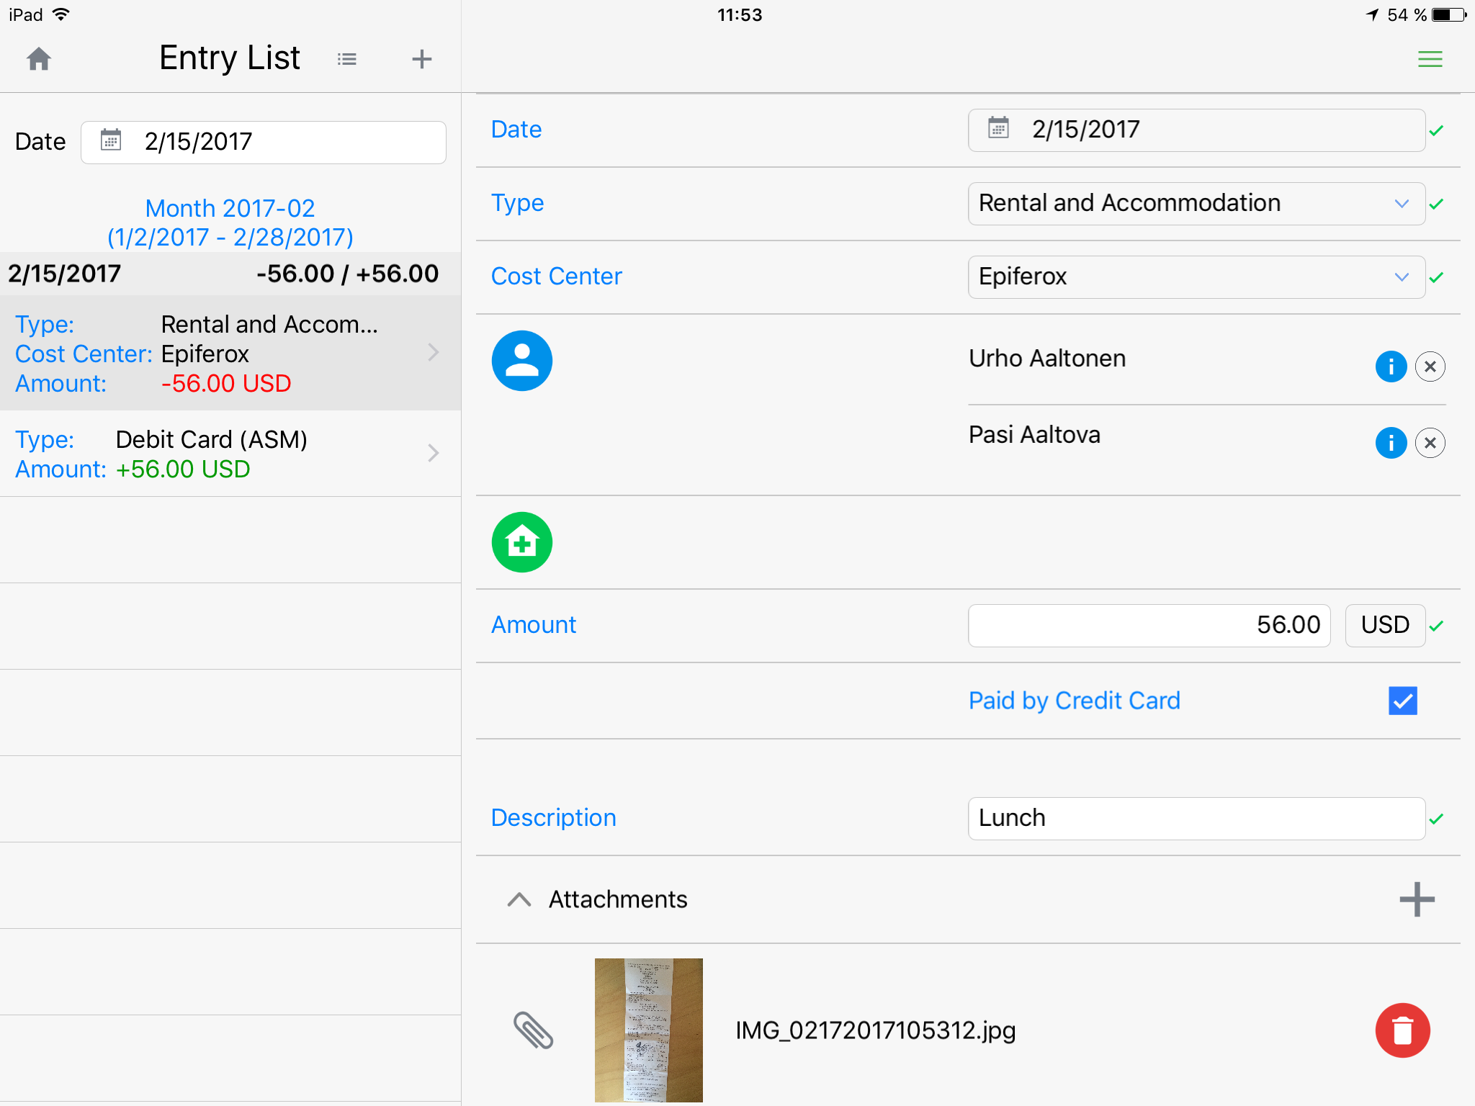
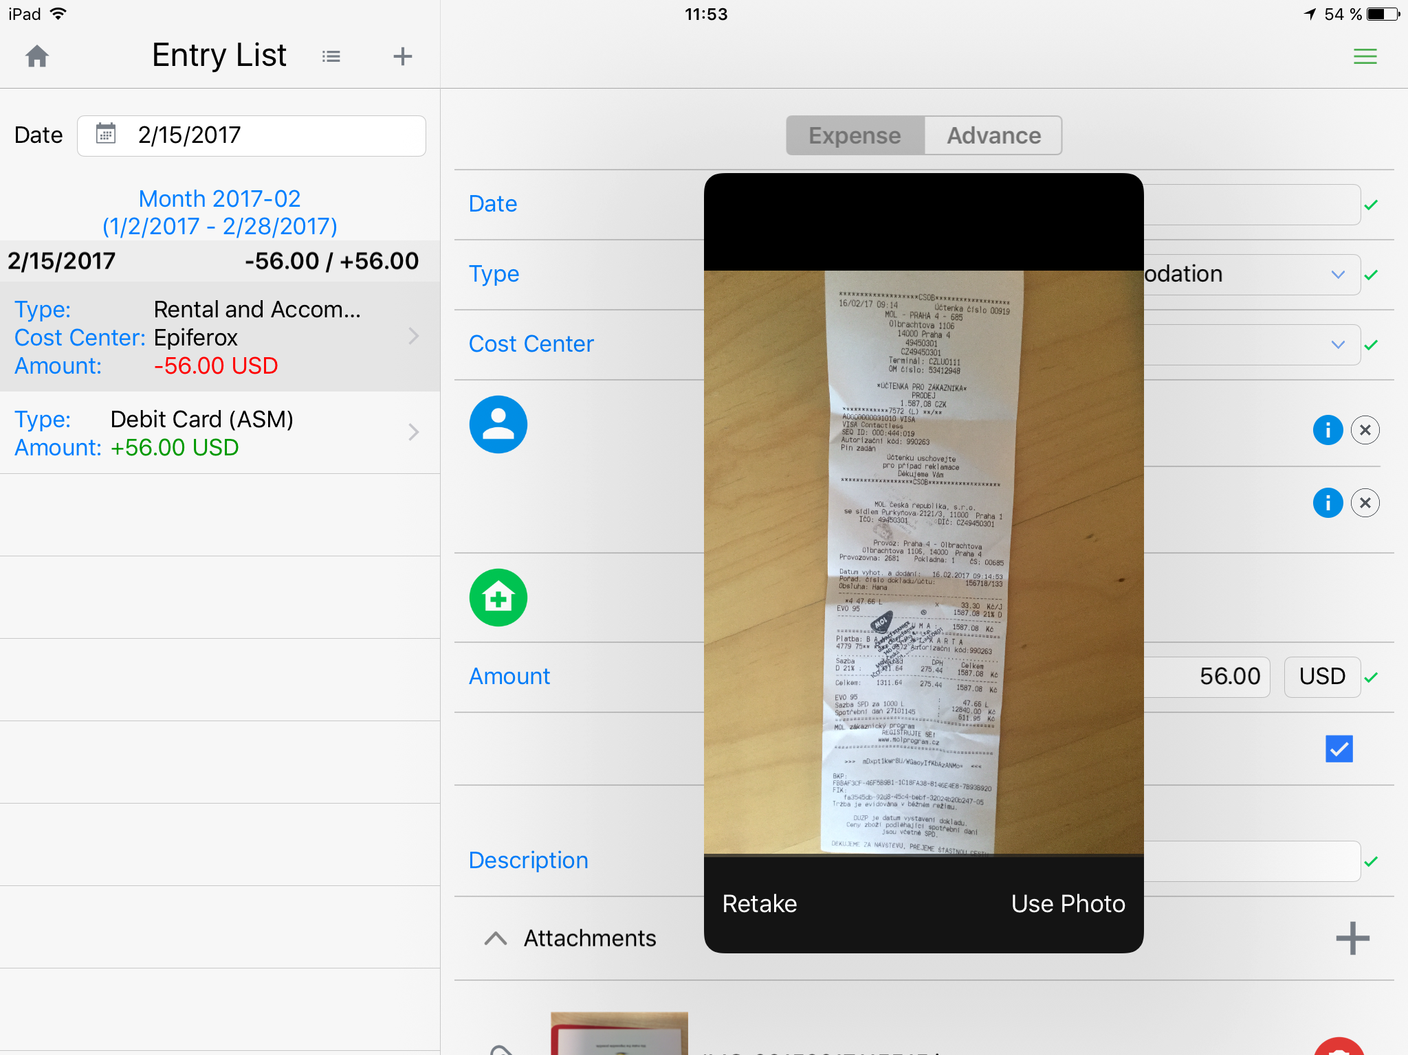
Inception CRM Expense Reporting
EXPENSES are easily recorded and sent to accounting for real-time monitoring of field sales costs, supporting balanced, effective field sales budgets and timely reimbursements to reps.
© 2017 D3S a.s.

Slide 21
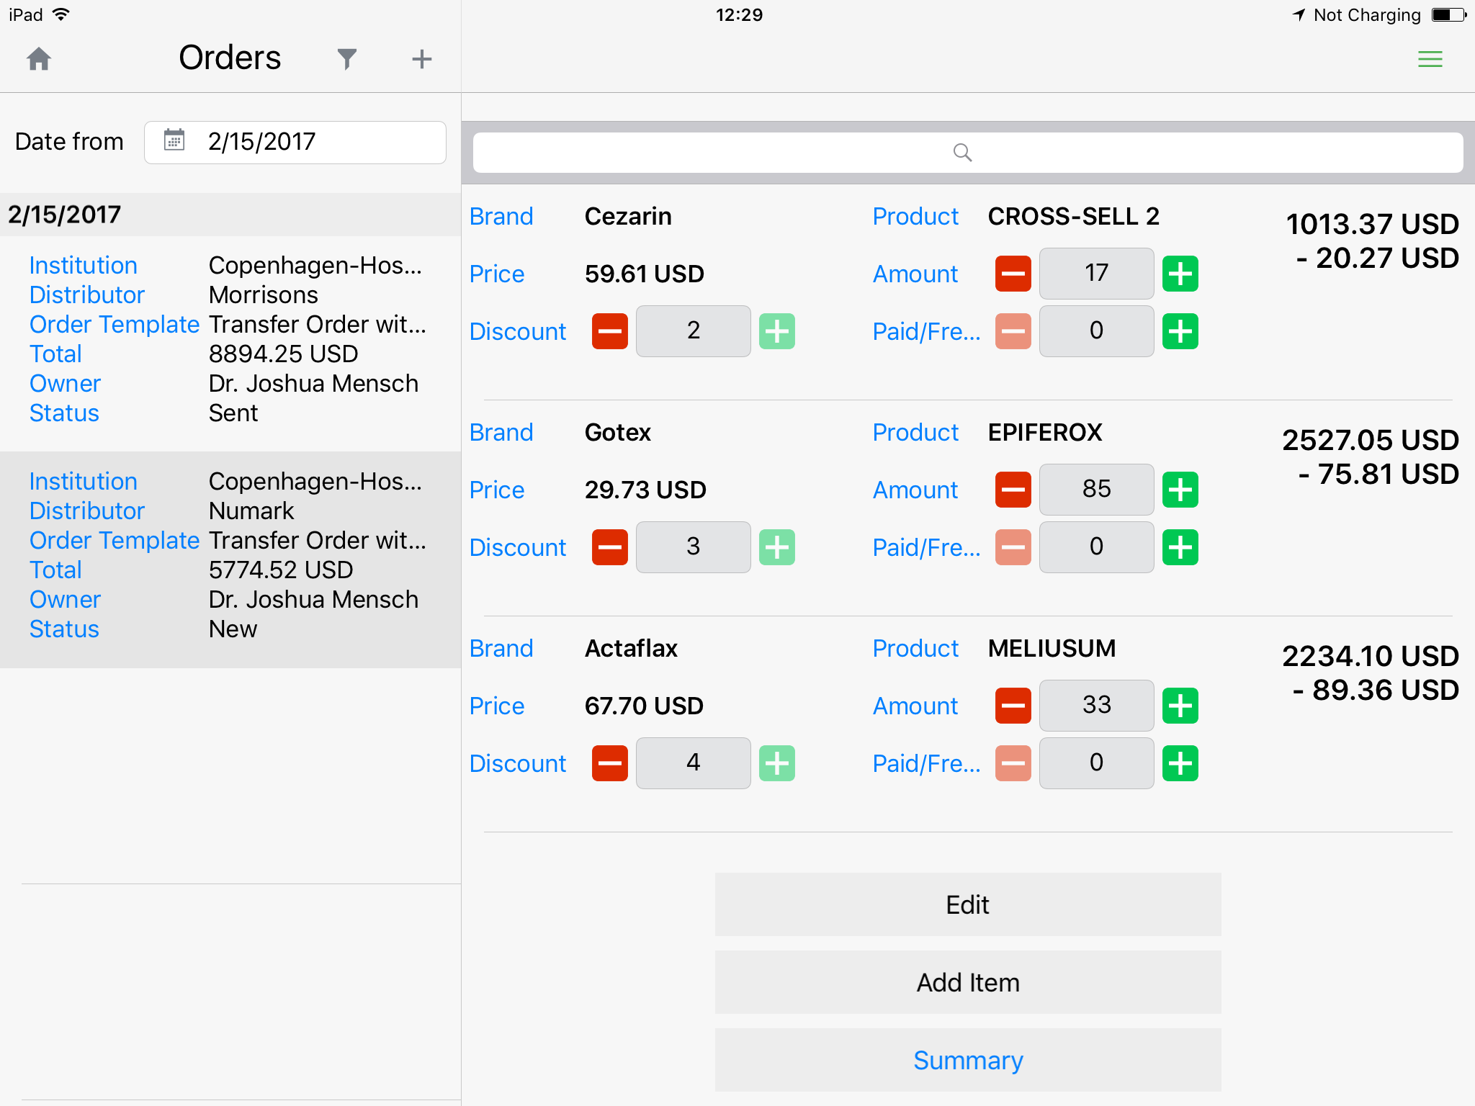
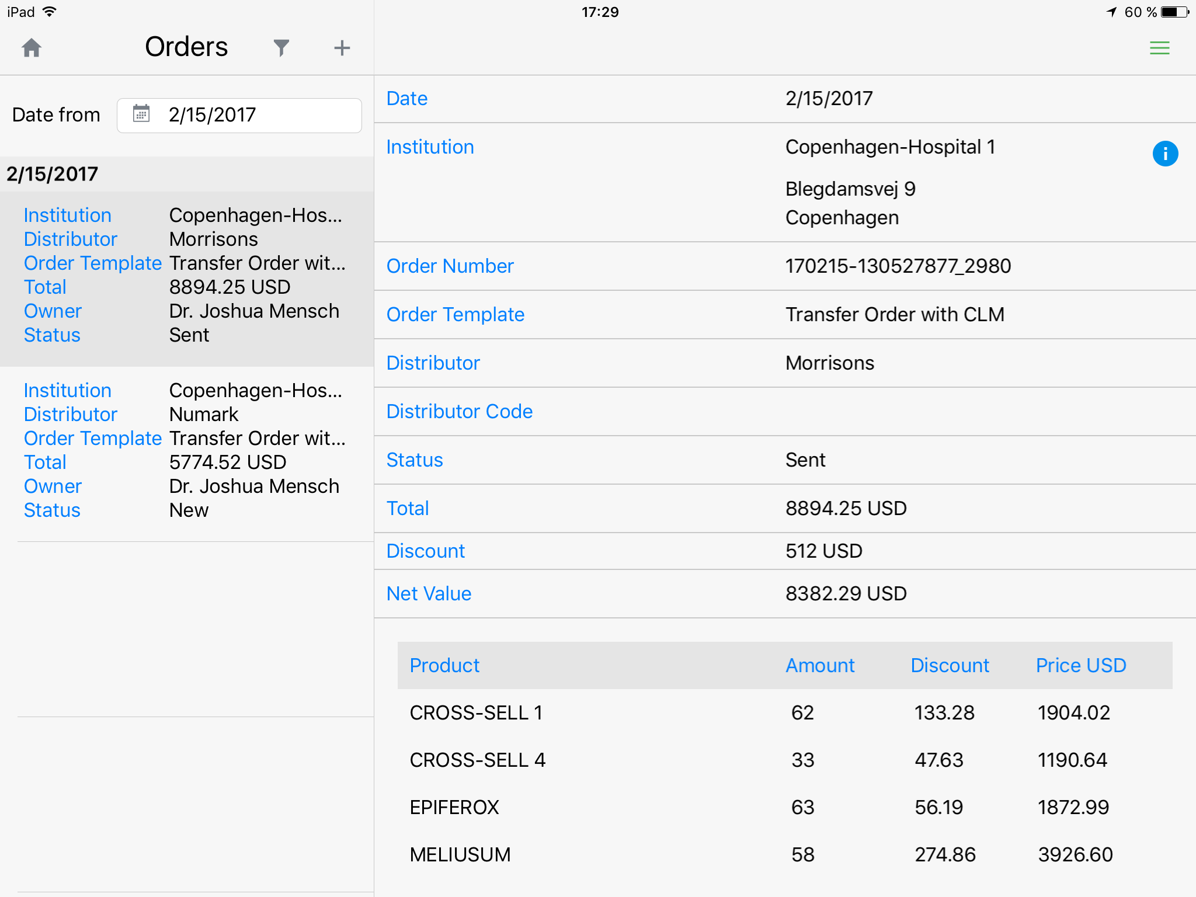
Inception CRM Order Taking
ORDER pharmacy stock right at the point of sale, applying the commercial conditions you need to close the deal – from discounts and rebates to free pieces – in a secure, compliant manner.
© 2017 D3S a.s.

Slide 22
Inception CRM Order Taking
• Template based, supporting a wide range of commercial conditions
• Allows reps to process multiple order types and apply variable discounts according to a wide range of balanced criteria
• Tracks the status of each order
• Supports multiple workflow scenarios (e.g. users can request orders directly from wholesalers and distributors, distribution managers in their own companies, or drop ordered goods directly) including different means of communicating order requests (email, XML, etc.)
• Supports the use of NIF codes and other identifying data
• Orders can be exported to ERP and other back office systems (e.g. SAP, JDE, etc.) for internal processing and records compliance
© 2017 D3S a.s.

Slide 23
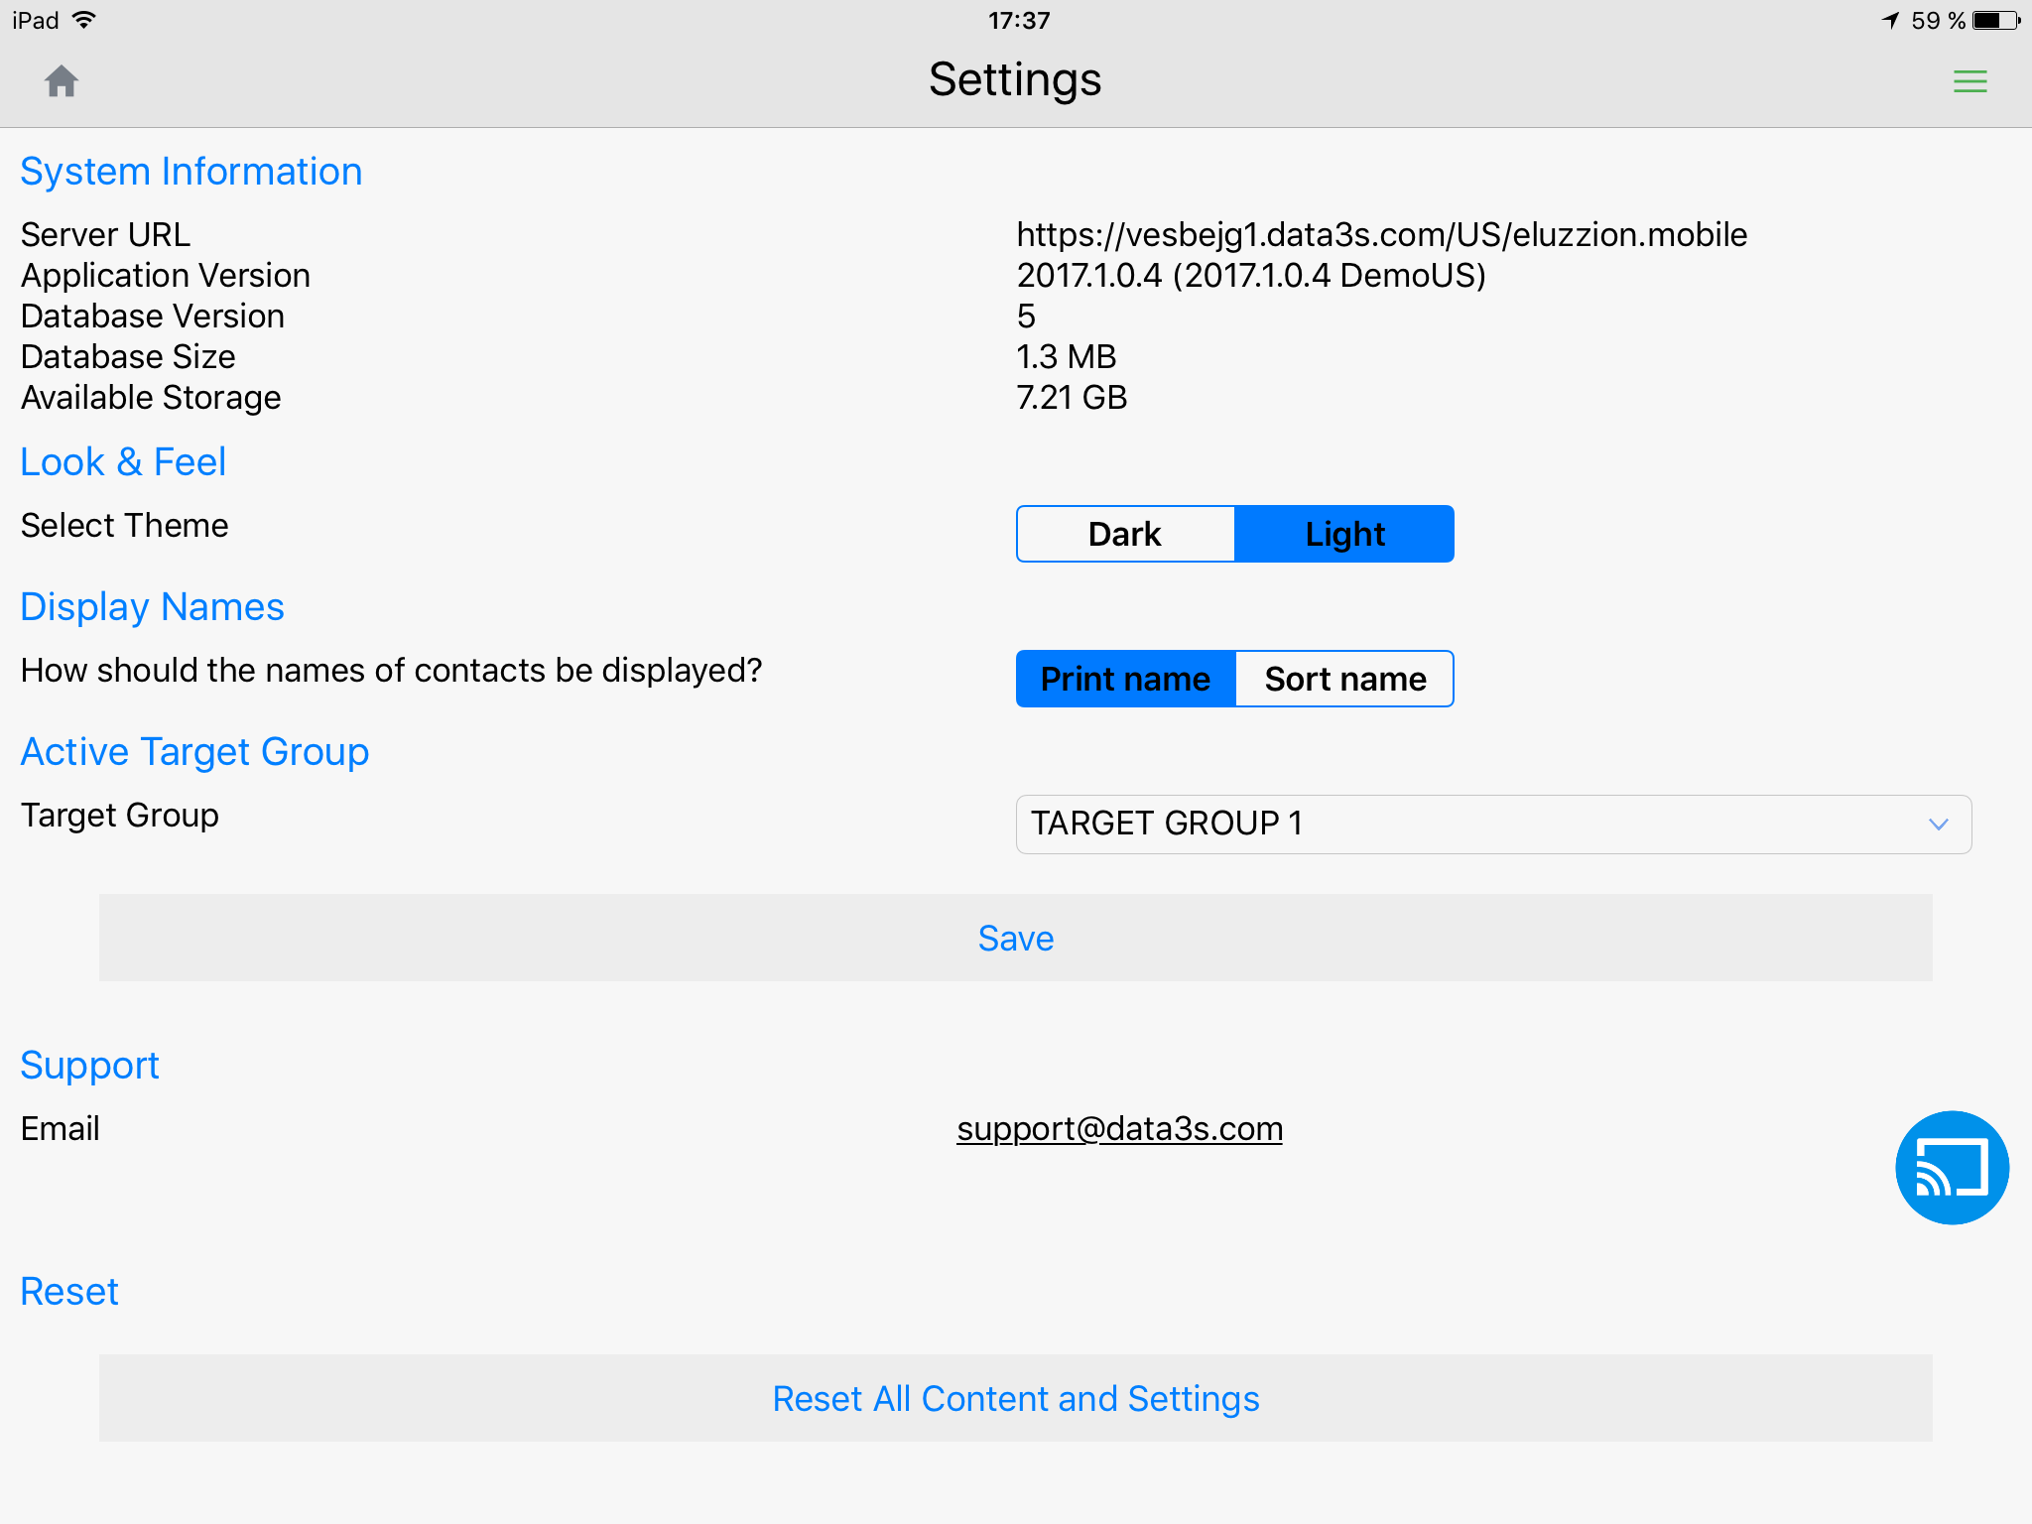
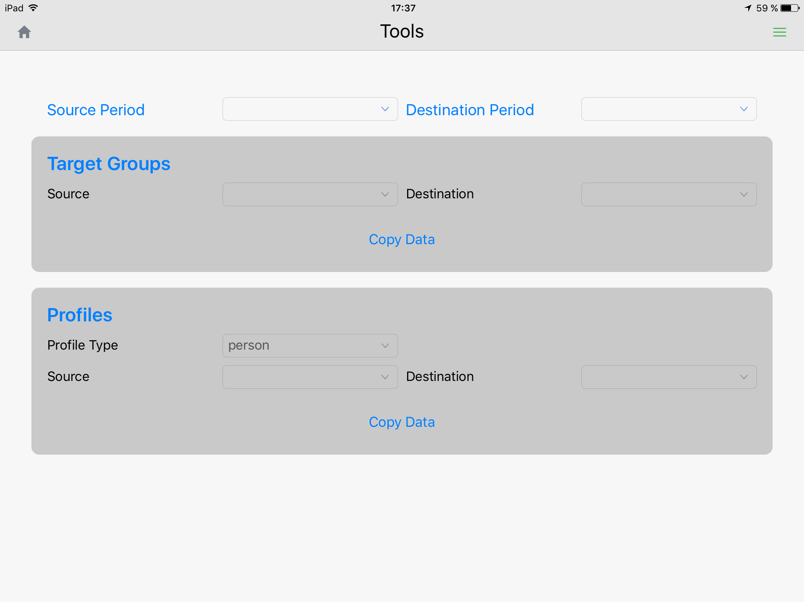
Inception CRM Settings & Tools
SETTINGS allow reps to personalize their app experience, from theme selection and name appearance to active target group selection, while TOOLS supports bulk operations such as target group cloning and group profile changes.
© 2017 D3S a.s.

Slide 24

add-ons for Web Browsers
Inception CRM comes with a variety of web-based add-ons, from management dashboards and knowledge base platforms to online learning and tender systems.
Our suite of apps are available as both standalone applications and as integrated modules within the Inception CRM suite. Pick the apps that you need to enhance your CRM landscape, or just choose the ones you find useful, no matter what CRM system you use.
© 2017 D3S a.s.

Slide 25
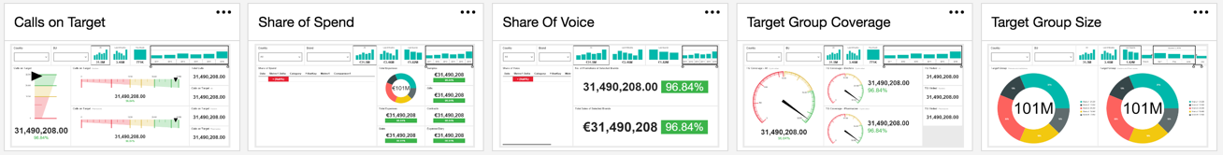
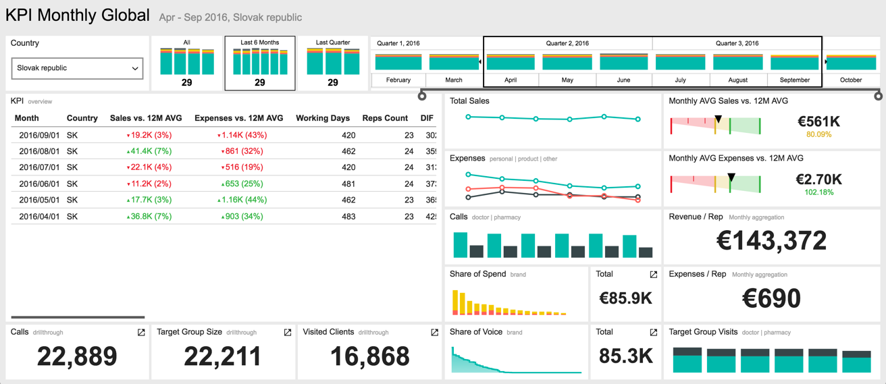
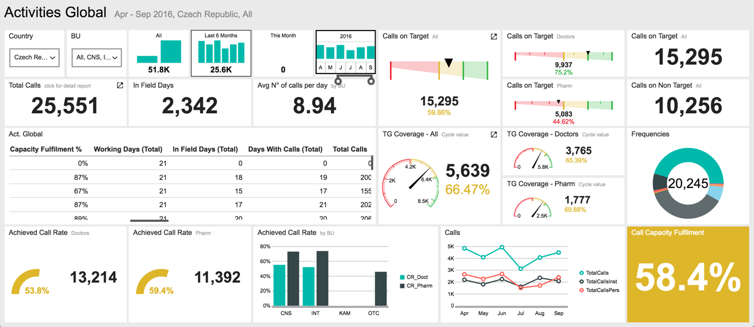
Management Dashboards (online / integrated or standalone)
BUSINESS INTELLIGENCE ONLINE is Inception CRM’s comprehensive Business Intelligence Suite that include both classic dashboards and richly detailed tabular reports that support an extensive set of parameters drawn from multiple data sets and intuitive drilldown capabilities for insights based on deep data analysis.
Leveraging the power and graphic capabilities of Microsoft’s latest analytics suite (MS Reporting Services 2016), BI Online is a modern, continuously updated portal that incorporates KPIs, Mobile Reports, Paginated Reports, Excel and Power BI Desktop files into a single Business Intelligence platform.
© 2017 D3S a.s.

Slide 26
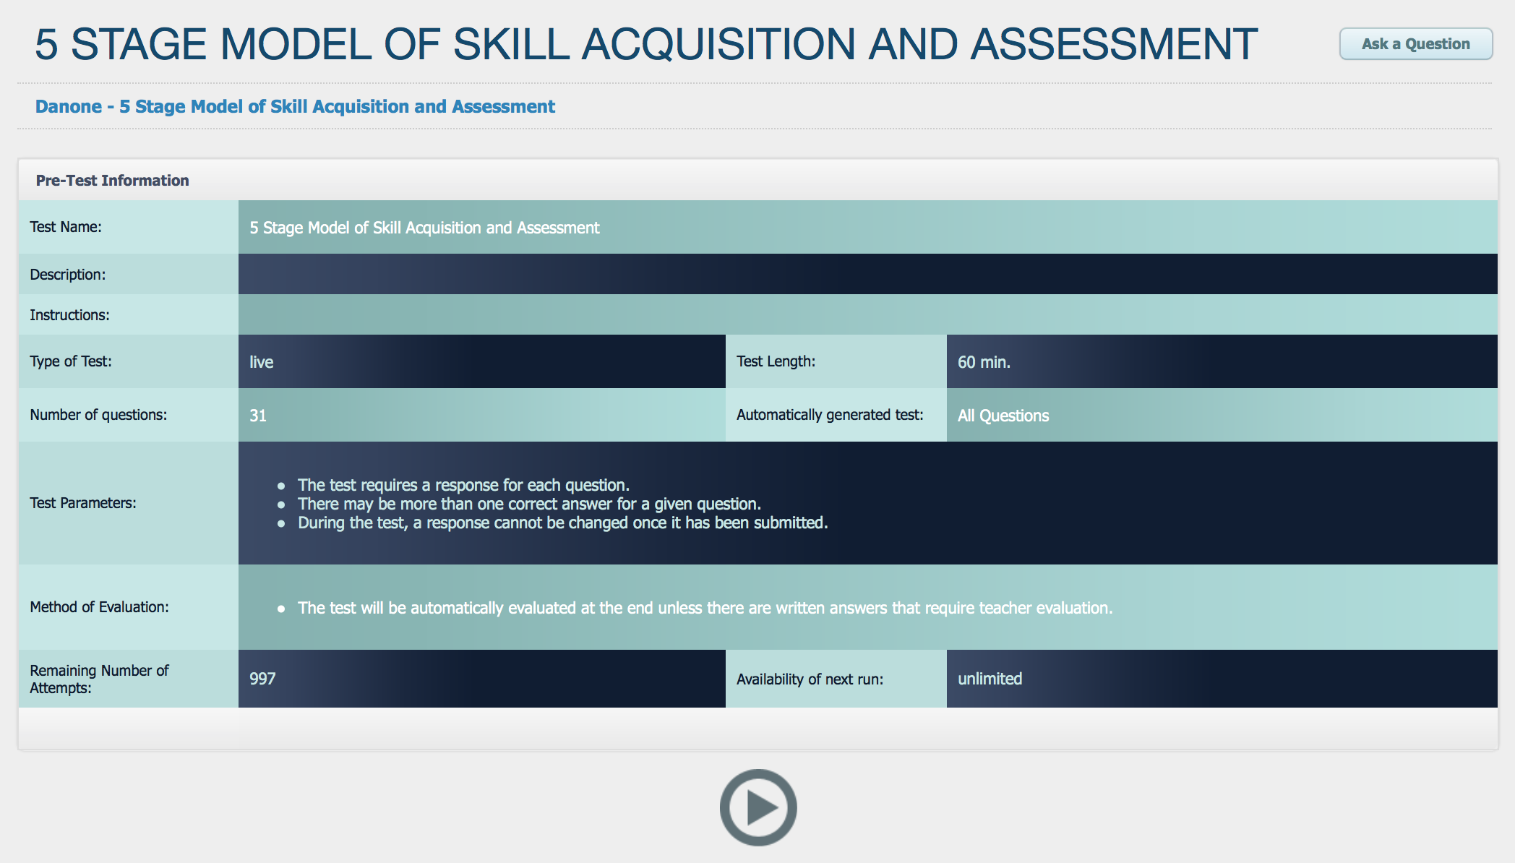
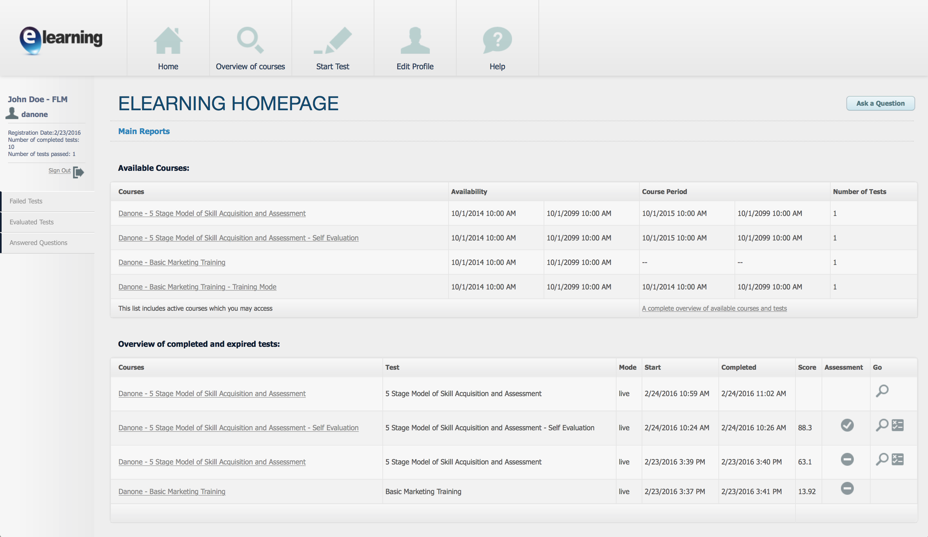
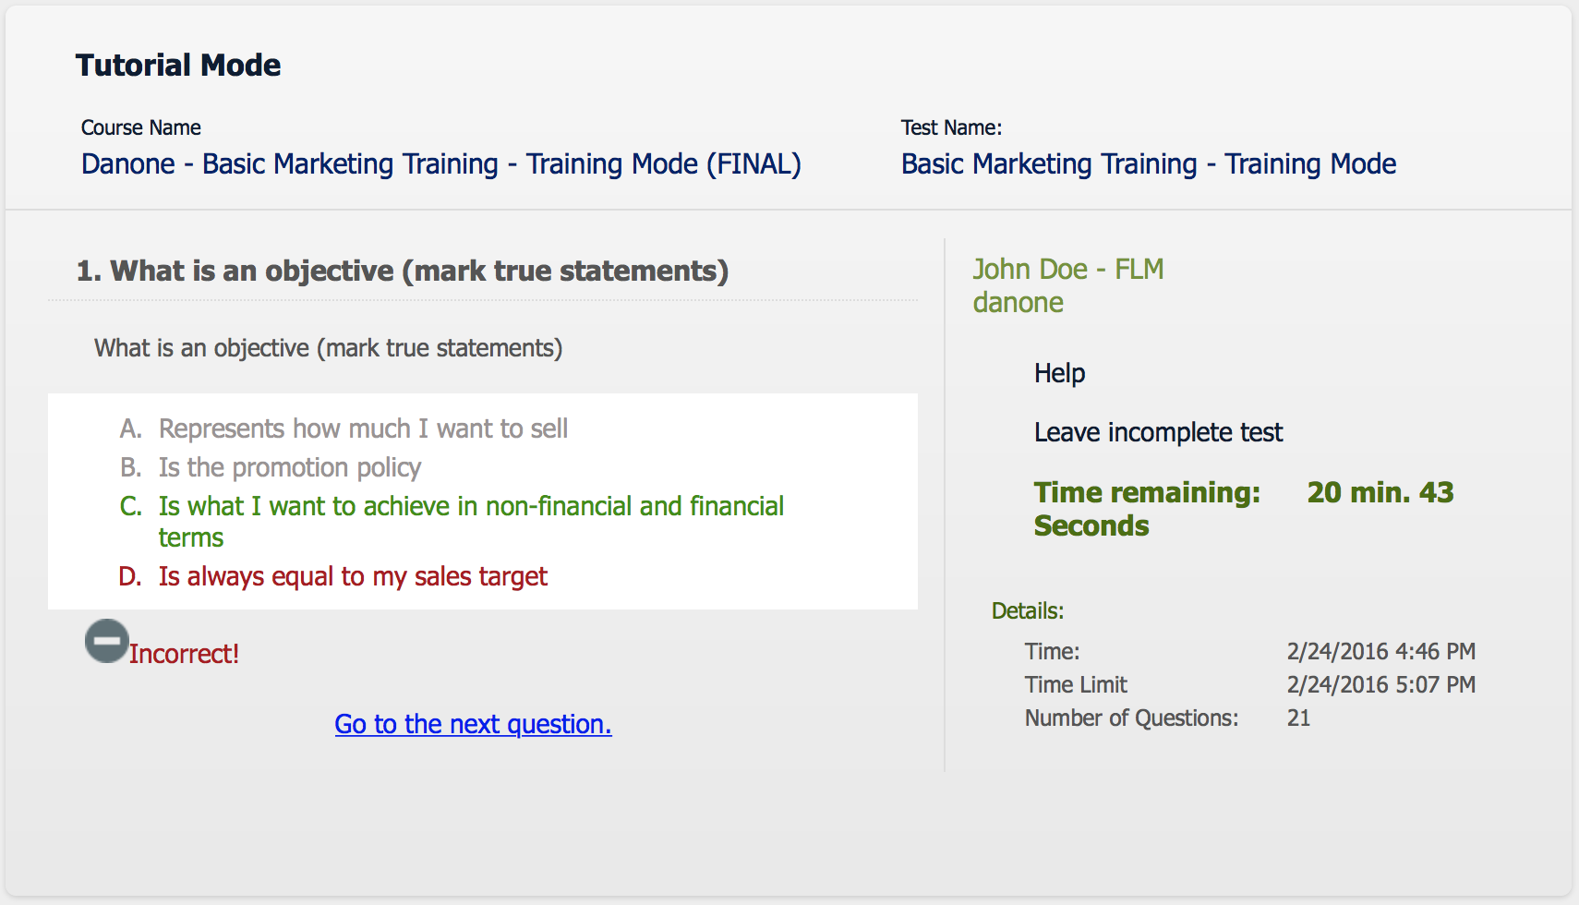

eLearning (online / integrated or standalone)
ELEARNING is an online training tool and Learning Management System (LMS) designed for advancing the professional growth of system users through guided self-study and flexible testing schedules, with comprehensive reporting for evaluation of progress and results.
ELEARNING makes training & educational activities simple, fast, and flexible. Training managers can easily create courses that include both training sessions and final exams – which the system can automatically evaluate for immediate feedback. Managers can also upload training materials relevant to each question on a practice test to help users study independently and make progress in their knowledge of each subject.
© 2017 D3S a.s.

Slide 27

Knowledge Base (online / integrated or standalone)
KNOWLEDGE BASE is an easily accessible, role-based online platform that allows individuals and groups to share/receive information, and even collaborate to solve collective problems (via closed- or open-group crowdsourcing).
It supports role-based document management, and document versioning, so that end-users interact only with the latest approved content.
It also makes vast amounts of information, including media, and documents, quickly and easily searchable by simple keywords and phrases, with content dynamically presented so that any pages containing keywords float to the top of the screen, making it an elegant yet powerful tool for knowledge and content sharing.
© 2017 D3S a.s.

Slide 28
Tender Web (online / integrated or standalone)
TENDER WEB is an online, role-based platform that allows tender teams collaborate on the preparation of tender bids and offers in real time. Supporting structured workflows and approval processes, account, supply chain, pricing and executive managers can quickly prepare successful bids and build knowledge for increased win rates as the system learns.
TENDER WEB is based on real business intelligence and streamlines internal processes so that competitive bids can be prepared and approved quickly from any device, and submitted early with the highest probability of success. When integrated with COGs data, the system is able to calculate the profitability of each offer before it is approved or submitted.
© 2017 D3S a.s.

Slide 29
Get in touch to learn more
Key Contacts:
Joshua Mensch | Marketing Director (Prague) joshua.mensch@data3s.com | +420 724 710 052
Jaroslav Hruska | Global Accounts Director (Prague)
jaroslav.hruska@data3s.com | +420 602 768 662
© 2017 D3S a.s.

